Slide 1
37262 Mathematical Statistics
Lecture 2

Slide 2
Simulating Discrete Events
We saw in Lecture 1 how we could use realisations of a variable to simulate realisations of flipping a fair coin.
Using a realisation, u, of a variable, if we call the outcome Heads if and Tails if
, then we have a random
experiment which returns Heads
or Tails, each with probability 0.5.
x
x

Slide 3
Cumulative Probability Functions
For a discrete random variable X with probability mass function , the cumulative probability function is defined as .
In other words, for any input, the function gives the value that the random variable takes a value less than or equal to that input.
For example, consider the random variable X which takes the value of the number shown when rolling one regular fair six-sided die.
The probability mass function is clearly

Slide 4
Cumulative Probability Functions
When rolling a die, there is no chance of a result < 1.
The chance of a result < 2 is 1/6.
The chance of a result < 3 is 2/6 (or 1/3.)
For , we have

Slide 5
Cumulative Probability Functions
Plotting up the cumulative probability function:

Slide 6
Cumulative Probability Functions
We can generate realisations of a discrete random variable X from realisations of a variable and the cumulative probability function .
Given a realisation ,
we generate a realisation
where
For example, with the die example,
a realisation would give

Slide 7
Cumulative Probability Functions
For a continuous random variable with probability density function f(x) , the cumulative probability function F(x) is defined as .
Just as a cumulative probability function for a discrete random variable is obtained by summing all probabilities up to and including a given value, the cumulative probability function involves integrating all probability density up to and including a point.
This gives .
Similarly, if we know

Slide 8
Example: Uniform Random Variable
Maybe the simplest type of continuous random variable is the uniform variable.
For then X takes a value between a and b such that X is equally likely to be any two intervals of equal width.
That is

Slide 9
Example: Uniform Random Variable
We can see that this is a valid density function since
The expectation of this is

Slide 10
Example: Uniform Random Variable
The cumulative probability function of X is therefore

Slide 11
Simulating Continuous Random Variables
We can generate realisations of a discrete random variable X from realisations of a variable and the cumulative probability function
Given a realisation ,
we generate a realisation of X
where .
We do this via finding the inverse
function for the cumulative
function.
We set

Slide 12
Example: Exponential Random Variables
A random variable is an exponential random variable if it has the density function
It is commonly used to model inter-event times, when events occur independently of each other in time.
For example, if hospital admissions occur independently of each other, but with an average rate of per hour, then the time between two successive admissions (in hours) .
Integration by parts gives the expectation of the variable as

Slide 13
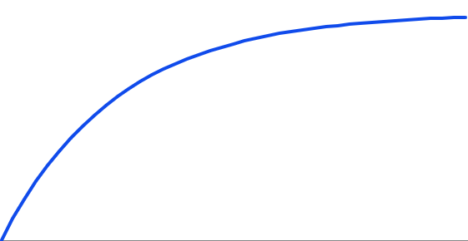
Example: Exponential Random Variables
The cumulative probability function of is therefore
To generate realisations of
from realisations, we need to invert
F(w).
hence .
Taking the logarithm of both sides gives hence .

Slide 14
Example: Exponential Random Variables
We have that .
We therefore generate a realisation
of W by from a realisation of U[0,1], u,
by
For example, a realisation of
corresponding to would be

Slide 15
Example
Let Z be a continuous random variable with probability density function
Clearly, there is no probability that Z is below 0 and it is certain that Z is no greater than 4 hence

Slide 16
Example
For
For
For

Slide 17
Example
Overall, this gives

Slide 18
Example
Inverting
We could therefore generate realisations of Z by simulating realisations
and setting

Slide 19
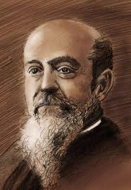
Pareto Distribution
A less commonly-seen variable is the Pareto variable.
Named after the Italian economist Vilfredo Pareto, it is used to characterise strongly skewed data i.e. ones where small values are extremely likely and very large ones are extremely rare.
Used in actuarial science and insurance modelling – for example, minor scrapes and car accidents are very common but low cost. Natural disasters (bushfires, earthquakes etc) are very rare but hugely costly.
It also describes the size distribution of living organisms. For example, in the oceans, there are many billions of zooplankton for each fish and many billions of fish for each whale etc.
Vilfredo Pareto (1848-1923)

Slide 20
Pareto Distribution
If
We can verify that this is a valid density
function, since

Slide 21
Example: Pareto Distribution
The cumulative probability of
Inverting gives
We therefore have that the inverse function is
To generate realisations of a Pareto variable, we would simply evaluate where u is drawn from a U[0,1] variable.

Slide 22
Acceptance-Rejection Methods
We have already seen the convolution method, which allows us to simulate realisations of one random variable by summing other (easier to simulate) variables.
We saw that a realisation of a binomial variable could be obtained by summing n independent realisations of a Bernoulli variable, .
Convolutions are used when summing a known number of variables.
In some cases, we instead wish to see how many variables need to be summed before some criterion is reached.
For example, counting how many independent realisations of a variable until the first 1 is seen would give a realisation of a geometric variable
These are acceptance-rejection methods.

Slide 23
Poisson Distribution
A Poisson variable is closely related to an exponential variable .
If events occur independently of each other, with expectation per unit time, then X gives the total number of events in unit time and W gives the time until the next event.
We can therefore use simulated realisations of W to obtain realisations of X.
We repeatedly simulate from variables and “accept” the next arrival only if it does not take the total time past 1. We stop this process when we first have to reject an arrival.
This is considerably simpler than simulating directly from a Poisson probability mass function

Slide 24
Poisson Distribution
For example, consider realisations of which give
This gives the first arrival after 0.0198, the second after 0.0198 + 0.4127 = 0.4325 and so on…
The fourth arrival comes after .
The fifth comes after
This implies only four events occur during unit time, hence our realisation of

