Slide 1
Tutorial 03
IEEE 48510

Slide 2
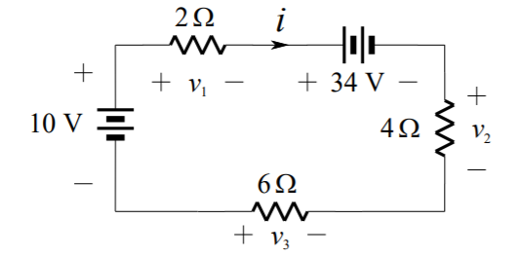
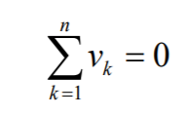
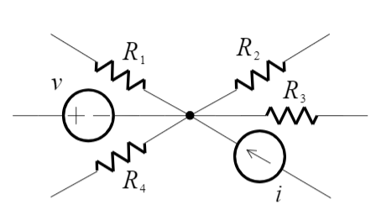
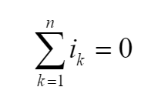
Review
KVL
In a loop, the voltages algebraically sum to zero
KCL
At any node, the currents algebraically sum to zero.

Slide 3
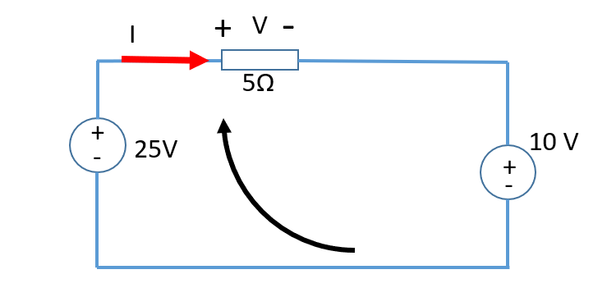
KVL
There are two methods to write KVL for a circuit. For the example below, if we choose clockwisely direction of the current.
Method 1: we use “+” for a voltage increase, and a “-”for a voltage drop. So, for the 25V voltage source, for a clockwise direction, the voltage is increased from 0 to 25 V, so we use +25. For the 5ohm resistor, there is always a voltage drop when current passes by. So we use “-V”, where V=I*5. For the 10 V voltage source, there is a voltage drop. So the KVL is 25-V-10=0; V= 15V. This means the actual voltage is the same direction as we defined.
Method 2: we use “+” if our defined direction encounter “+” of an element, including voltage, resistor, etc. So, for the clockwise direction, we first encounter the “-” sign of the 25V source, then “+” sign of the 5ohm resistor, then “+” sign of the 10 V source. So the KVL is
-25+V+10=0; It is the same as that out of method 1.
The main difference between the two methods are the sign of the resistor. Method 1 always has “-” for the resistor; Method 2 always has “+” for the resistor.

Slide 4
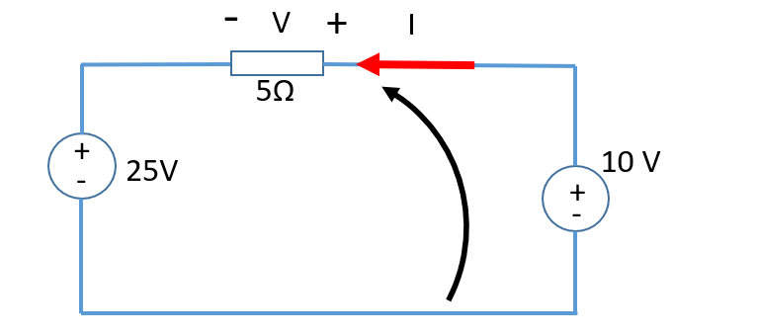
KVL
If we choose anti-clockwisely current direction
Method 1: we use “+” for a voltage increase, and a “-”for a voltage drop. -V -25+10=0, V =-15V. This means the actual voltage direction is opposite to what we have defined.
Method 2: we use “+” if our defined direction encounter “+” of an element, including voltage, resistor, etc.
V+25-10=0; v=-15V It is the same as that out of method 1.
When the pre-defined direction of the current is changed, the KVL equation is changed. But the result remains the same.

Slide 5
KVL - Compare different current direction
Method 1
25-V-10=0; V= 15V
Method 1
-V -25+10=0, V =-15V
Method 2
-25+V+10=0; V= 15V
Method 2
V+25-10=0 V=-15V
The actual voltage is the same as we defined
The actual voltage is opposite to what we defined.

Slide 6
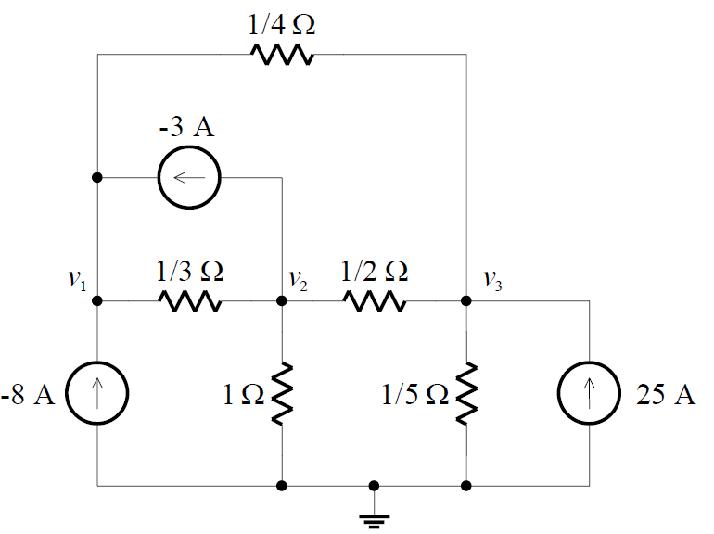
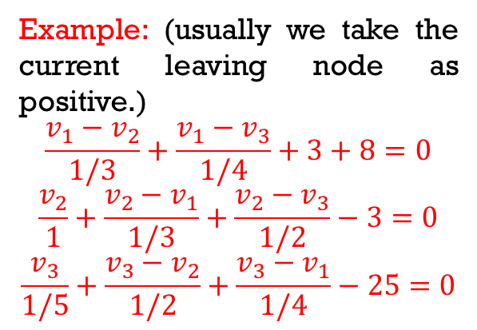
Nodal Analysis
In general terms, nodal analysis for a circuit with N nodes proceeds as follows:
1. Select one node as the reference node, or common (all nodal voltages are defined with respect to this node in a positive sense).
2. Assign a voltage to each of the remaining (N-1) nodes.
3. Write KCL at each node, in terms of the nodal voltages.
4. Solve the resulting set of simultaneous equations.
Example: (usually we take the current leaving node as positive.)
$$\frac{v_{1}−v_{2}}{1/3}+\frac{v_{1}−v_{3}}{1/4}+3+8=0$$
$$\frac{v_{2}}{1}+\frac{v_{2}−v_{1}}{1/3}+\frac{v_{2}−v_{3}}{1/2}−3=0$$
$$\frac{v_{3}}{1/5}+\frac{v_{3}−v_{2}}{1/2}+\frac{v_{3}−v_{1}}{1/4}−25=0$$

Slide 7
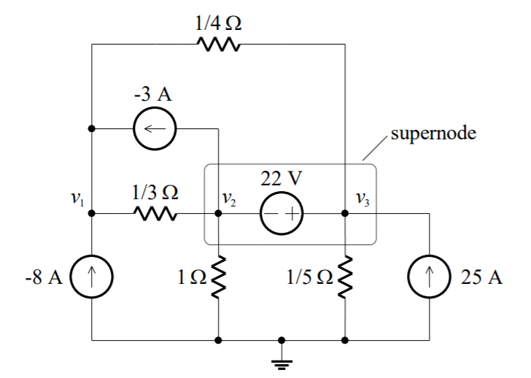
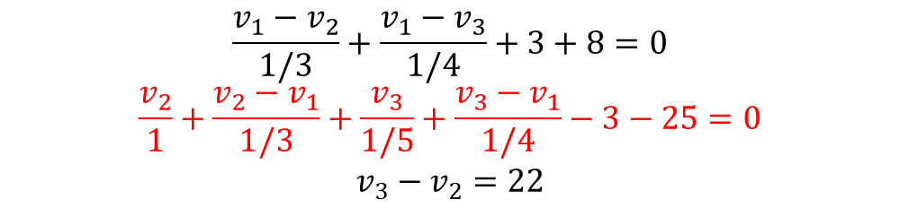
Highlight
Circuits with Voltage Sources
If the circuit contains voltage sources, we introduce supernode, by short circuiting the voltage source, and we apply KCL to both end nodes at the same time, thus reducing the number of nodes by one for each voltage source.
$$\frac{v_{1}−v_{2}}{1/3}+\frac{v_{1}−v_{3}}{1/4}+3+8=0$$
$$\frac{v_{2}}{1}+\frac{v_{2}−v_{1}}{1/3}+\frac{v_{3}}{1/5}+\frac{v_{3}−v_{1}}{1/4}−3−25=0$$
$$v_{3}−v_{2}=22$$

Slide 8
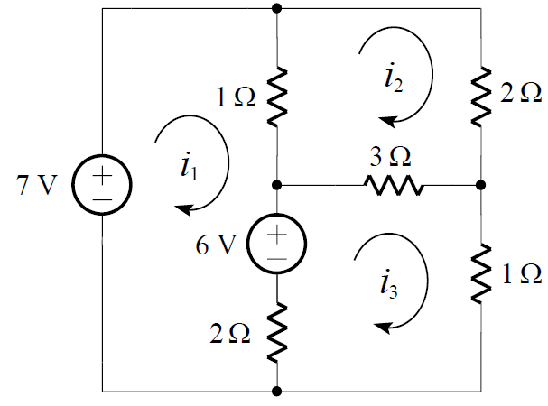
Mesh Analysis
In general terms, mesh analysis for a planar circuit with M meshes proceeds as follows:
1. Assign a clockwise mesh current in each of the M meshes.
2. Write KVL around each mesh, in terms of the mesh currents. The direction is defined by the dominant current in the mesh.
3. Solve the resulting set of simultaneous equations.
Using Method 2, KVL is below
Mesh 1: the direction is defined by i₁
$$−7+1\left(i_{1}−i_{2}\right)+6+2\left(i_{1}−i_{3}\right)=0$$
Mesh 2: the direction is defined by i₂
$$1\left(i_{2}−i_{1}\right)+2i_{2}+3\left(i_{2}−i_{3}\right)=0$$
Mesh 3: the direction is defined by i₃
$$−6+3\left(i_{3}−i_{2}\right)+{1i}_{3}+2\left(i_{3}−i_{1}\right)=0$$

Slide 9
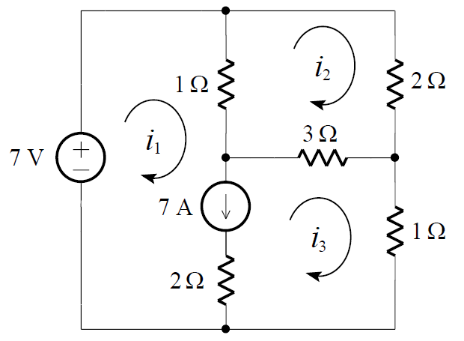
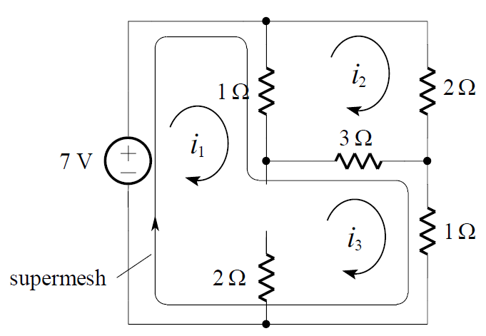


Highlight
In mesh analysis, a supermesh is formed by open-circuiting a current source and treating the perimeter of the original two meshes as a single mesh.
+
-
Circuits with Current Sources
If the circuit contains current sources, temporarily modify the given circuit by replacing each current source by an open-circuit to form supermeshes, thus reducing the number of meshes by one for each current source that is present.
-
+
$$−7+1\left(i_{1}−i_{2}\right)+3\left(i_{3}−i_{2}\right)+{1i}_{3}=0$$
$$1\left(i_{2}−i_{1}\right)+2i_{2}+3\left(i_{2}−i_{3}\right)=0$$
Mesh 1
Mesh 2
From Supermesh
$$i_{1}−i_{3}=7$$

