Slide 1
Tutorial 05
(Capacitance)
IEEE 48510

Slide 2
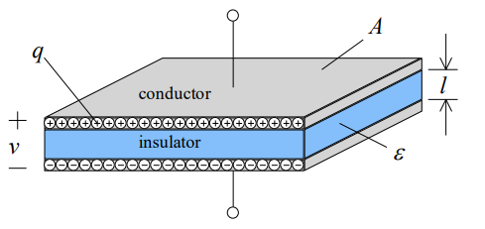

Capacitor
The simplest capacitor is formed by two conductive plates separated by a dielectric layer.
A parallel plate capacitor
One of the plates carries a positive charge, q, whilst the other carries an equal but opposite charge, -q. Therefore, the capacitor stores charge.
There is a potential difference, v, between the plates. Ideally, the amount of charge q deposited on the plates is proportional to the voltage v impressed across them. We define a constant called the capacitance, C, of the structure by the linear relationship
The unit of capacitance is the farad, with symbol F.

Slide 3
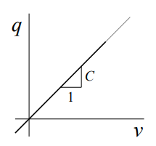
The capacitor is a linear circuit element
The ideal capacitance relationship is a straight line through the origin.
Even though capacitance is defined as C = q/ v , it should be noted that C is a purely geometric property, and depends only on the conductor arrangements and the materials used in the construction.

Slide 4

Calculation of Capacitance
To calculate capacitance between two conducting bodies:
The ratio of the charge Q to the potential difference V between them must be calculable. To calculate V it is essential to know the shape of the field.
where A is the area of either of the two parallel plates, and l is the distance between them.

Slide 5
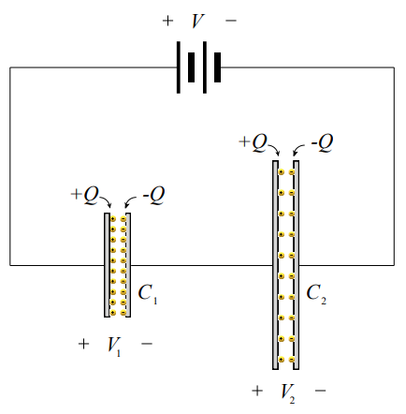



Capacitances in Series
Assume that two initially uncharged metal capacitor structures are connected in series as shown in the figure below:
The voltages which result from the presence of the charges on the structure are such that KVL gives:
But from the definition of capacitance:
Therefore, the capacitance of two series-connected capacitors is:

Slide 6
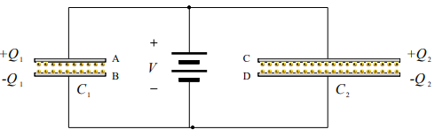



Capacitances in Parallel
Assume that two initially uncharged metal capacitor structures are connected in parallel with a battery as shown in the figure below:
Upon connection of the battery of potential difference V to the parallel connected structure, charge will distribute itself between the capacitors C1 and C2 , such that:
From the definition of capacitance, the effective capacitance of the parallel connected structure Cpar is given by
The capacitance of two parallel-connected capacitors is:
In summary, capacitors in series and parallel are treated like conductance

Slide 7



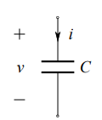
Capacitor v-i Relationships
We now seek a v-i relationship for the capacitor.
From the definition of current:
Substitute q = Cv and obtain:
The capacitor voltage may be expressed in terms of the current by integrating
The circuit symbol for the capacitor

Slide 8
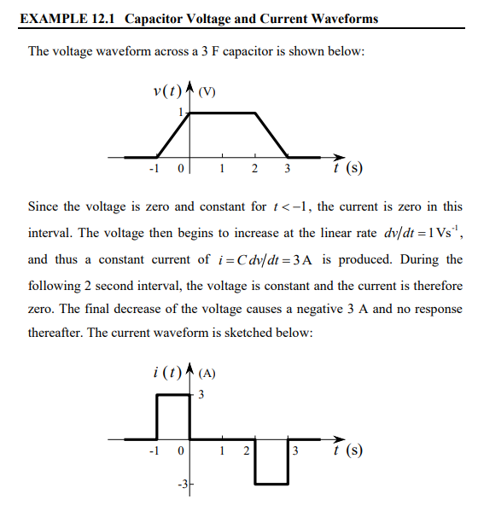
Capacitor v-i Relationships

Slide 9

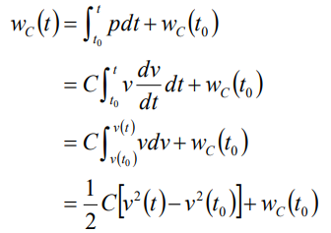

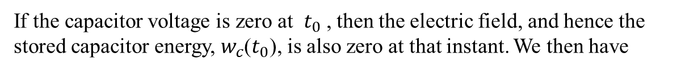
Energy Stored in a Capacitor
The power delivered to a capacitor is:
The energy stored in its electric field is therefore:
If the capacitor voltage is zero at $t_{0}$, then the electric field, and hence the stored capacitor energy,${ w}_{c}$($t_{0}$), is also zero at that instant. We then have
Notes:
We can see that the energy stored in a capacitor depends only on the capacitance and the voltage. Therefore, a finite amount of energy can be stored in a capacitor even if the current through the capacitor is zero. Whenever the voltage is not zero, and regardless of its polarity, energy is stored in the capacitor. It follows, therefore, that power must be delivered to the capacitor for a part of the time and recovered from the capacitor later.

Slide 10
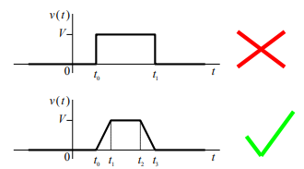
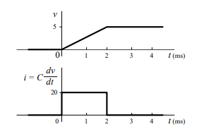
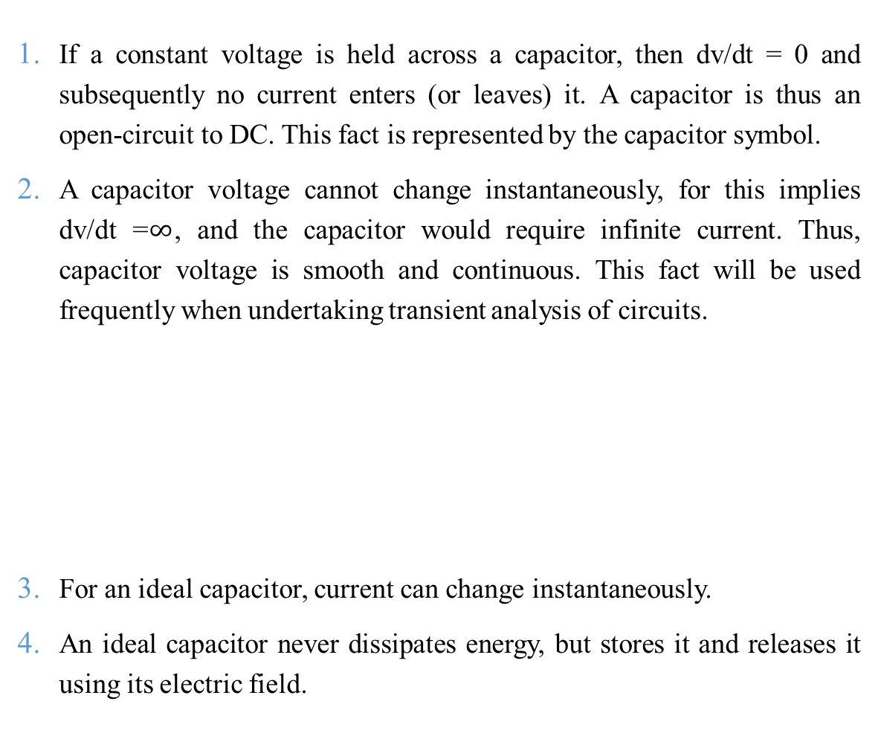
Summary
If a constant voltage is held across a capacitor, then dv/dt = 0 and subsequently no current enters (or leaves) it. A capacitor is thus an open-circuit to DC. This fact is represented by the capacitor symbol.
A capacitor voltage cannot change instantaneously, for this implies dv/dt =$∞$, and the capacitor would require infinite current. Thus, capacitor voltage is smooth and continuous. This fact will be used frequently when undertaking transient analysis of circuits.
For an ideal capacitor, current can change instantaneously.
An ideal capacitor never dissipates energy, but stores it and releases it using its electric field.

