Slide 1
41080 Theory of Computing
Week 9, Spring 2023
Youming Qiao

Slide 2
Coming to the 9th week!
Assignment 2 will be due at the end of this week
If there is any difficulty, do write to me or Chuanqi to schedule an appointment

Slide 3
Review of the last lecture
Universal Turing machines
Languages that are not recognisable
Languages that are not decidable
Reductions: from one undecidable problem to more

Slide 4
The content today
A more conceptual approach for undecidability: Rice’s theorem
Non-deterministic Turing machines
Computational complexity: P and NP

Slide 5
More undecidable problems

Slide 6

Undecidable problems
Our first undecidable problem
A_{TM}={(M, w) : M is a TM, M accepts w}
In the last tutorial, you are asked to prove that E_{TM} is undecidable
E_{TM}={ M : M is a TM, and L(M)=$∅$}
  That is, M accepts nothing
How did we prove that E_{TM} is undecidable?

Slide 7

E_{TM} is undecidable
Let M be a TM, and w be an input to M
Construct an auxiliary Turing machine X_{M,w}
  If the input is not w, REJECT
  If the input is w, run M on w
By (1), L(X_{M,w}) is either {w} or $∅$
By (2), L(X_{M,w})={w} if and only if M accepts w
Let H be a TM deciding E_{TM}
We can use H and X_{M,w} to help us to decide A_{TM} as follows
To decide if M accepts w
Construct X_{M,w}
Run H on X_{M,w}
Return ACCEPT if and only if H returns REJECT

Slide 8

Properties of TMs
We wish to extract some general principles or observations from it
And try to generalise this to the following setting
Let P be a property of TMs: P : {Turing Machines} $→$ {0,1}.
  (Think of 0=false, 1=true)
Property 1: P(M)=1 if and only if L(M)= $∅$
Property 2: P(M)=1 if and only if (w in L(M)$⇔$ w^{R} in L(M))
Property 3: P(M)=1 if and only if M has 154 states
Let L_{P}={M : P(M)=1}
Which L_{P} (for properties 1, 2, 3) is decidable? POLL.

Slide 9

Properties of TMs: syntactic and semantic
Property 1: P(M)=1 if and only if L(M)= $∅$
Property 2: P(M)=1 if and only if (w in L(M)$⇔$ w^{R} in L(M))
Property 3: P(M)=1 if and only if M has 154 states
Property 3 is different from the other two. Why?
“M has 154 states” is not related to L(M)!
Syntactic: questions about the descriptions of TMs
Semantic: questions about the languages of TMs

Slide 10
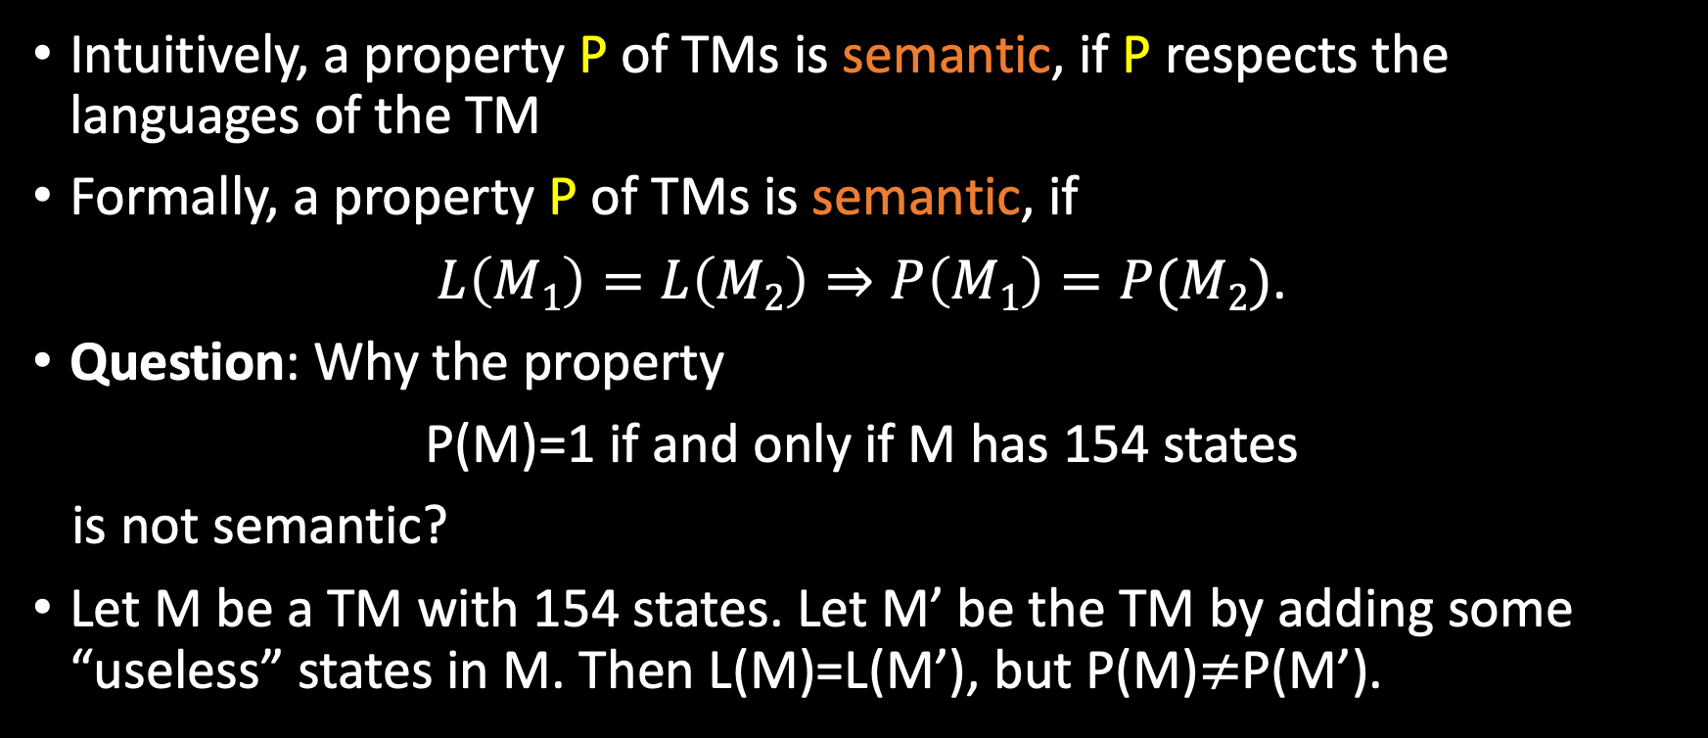
Semantic properties of TMs
Intuitively, a property P of TMs is semantic, if P respects the languages of the TM
Formally, a property P of TMs is semantic, if
$L\left(M1\right)=L\left(M2\right)⇒P\left(M1\right)=P(M2)$.
Question: Why the property
P(M)=1 if and only if M has 154 states
is not semantic?
Let M be a TM with 154 states. Let M’ be the TM by adding some “useless” states in M. Then L(M)=L(M’), but P(M)$≠$P(M’).

Slide 11
Trivial properties
Some properties are about semantics, but they are trivial
P(M)=1 if and only if L(M) is recognisable by a TM
  Trivial to decide, because L(M) is recognisable by M
P(M)=1 if and only if L(M) is either empty or non-empty
  Trivial to decide, because this holds for sure
Formally, a property P is trivial if every M satisfies P, or no M satisfy P
  That is, P(M)=1 for every M, or P(M)=0 for every M
Trivial properties can be decided easily

Slide 12

Rice’s theorem
Theorem [Rice]. Let P : {Turing Machines} $→$ {0,1} be a non-trivial semantic property. Then L_{P}={ M : P(M)=1} is undecidable.
Proof: Reduce A_{TM} to L_{P}
  A_{TM}={(M, w) : M is a TM, M accepts w}
The idea is to construct an auxiliary machine which uses “whether M accepts w” as a guard to testing the property
Let M$∅$ be a machine that rejects everything (L(M$∅$)= $∅$)
Let us assume that P(M$∅$)=0
  If P(M$∅$)=1, we can consider $¬$L_{P} and do the rest.

Slide 13
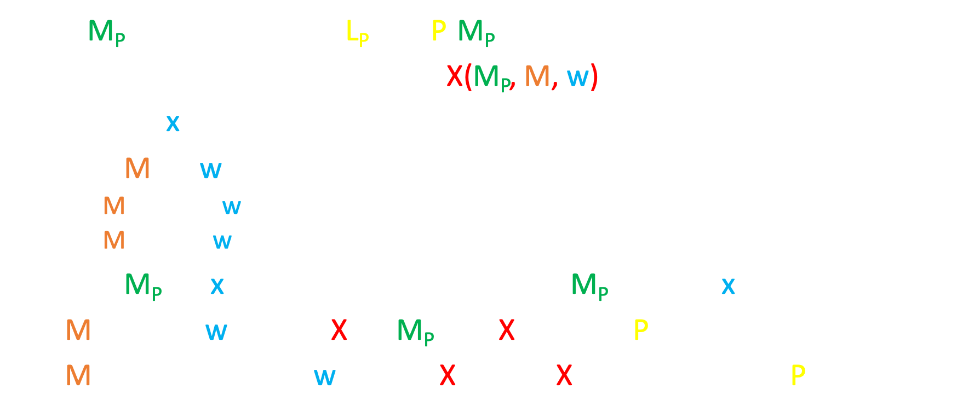
Constructing auxiliary machines
Let M_{P} be a machine in L_{P} (i.e. P(M_{P})=1)
Construct an auxiliary machine X(M_{P}, M, w) that does the following:
On input x:
Run M on w.
  If M accepts w, go to step 2.
  If M rejects w or loops, loop.
Run M_{P} on x, and ACCEPT if and only if M_{P} accepts x.
If M accepts w, then L(X)=L(M_{P}). So X satisfies P.
If M does not accept w, then L(X)=$∅$. So X does not satisfy P.

Slide 14
Using auxiliary machines
Now we show that L_{P}={ M : P(M)=1} is undecidable
By way of contradiction, suppose a TM H decides L_{P}
On input (M, w)
Construct M_{P}, a representative TM in L_{P}
Construct X(M_{P}, M, w)
Run H on X(M_{P}, M, w). ACCEPT if and only if H accepts.
L(X) satisfies P if and only if M accepts w.
This concludes the proof of Rice’s theorem.

Slide 15

Using Rice’s theorem
Rice’s theorem is meaningful
  Analysing programs is difficult!
It is also useful as a tool to show undecidability
To show that some property is undecidable, we need to demonstrate
Non-trivial
Semantic
Consider the property P
  P(M)=1 if and only if L(M)= $∅$
P is non-trivial:
  Can devise a machine A that rejects everything (L(A)= $∅$)
  Can devise a machine B that accepts everything (L(B)={0,1}*)
P is semantic:
  L(M)= L(N)=$∅$ $⇒$ P(M)=P(N)=1

Slide 16


Another example of using Rice’s theorem
Another property P of Turing machines:
P(M)=1 if and only if L(M) is a regular language
P is non-trivial
  Devise M rejecting everything. L(M)= $∅$ which is regular
  Devise M such that L(M)={0^{n}1^{n}}, which is not regular.
P is semantic
  If L(M)=L(N), then L(M) is regular if and only if L(N) is regular
  So P(M)=P(N)=1 or 0 depending on whether L(M) is regular
So P={M : L(M) is regular} is undecidable

Slide 17
Break time
Take a rest, ask questions, or grab a coffee ☺

Slide 18
Nondeterministic Turing machines

Slide 19

Nondeterminism again
Recall that we met nondeterminism in the previous two contexts
  DFA vs NFA: they are equal in power (the powerset construction)
  PDA vs DPDA: they are different in power (recall the palindrome)
It is natural to consider nondeterminism for Turing machines
The transition function of a TM: $δ:Q×Γ→Q×Γ×\{L, R\}$
The transition function of a nondeterministic TM:
$$δ:Q×Γ→𝒫(Q×Γ×\left\{L, R\right\})$$
That is, $δ\left(q, a\right)=\{\left(q_{1},b_{1}, D_{1}), \left(q_{2}, b_{2},D_{2}\right), …\right\}$, $D_{i}∈\{L, R\}$

Slide 20
Deterministic
Computation
Non-Deterministic
Computation
reject
accept or reject
accept

Slide 21

Defining Acceptance for NTMs
Let N be a nondeterministic Turing machine
An accepting computation history for N on w is a sequence of configurations C₀,C₁,…,C_{t} where
1. C₀ is the start configuration q₀w,
2. C_{t} is an accepting configuration,
3. Each configuration C_{i} yields C_{i+1}
Def. N accepts w ⬄ Such a history exists
A language L is recognizable by a nondeterministic Turing machine if L=L(N) for some NTM N

Slide 22
Nondeterminism vs determinism in TMs
POLL: Are nondeterministic TMs more powerful than deterministic TMs as for recognisability?
Theorem. For every nondeterministic TM, there exists a deterministic TM that recognizes the same language.
Proof idea. Let N be an NTM. Suppose N accepts w.
Then there exists a computation history of N accepting w.
We can enumerate all possible computation histories, starting from length 1, then length 2, and so on…

Slide 23
Nondeterminism vs determinism in TMs
A language L is recognisable by a nondeterministic TM
if and only if
it is recognisable by a deterministic TM
We can also define a nondeterministic TM to decide a language, if all its branches terminate for every input
We can also show that
A language L is decidable by a nondeterministic TM
if and only if
it is decidable by a deterministic TM
Nondeterminism does not add power in the context of computability!

Slide 24
Computational complexity

Slide 25
Computational complexity
What can and can’t be computed with limited resources on computation, such as time, space, randomness, communication…
Captures many of the significant issues in practical problem solving
The field is rich with important open questions, many are way beyond our current understanding

Slide 26
Measuring Time Complexity of a TM
We measure time complexity by counting the steps taken for a Turing machine to halt
Consider the language A = { 0^{k}1^{k} | k ≥ 0 }
Here’s a TM for A. On input of length n:
1. Scan across the tape and reject if the
string is not of the form 0^{i}1^{j}
O(n)
2. Repeat the following if both 0s and 1s
remain on the tape:
Scan across the tape, crossing off a
single 0 and a single 1
O(n²)
3. If 0s remain after all 1s have been crossed off,
or vice-versa, reject. Otherwise accept.
O(n)

Slide 27
Let M be a TM that halts on all inputs.
(We will only consider decidable languages now!)
Definition:
The running time or time complexity of M is the function T : ℕ → ℕ such that
T(n) = maximum number of steps taken by M
over all inputs of length n

Slide 28
Time-Bounded Complexity Classes
Definition:
TIME(t(n))
= { L’ | there is a Turing machine M with time complexity O(t(n)) so that L’ = L(M) }
= { L’ | L’ is a language decided by a Turing machine with O(t(n)) running time }
We just showed: A = { 0^{k}1^{k} | k ≥ 0 } ∈ TIME(n²)

Slide 29
A = { 0^{k}1^{k} | k ≥ 0 } ∈ TIME(n log n)
M(w) := If w is not of the form 0*1*, reject.
Repeat until all bits of w are crossed out:
If (parity of 0’s) ≠ (parity of 1’s), reject.
Cross out every other 0. Cross out every other 1.
Once all bits are crossed out, accept.
00000000000001111111111111
x0x0x0x0x0x0xx1x1x1x1x1x1x
xxx0xxx0xxx0xxxx1xxx1xxx1x
xxxxxxx0xxxxxxxxxxxx1xxxxx
xxxxxxxxxxxxxxxxxxxxxxxxxx

Slide 30
Polynomial Time
∪
P = TIME(n^{k})
k ∈ N

Slide 31
A criteria: the Cobham-Edmonds thesis
Cobham-Edmonds thesis: A function that can be efficiently solved by a computer if and only if it admits a polynomial-time algorithm.
Again, it is a thesis (or a hypothesis), and a controversial one (compared to the Church-Turing thesis).
Still, this establishes the complexity class P (problems solvable in polynomial time) as a central object in
Computational Complexity

Slide 32
Break time
Take a rest, ask questions, or grab a coffee ☺

Slide 33
Nondeterministic Polynomial-Time

Slide 34
Defining Acceptance for NTMs
Let N be a nondeterministic Turing machine
An accepting (resp. rejecting) computation history for N on w is a sequence of configurations C₀,C₁,…,C_{t} where
1. C₀ is the start configuration q₀w,
2. C_{t} is an accepting (resp. reject) configuration,
3. Each configuration C_{i} yields C_{i+1}
Def. N(w) accepts in time t ⬄ Such a history exists
N has time complexity T(n) if for all n, for all inputs of length n and for all histories, N halts (i.e. accepts or rejects) in T(n) time

Slide 35

Definition: NTIME(t(n)) =
{ L | L is decided by a O(t(n)) time
nondeterministic Turing machine }
TIME(t(n)) ⊆ NTIME(t(n))
Is TIME(t(n)) = NTIME(t(n)) for all t(n)?

Slide 36
What problems can we efficiently solve
nondeterministically, but not
deterministically?

Slide 37
The Clique Problem
a
d
f
c
b
e
g
k-clique = complete subgraph on k nodes

Slide 38
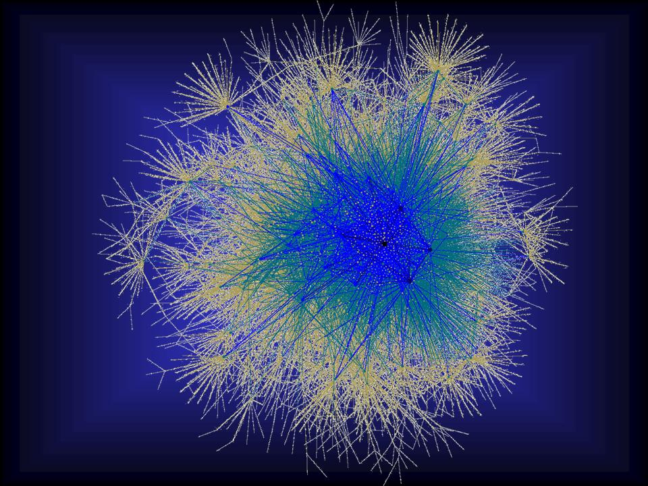
The Clique Problem
Find a clique of 1 million nodes?

Slide 39
Assume a reasonable encoding of graphs (example: the adjacency matrix is reasonable)
CLIQUE = { (G,k) | G is an undirected graph with a k-clique }
Theorem: CLIQUE ∈ NTIME(n^{c}) for some c > 1
N((V,E),k):
Nondeterministically guess a subset S of V with |S| = k
For all u, v in S, if (u,v) is not in E then reject
Accept

Slide 40
The Hamiltonian Path Problem
f
b
e
g
a
d
i
c
h
A Hamiltonian path traverses through each node exactly once

Slide 41
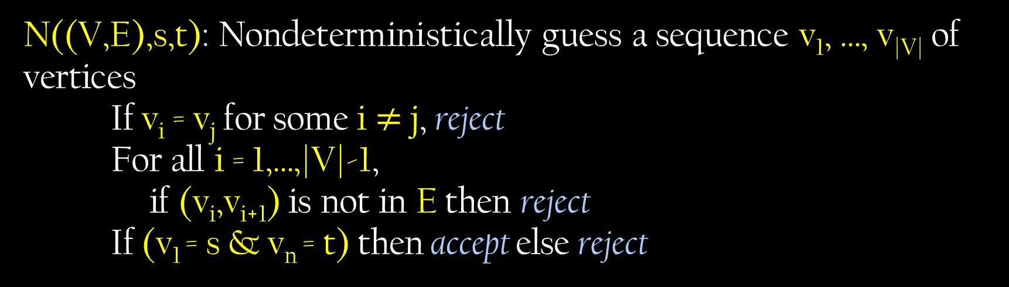
HAMPATH = { (G,s,t) | G is a directed graph with a Hamiltonian path from s to t }
Theorem: HAMPATH ∈ NTIME(n^{c}) for some c > 1
N((V,E),s,t): Nondeterministically guess a sequence v₁, …, v_{|V|} of vertices
If v_{i} = v_{j} for some i $≠$ j, reject
For all i = 1,…,|V|-1,
if (v_{i},v_{i+1}) is not in E then reject
If (v₁ = s & v_{n} = t) then accept else reject

Slide 42
Nondeterministic Polynomial Time
∪
NP = NTIME(n^{k})
k ∈ N

Slide 43

Theorem: L ∈ NP ⇔ There is a constant k and polynomial-time TM V such that
L = { x | ∃ y ϵ Σ* [|y| ≤ |x|^{k} and V(x,y) accepts ] }
Proof:
If L = { x | ∃y |y| ≤ |x|^{k} and V(x,y) accepts } then L ∈ NP
Define the NTM N(x): Guess y of length at most |x|^{k}
Run V(x,y) and output answer
Then, L(N) is the set of x s.t. [|y| ≤ |x|^{k} & V(x,y) accepts]
(2) If L ∈ NP then L = { x | ∃y |y| ≤ |x|^{k} and V(x,y) accepts }
Suppose N is a poly-time NTM that decides L. Define V(x,y) to accept iff y encodes an accepting computation history of N on x

Slide 44
A language L is in NP
if and only if
there are polynomial-length proofs
(aka. certificates or witnesses) for membership in L
CLIQUE =
{ (G,k) | ∃ subset of nodes S such that
S is a k-clique in G }
HAMPATH =
{ (G,s,t) | ∃ Hamiltonian path in graph G
from node s to node t }

Slide 45
NP = Problems with the property that, once you have the solution, it is “easy” to verify the solution
When (G, k) ϵ CLIQUE,
or (G,s,t) ϵ HAMPATH,
Can prove that with a short proof that can easily been verified
What if (G, k) $∉$ CLIQUE? Or (G,s,t) $∉$ HAMPATH?

Slide 46

P = the problems that can be efficiently solved
NP = the problems where proposed solutions can be efficiently verified
Is P = NP? can problem solving be automated?
Clay Math Institute in the year 2000:
“millennium problems”

Slide 47
If P = NP:
Mathematicians may be out of a job
Cryptography as we know it may be impossible
In principle, every aspect of life could be efficiently and globally optimized … life as we know it would be different!
Conjecture: P ≠ NP

Slide 48
The Time Hierarchy Theorem
Intuition: If you get more time to compute, then you can solve strictly more problems.
Theorem: For all “reasonable” f, g : ℕ → ℕ where
for all n, g(n) > n² f(n)² ,
TIME(f(n)) ⊊ TIME(g(n))
Proof Idea: Diagonalization with a clock. Make a TM N that on input M, simulates the TM M on input M for f(|M|) steps,
then flips the answer.
Then, L(N) cannot have time complexity f(n)

Slide 49
The Time Hierarchy Theorem
Theorem: For all “reasonable” f, g : ℕ → ℕ where
for all n, g(n) > n² f(n)² ,
TIME(f(n)) ⊊ TIME(g(n))
Proof Sketch: Define a TM N as follows:
N(M) = Compute t = f(|M|). Run U(M, M, 1^{t}) and output the opposite answer.
Claim: L(N) does not have time complexity f(n).
Proof: Assume N’ runs in time f(n), and L(N’) = L(N).
By assumption, N’(N’) runs in f(|N’|) time and outputs the opposite answer of U(N’, N’, 1^{f(|N’|)})
But by definition, U(N’, N’, 1^{f(|N’|)}) accepts ⬄ N’(N’) accepts in f(|N’|) steps. This is a contradiction

Slide 50
The Time Hierarchy Theorem
Theorem: For all “reasonable” f, g : ℕ → ℕ where
for all n, g(n) > n² f(n)² ,
TIME(f(n)) ⊊ TIME(g(n))
Proof Sketch: Define a TM N as follows:
N(M) = Compute t = f(|M|), Run U(M, M, 1^{t}) and output the opposite answer. So, L(N) does not have time complexity f(n).
What do we need in order for N to run in O(g(n)) time?
Compute f(|M|) in O(g(|M|)) time [“reasonable”]
Simulate U(M, M, 1^{t}) in O(g(|M|)) time
Recall: U(M, w, 1^{t}) halts in O(|M|² t²) steps
Set g(n) so that g(|M|) > |M|² f(|M|)² for all n. QED

Slide 51
A review
A more conceptual approach for undecidability: Rice’s theorem
Non-deterministic Turing machines
Computational complexity: P and NP

Slide 52

Thanks!

