Slide 1
41080 Theory of Computing
Week 6, Spring 2023
Youming Qiao

Slide 2
Assignment 2 released
This is a group programming assignment
Due date: 11.59pm, 13 October 2023
Group sizes: 2 to 3
Task for this week: form you groups! And understand this lecture.
Use the “Group Members” on EdStem to report your group
Use the “Looking for a group?” thread on EdStem if you need
If you cannot find peers by the end of this week, send emails to me

Slide 3
Summary of the last lecture
Context free grammar
  Grammar: another way to generate languages
  Context free: left-hand side of the rule is a single variable
CFG and PDA
  Equivalence in power
  From CFG to PDA: use stacks to track the rules applied
  From PDA to CFG: use rules to track the stack changes

Slide 4
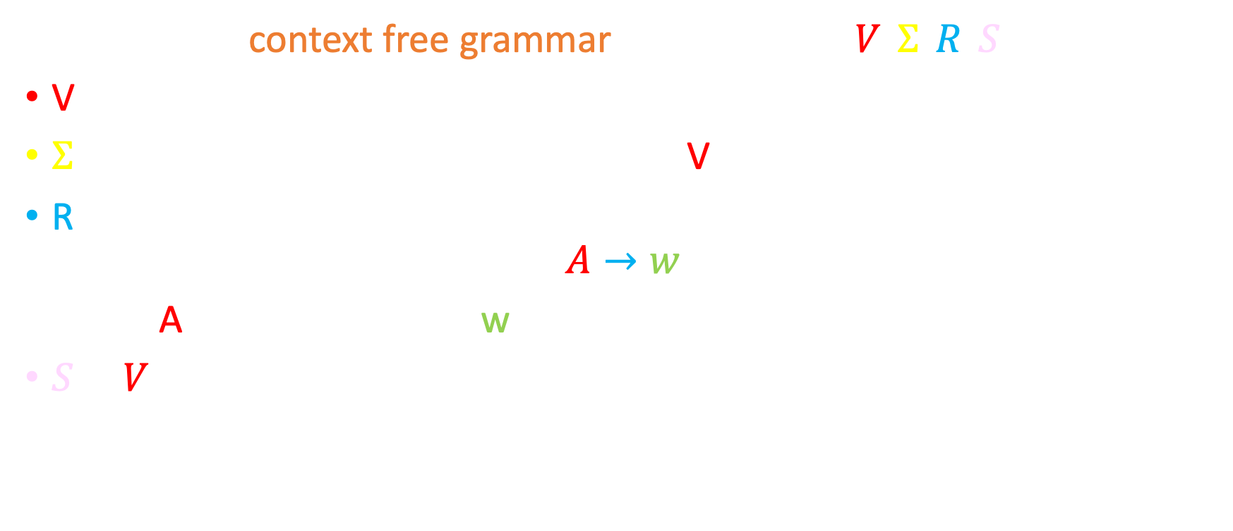
Context free grammars
Definition. A context free grammar (CFG) is $G=(V, Σ, R, S)$, where
V is the set of variables
$Σ$ is the set of terminals, disjoint from V
R is a set of rules. A rule is of the form
$$A→w$$
where A is a variable, and w is a string of variables and terminals
$S∈V$ is called the start variable
Note: A more general grammar can allow rules of the form $v→w$ where v and w are both in ${\left(V∪Σ\right)}^{∗}$.

Slide 5

An example
V={S}
$Σ=\{0,1\}$
R={$S→0S1, S→ε$}
S=S
This generates the language L={0^{n}1^{n} : n $∈ℕ$}
For example: $S⇒0S1⇒00S11⇒00ε11=0011$

Slide 6
Deterministic PDAs

Slide 7

Determinism vs non-determinism
Deterministic finite automata (DFA) : $δ:Q×Σ→Q$
Nondeterministic finite automata (NFA) : $δ:Q×(Σ∪\left\{ε\right\})→𝒫(Q)$
DFAs and NFAs are equivalent in power
PDAs generalise NFAs : $δ:Q×\left(Σ∪\left\{ε\right\}\right)×\left(Γ∪\left\{ε\right\}\right)→𝒫(Q×\left(Γ∪\left\{ε\right\}\right))$
How about deterministic PDA?
The principle. For each state in the PDA, and for any combination of a current input symbol and a current stack symbol, there is at most one transition defined.

Slide 8

Deterministic PDAs
First attempt: $δ:Q×Σ×Γ→Q×Γ$
Surely fine, but we also want to
  Include $ε$-transitions;
  Possibly not designating the next step…
Second attempt: $δ:Q×\left(Σ∪\left\{ε\right\}\right)×\left(Γ∪\left\{ε\right\}\right)→\left(Q×\left(Γ∪\left\{ε\right\}\right)\right)∪\{∅\}$
  $ε$-transitions are allowed;
  $∅$ means that no need to designate the next step.
This may still cause some non-determinism: which one? Polling time!

Slide 9
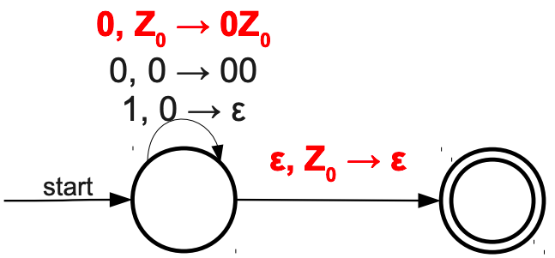


Non-determinism caused by $ε$-transitions
First, note that at any state, for any $(a, x)∈\left(Σ∪\left\{ε\right\}\right)×\left(Γ∪\left\{ε\right\}\right)$, there exists at most one next step
However, if it reads 0 with top stack symbol being Z₀, there are two possibilities…

Slide 10

Requirements for Deterministic PDAs
Second attempt: $δ:Q×\left(Σ∪\left\{ε\right\}\right)×\left(Γ∪\left\{ε\right\}\right)→\left(Q×\left(Γ∪\left\{ε\right\}\right)\right)∪\{∅\}$
$ε$-transitions may still cause non-determinism
How to remedy this?
If $δ(q, ε, x)$ is defined, then $δ\left(q, a, x\right)$ must be empty for any $a∈Σ$
  Otherwise, when reading a with top stack symbol x, there are to possibilities
Similarly, if $δ\left(q, a, ε\right)$ is defined, then $δ\left(q, a, x\right)$ must be empty for any $x∈Γ$
  Otherwise the stack will be processed differently

Slide 11

Deterministic PDAs
Definition. A deterministic PDA is $M=(Q,Σ,Γ,δ,q0, F)$:
$Q,Σ,Γ$, $q0, F$ remain the same as before
$δ:Q×\left(Σ∪\left\{ε\right\}\right)×\left(Γ∪\left\{ε\right\}\right)→\left(Q×\left(Γ∪\left\{ε\right\}\right)\right)∪\{∅\}$ such that
  for any $q∈Q$ and $x∈Γ$, if $δ(q, ε, x)$ is defined, then $δ\left(q, a, x\right)$ must be empty for any $a∈Σ$
  for any $q∈Q$ and $a∈Σ$, if $δ\left(q, a, ε\right)$ is defined, then $δ\left(q, a, x\right)$ must be empty for any $x∈Γ$

Slide 12
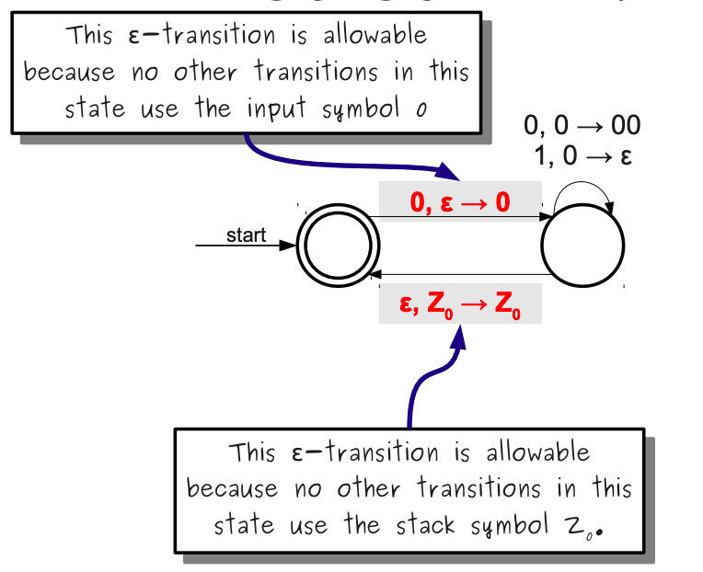
An example of deterministic PDA

Slide 13
Why DPDAs Matter
Because DPDAs are deterministic, they can be simulated efficiently:
Keep track of the top symbol of the stack.
Store a “predictive parsing” table that says what operations to perform on the stack and what state to enter on each input/stack pair.
Loop over the input, processing input/stack pairs until the automaton rejects or ends in an accepting state with all input consumed.
If we can find a DPDA for a CFL, then we can recognize strings in that language efficiently

Slide 14
The Power of Nondeterminism
When dealing with finite automata, there is no difference in the power of NFAs and DFAs.
How about PDAs? – Polling time!
However, when dealing with PDAs, there are CFLs that can be recognized by NPDAs that cannot be recognized by DPDAs.
Simple example: The language of palindromes.
  How do you know when you've read half the string?
NPDAs are more powerful than DPDAs.

Slide 15
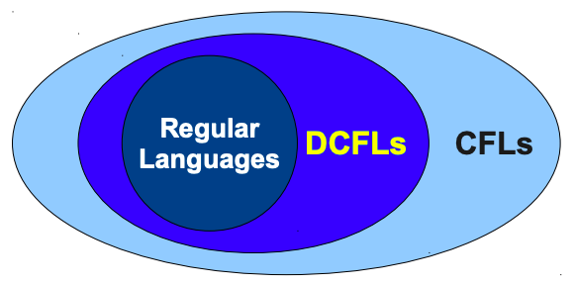
Deterministic CFLs
A context-free language L is called a deterministic context-free language (DCFL) if there is some DPDA that recognizes L.
Not all CFLs are DCFLs, though many important ones are.
  Balanced parentheses, most programming languages, etc.
Why every regular language can be recognised by a DPDA?

Slide 16
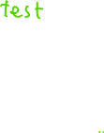
LL(1) grammars

Slide 17
From CFG to deterministic PDA?
Last lecture: CFG to PDA construction
The result is a nondeterministic PDA, so not useful in practice
Deterministic PDAs are easy to use
Can we restrict the grammar so that we can always make a DPDA?

Slide 18

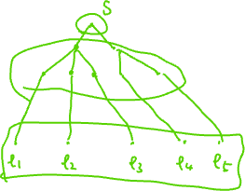
Parsers for grammars
Given a grammar $G=(V, Σ, R, S)$, and a terminal string $w∈Σ^{∗}$
Goal: construct the process of generating this w from S, if it is possible.
  Recall that the generation process can be represented as a tree
This is achieved through a parser, which is a pushdown automaton (or transducer)
Possible approaches?
  Top-down: start with S and derive the string w
  Bottom-up: start with the string w and reach S
We take the top-down approach here

Slide 19

Top-down parser
A top-down parser, given a string $w∈Σ^{∗}$, builds the parse tree from S
We focus on a special type of top-down parsers called LL(1) parser
  L: left-right
  L: left-most derivation
  1: 1 symbol look-ahead
What rules prevent us from doing LL(1)-type parsing?
  Rules that does left recursion
  Rules that need more than one token to pick between

Slide 20

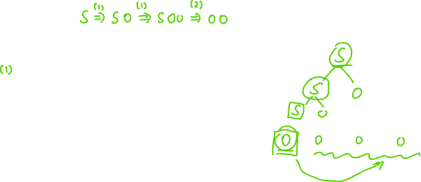
Rules with left recursion
Consider the grammar
$$S→S0∣ε$$
Why is this a problem for LL(1)?
Consider the string 0000

Slide 21

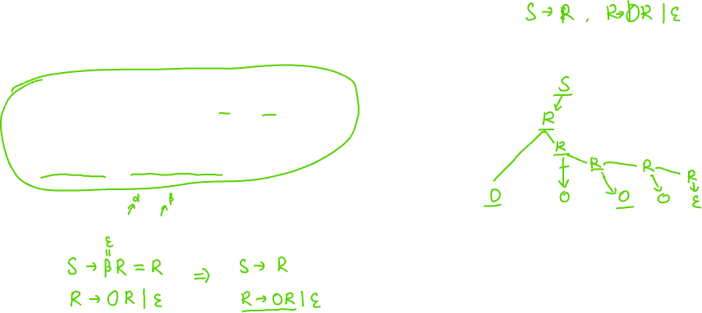
How to resolve left recursion?
Left recursion rule: $A→Aα∣β$
Resolving left recursion:
$A→βR$, $R→αR∣ε$
So $S→S0∣ε$ changes to
$S→εR=R$, $R→0R∣ε$
Why does this help with LL(1)?

Slide 22


Rules that need more than one symbol to pick from
$A→0w∣0v$
Why is this a problem for LL(1)?
Consider the string …0…
How to resolve this?
$A→0X$, $X→w∣v$
This is called left factoring

Slide 23
Construct a parser for LL(1) grammar
Left recursion removal and left factoring help to get to a grammar that allows LL(1) parsing
  Not every grammar can be transformed to so by such techniques
Suppose our grammar now allows for LL(1) parsing
Our goal is to construct such a parser, which is actually a PDA
We will specify the transitions in the form of a table
This is called the transition table or the predicative parsing table!

Slide 24
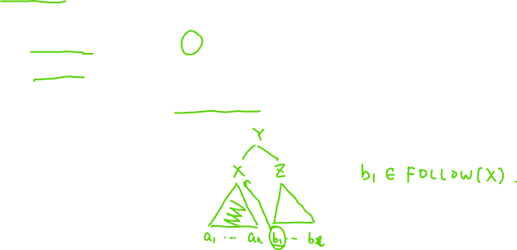
Construct the transition table
Gather some information for terminals and variables
The FIRST set: the first symbol that can be generated by a terminal or a variable
  For a terminal a, it is just a
  For a variable X, it is the left-most terminal that can be generated from X
The FOLLOW set: for a variable X, the terminals that can follow after expanding X

Slide 25

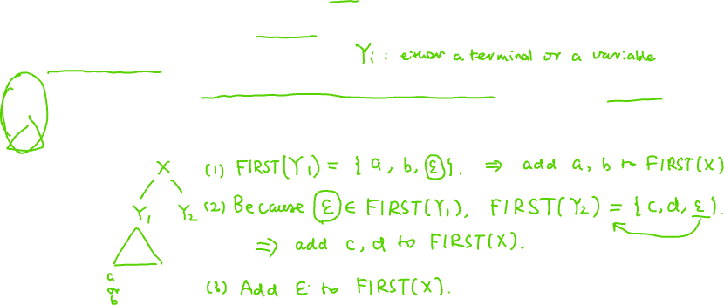
FIRST sets
For a terminal $a∈Σ$, FIRST(a)={a}
For a variable $X∈V$, if $X→ε$, then add $ε$ to FIRST(X)
If $X→Y_{1}…Y_{k}$ is a rule, then
  For any $i∈[k]$, if $ε∈FIRST\left(Y_{1}\right)∩ …∩FIRST(Y_{i−1})$, then add FIRST($Y_{i}$) (excluding $ε$) to FIRST(X)
  If $ε∈FIRST\left(Y_{1}\right)∩…∩FIRST(Y_{k})$, then add $ε$ to FIRST(X)
Note. The above also defines FIRST(w) for any w in ${\left(Σ∪V\right)}^{∗}$.

Slide 26

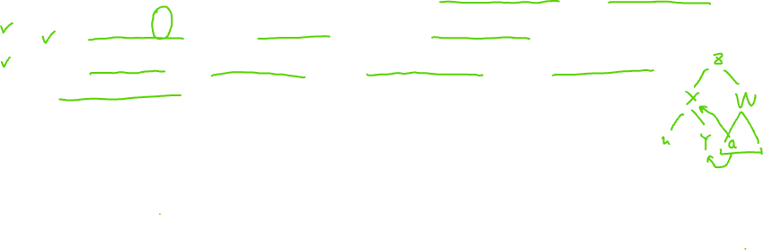
FOLLOW sets
After FIRST sets are computed, we can compute FOLLOW sets
If X is the start variable S, then add $ (end of input) to FOLLOW(S)
For $X→uYw$, add FIRST(w)$−\{ε\}$ to FOLLOW(Y)
For $X→uY$, or $X→uYw$ with $ε∈$FIRST(w), add FOLLOW(X) to FOLLOW(Y)

Slide 27

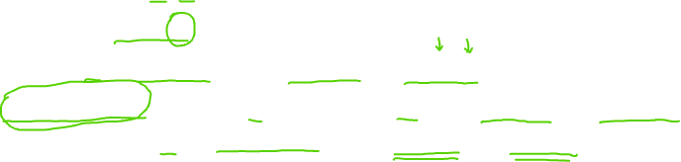
Parsing table
After FIRST and FOLLOW sets are computed, we can compute the parsing table M
M is indexed by (X, a) where $X∈V$ and $a∈Σ$
For each rule $X→w$ do
For each $a∈$FIRST(w), add $X→w$ to M(X, a)
If $ε∈$FIRST(w), for each $b∈$FOLLOW(X), add $X→w$ to M(X, b).
Furthermore, if $ $∈$FOLLOW(X), add $X→w$ to M(X, $)
If an entry of M is undefined, it is an error

Slide 28
An example of LL(1) parsing

Slide 29


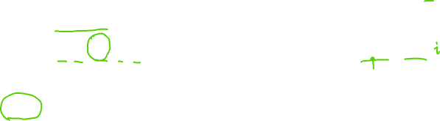
An example
$G=(V, Σ, R, S)$
$V=\{E, T, F\}$
$Σ=\{+,∗,id, (, )\}$
R includes six rules:
S=E
$E→E+T | T$
$T→T∗F | F$
$F→\left(E\right) | id$

Slide 30


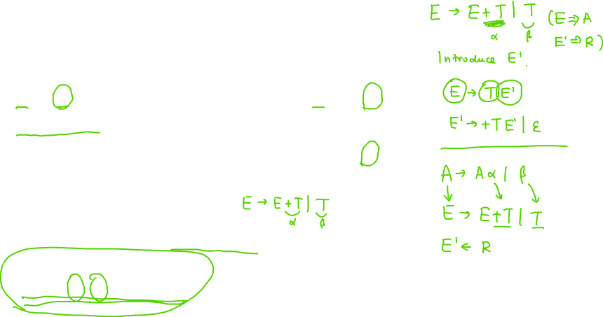
An example
$E→E+T | T$
$T→T∗F | F$
$F→\left(E\right) | id$
Removing left recursion?
Left recursion rule: $A→Aα∣β$
Resolving left recursion:
$A→βR$, $R→αR∣ε$
$E→TE′$
$E^{′}→+TE^{′}∣ε$
$T→FT′$
$T^{′}→∗FT^{′}∣ε$
$F→\left(E\right)∣id$

Slide 31

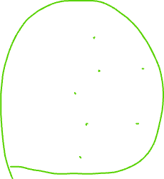
FIRST sets of terminals
$E→TE′$
$E^{′}→+TE^{′}∣ε$
$T→FT′$
$T^{′}→∗FT^{′}∣ε$
$F→\left(E\right)∣id$
FIRST sets of:
+
*
(
)
id

Slide 32

FIRST sets of terminals
$E→TE′$
$E^{′}→+TE^{′}∣ε$
$T→FT′$
$T^{′}→∗FT^{′}∣ε$
$F→\left(E\right)∣id$
FIRST sets of:
+ | +
* | *
( | (
) | )
id | id

Slide 33

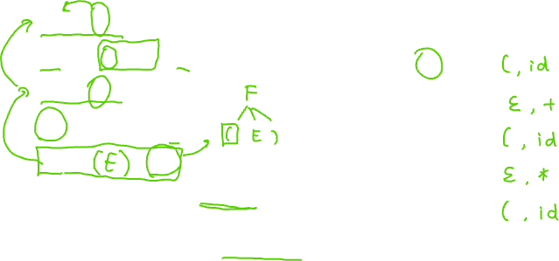
FIRST sets of variables
$E→TE′$
$E^{′}→+TE^{′}∣ε$
$T→FT′$
$T^{′}→∗FT^{′}∣ε$
$F→\left(E\right)∣id$
FIRST sets of:
E
E’
T
T’
F
For a variable $X∈V$, if $X→ε$, then add $ε$ to FIRST(X)
If $X→Y_{1}…Y_{k}$ is a rule, then
  For any $i∈[k]$, if $ε∈FIRST\left(Y_{1}\right)∩ …∩FIRST(Y_{i−1})$ then add FIRST($Y_{i}$) (excluding 𝜀) to FIRST(X)
  If $ε∈FIRST\left(Y_{1}\right)∩…∩FIRST(Y_{k})$, then add $ε$ to FIRST(X)

Slide 34
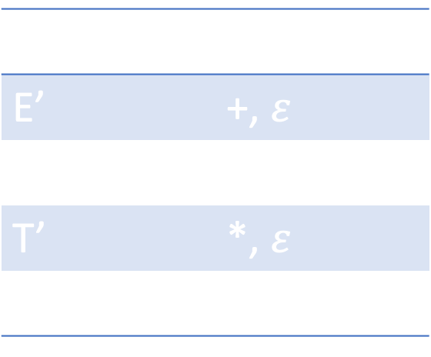
FIRST sets of variables
$E→TE′$
$E^{′}→+TE^{′}∣ε$
$T→FT′$
$T^{′}→∗FT^{′}∣ε$
$F→\left(E\right)∣id$
FIRST sets of:
E | (, id
E’ | +, $ε$
T | (, id
T’ | *, $ε$
F | (, id

Slide 35
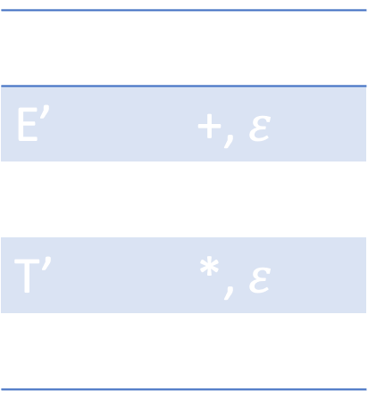
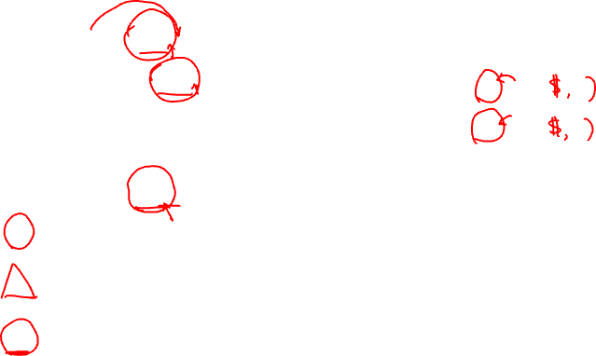

FOLLOW sets
FIRST sets
E | (, id
E’ | +, $ε$
T | (, id
T’ | *, $ε$
F | (, id
$E→TE′$
$E^{′}→+TE^{′}∣ε$
$T→FT′$
$T^{′}→∗FT^{′}∣ε$
$F→\left(E\right)∣id$
FOLLOW sets of:
E
E’
T
T’
F
If X is the start variable S, then add $ (end of input) to FOLLOW(S)
For $X→uYw$, add FIRST(w)$−\{ε\}$ to FOLLOW(Y)
For $X→uY$, or $X→uYw$ with $ε∈$FIRST(w), add FOLLOW(X) to FOLLOW(Y)

Slide 36

FOLLOW sets
$E→TE′$
$E^{′}→+TE^{′}∣ε$
$T→FT′$
$T^{′}→∗FT^{′}∣ε$
$F→\left(E\right)∣id$
FOLLOW sets of:
E | $, )
E’ | $, )
T | +, $, )
T’ | +, $, )
F | *, +, $, )

Slide 37

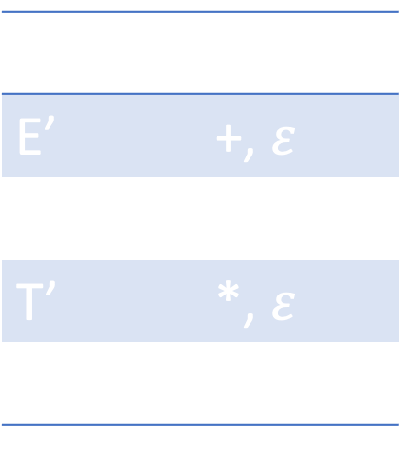
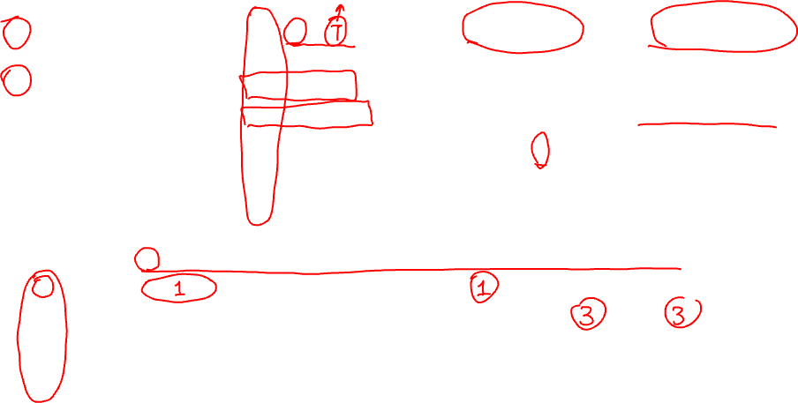
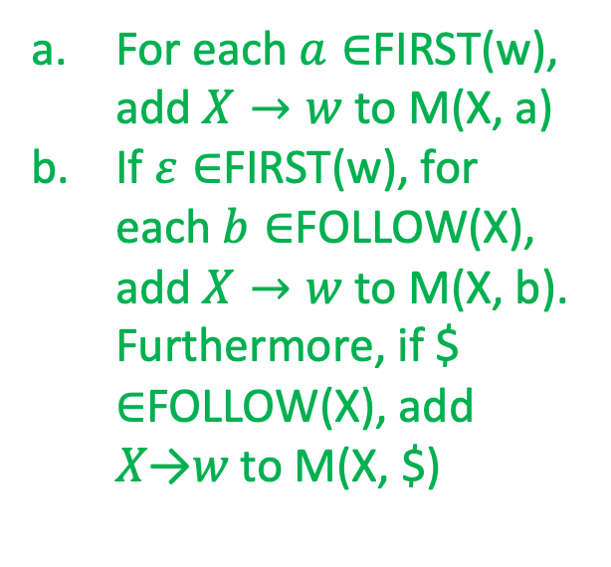
Parsing table
For each $a∈$FIRST(w), add $X→w$ to M(X, a)
If $ε∈$FIRST(w), for each $b∈$FOLLOW(X), add $X→w$ to M(X, b). Furthermore, if $ ∈FOLLOW(X), add 𝑋→𝑤 to M(X, $)
FIRST sets
FOLLOW sets
$E→TE′$
$E^{′}→+TE^{′}$
$E^{′}→ε$
$T→FT′$
$T^{′}→∗FT^{′}$
$T^{′}→ε$
$F→\left(E\right)$
$F→id$
E | (, id
E’ | +, $ε$
T | (, id
T’ | *, $ε$
F | (, id
E | $, )
E’ | $, )
T | +, $, )
T’ | +, $, )
F | *, +, $, )
 | id | + | * | ( | ) | $
E
E’
T
T’
F

Slide 38
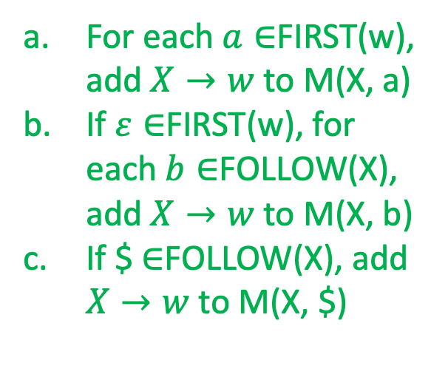
Parsing table
For each $a∈$FIRST(w), add $X→w$ to M(X, a)
If $ε∈$FIRST(w), for each $b∈$FOLLOW(X), add $X→w$ to M(X, b)
If $ $∈$FOLLOW(X), add $X→w$ to M(X, $)
FIRST sets
FOLLOW sets
$E→TE′$
$E^{′}→+TE^{′}$
$E^{′}→ε$
$T→FT′$
$T^{′}→∗FT^{′}$
$T^{′}→ε$
$F→\left(E\right)$
$F→id$
E | (, id
E’ | +, $ε$
T | (, id
T’ | *, $ε$
F | (, id
E | $, )
E’ | $, )
T | +, $, )
T’ | +, $, )
F | *, +, $, )
 | id | + | * | ( | ) | $
E | 1 |  |  | 1
E’ |  | 2 |  |  | 3 | 3
T | 4 |  |  | 4
T’ |  | 6 | 5 |  | 6 | 6
F | 8 |  |  | 7

Slide 39

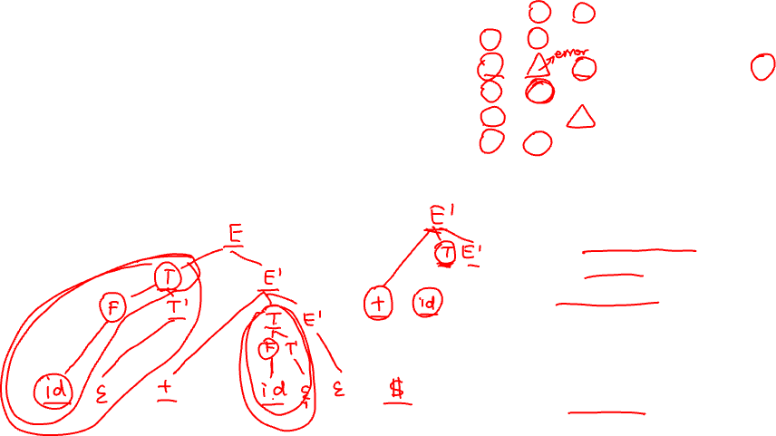
Parsing table in use
 | id | + | * | ( | ) | $
E | 1 |  |  | 1
E’ |  | 2 |  |  | 3 | 3
T | 4 |  |  | 4
T’ |  | 6 | 5 |  | 6 | 6
F | 8 |  |  | 7
The parsing table defines a PDA
It also helps to construct a parse tree!
Example: id+id$
$E→TE′$
$E^{′}→+TE^{′}$
$E^{′}→ε$
$T→FT′$
$T^{′}→∗FT^{′}$
$T^{′}→ε$
$F→\left(E\right)$
$F→id$

Slide 40
Parsing table as a PDA
Let M be a parsing table
Given the current letter a and the top stack symbol X, check M(a, X) – there is at most one rule there
If no rule there, reject (not valid)
If there is a rule there, pop out X and push in the rule
The whole process then work just like the more general NPDA form, but now we always know which rule to apply!

Slide 41
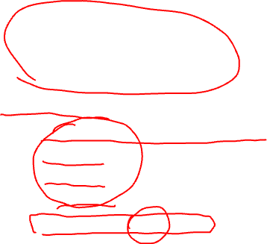
Summary
Deterministic PDAs
  Useful in practice
  Not as powerful as general PDAs
LL(1) parser
  Left recursion removal / left factoring
  FIRST sets
  FOLLOW sets
  Parsing table
  Parsing a concrete string

Slide 42

Thanks!

