Slide 1
41080 Theory of Computing
Week 10, Spring 2023
Youming Qiao

Slide 2
Assignment 2
It was good to communicate with many of you in the past few weeks.
I hope that you’ve made through it, and if not, will finish soon this week.
Any questions please let us know.

Slide 3
Review of the last lecture
Rice’s theorem
Nondeterministic Turing machines
Computational complexity, polynomial time (P)
Nondeterministic polynomial time (NP)

Slide 4
Today’s lecture
Big Oh and algorithm running times
Polynomial-time reductions and NP-complete
SAT and 3SAT are NP-complete

Slide 5
Algorithm analysis and big Oh

Slide 6
Algorithm analysis
Now that we talk about polynomial time, we need to “estimate” the running times of algorithms
We saw an example, namely Turing machines for {0^{n}1^{n}}
Algorithms on Turing machines are sometimes cumbersome
We will mostly do in the pseudo-code level

Slide 7
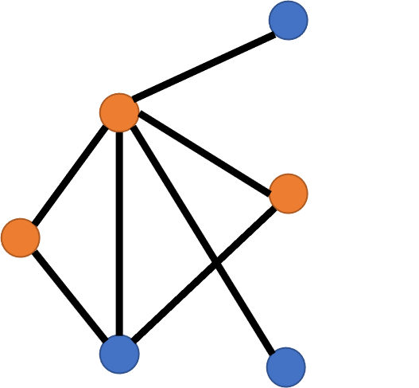

Example: Vertex Cover in NP
Let G=(V, E) be a graph
$S⊆V$ is a vertex cover, if every edge is incident to at least one vertex in S
VC={(G, k) : G has a size-k vertex cover}
To show VC in NP: a poly-time algorithm taking (G, k, S) as input accepts iff S is a size-k VC of G
For every edge e={u, v} in E:
  If neither u nor v in S, REJECT
ACCEPT

Slide 8

Example: Vertex Cover in NP
For every edge e={u, v} in E:
  If neither u nor v in S, REJECT
ACCEPT
Analysing this algorithm: Let n=|V|, m=|E|.
Input size: $n⋅m$ (if using adjacency list)
Check each edge: a multiplicative factor of m
  Checking u nor v in S: 2|S|$≤2n$ comparisons
Constant time
Total operations: at most 2nm comparisons
  Each comparison: looking up at the adjacency list

Slide 9

Remarks
Algorithm analysis is a broad and deep area
  How to analyse recursive algorithms? Randomised algorithms? Amortised running time?
There are many salient details
  Input formats affect the running times: adjacency list? Adjacency matrix?
  How to check if the vertex is in a list?
For a given task, there may be several algorithms with different time complexities
  Sorting, integer multiplication : $O\left(n^{2}\right)→O(n\log{n})$.
  Vertex cover:$\left({n \atop k}\right)⋅poly\left(n\right)≈n^{k}⋅poly(n)→2^{k}⋅poly(n)$.

Slide 10

Big Oh notation
We wish to make the analysis of algorithms easier
This requires us to go somewhat “broad stroke”
Definition. Given $f, g:ℕ^{k}→ℕ$, we say $f=O(g)$, if there exist $c, t∈ℕ$, s.t. for every $n_{1},…, n_{k}≥t$, we have $f\left(n_{1}, …, n_{k}\right)≤c⋅g(n_{1}, …, n_{k})$.
Broad stroke 1: omit a multiplicative constant
  For example, $2nm=O(nm)$
Broad stroke 2: only care about “large enough” n
  For example, $3+2nm=O(nm)$

Slide 11

More examples of using big Oh
1+3n+4m+5nm$=O(nm)$
$\log^{999}{(n)}=O(n)$
$n^{999}=O(2^{n})$
$100n=O\left(n\right)$
$f_{1}=O\left(g_{1}\right), f_{2}=O\left(g_{2}\right)⇒f_{1}⋅f_{2}=O(g_{1}⋅g_{2})$
$f=O\left(g\right)⇒c⋅f=O(g)$ for any constant c
$f=O\left(g\right), g=O\left(h\right)⇒f=O(h)$

Slide 12
Remarks
Big Oh notation simplifies things by
Omitting constants, and
Caring only about behaviours for large enough integers
So the algorithm for Vertex Cover in NP runs in time O(nm)
We may also make our life easier by assuming that some basic operations can be done efficiently
  For example, checking whether u in S needs |S| many comparisons
  Each comparison takes time O(log n)
  But we usually don’t go into such details

Slide 13
Polynomial-time reductions

Slide 14

Polynomial Time Reducibility
f : Σ* → Σ* is a polynomial time computable function
if there is a poly-time Turing machine M that on every input w, halts with just f(w) on its tape
Language A is poly-time reducible to language B, written as A ≤_{P} B,
if there is a poly-time computable f : Σ* → Σ* so that:
w ∈ A ⇔ f(w) ∈ B
f is a polynomial time reduction from A to B
Note there is a k such that for all w, |f(w)| ≤ |w|^{k}

Slide 15
A
B
f
n
n^{c}
w
f(w)
f
n
n^{c}
f converts any string w into a string f(w) such that
w ∈ A ⇔ f(w) ∈ B

Slide 16
Theorem: If A ≤_{P} B and B ≤_{P} C, then A ≤_{P} C
A
f
B
C
g
n
n^{c}
n^{cd}
f
g

Slide 17
Theorem: If A ≤_{P} B and B ∈ P, then A ∈ P
Proof:
Let M_{B} be a poly-time TM that decides B.
Let f be a poly-time reduction from A to B.
We build a machine M_{A} that decides A as follows:
M_{A} = On input w,
1. Compute f(w)
2. Run M_{B} on f(w), output its answer
w ∈ A ⇔ f(w) ∈ B

Slide 18
Theorem: If A ≤_{P} B and B ∈ NP, then A ∈ NP
Proof:
Analogous…

Slide 19
Theorem: If A ≤_{P} B and B ∈ P, then A ∈ P
Theorem: If A ≤_{P} B and B ∈ NP, then A ∈ NP
Corollary: If A ≤_{P} B and A ∉ P, then B ∉ P

Slide 20
NP-completeness

Slide 21
NP-completeness
Now that we defined polynomial-time reductions, we can define:
Definition. A language A is NP-complete if
It is in NP
For any problem B in NP, B ≤_{P} A
If only 2 holds, then A is NP-hard (rather than NP-complete)

Slide 22
Suppose L is NP-Complete…
NP
P
L
If L ∉ P, then P ≠ NP
If L ∈ P, then P = NP

Slide 23
The meaning of NP-completeness
NP-complete problems: the most difficult problems in NP
P vs NP is a major open problem
How to prove P=NP? To show any NP-complete problem to be in P!
Question: Do NP-complete problems exist at all?
Yes, and there are thousands of them.
  You may encounter one in your work too!

Slide 24
SAT and Cook-Levin Theorem

Slide 25


The first NP-complete problem
The very first NP-complete problem: Satisfiability problem (SAT)
  It plays the role of A_{TM} in computability
Theorem. [Cook-Levin] SAT is NP-complete.
A fundamental discovery in computer science
Every language in NP can be polynomial-time reduced to SAT
Corollary. SAT ∈ P if and only if P = NP

Slide 26

Boolean operations
We are used to functions f(x₁, …, x_{n}) s.t. x_{i} take value as real numbers
In circuits and logic, it is more common to see x_{i} taking values {0, 1}
  Digital circuits use semiconductors to represent two states
Such variables are called Boolean variables
The most common Boolean operations on Boolean variables are:
AND($∧$): {0, 1} x {0, 1} -> {0, 1}
OR($∨$): {0, 1} x {0, 1} -> {0, 1}
NOT($¬$): {0, 1} -> {0, 1}

Slide 27
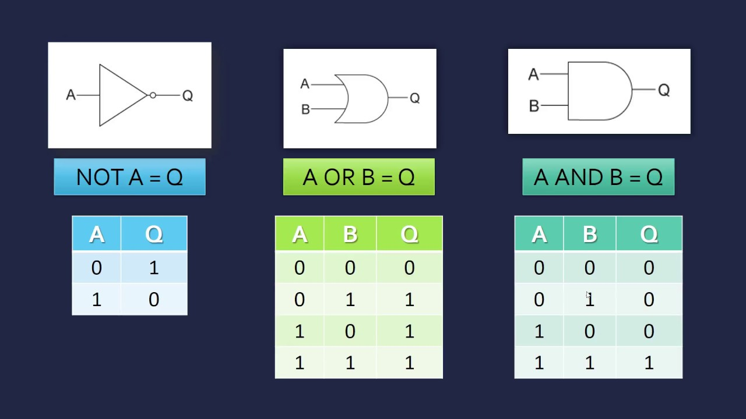
AND, OR, NOT

Slide 28

Boolean formulas
Arithmetic expressions:
  Variables (x, y, z…) taking values from integers or real numbers
  Operations such as +, -, x, /
Boolean formulas: “Arithmetic expressions” for Boolean variables
  Boolean variables, taking values in {0, 1}
  Boolean operations: $∧, ∨, ¬$
Boolean formulas are useful in circuit design and logic

Slide 29
Boolean Formula Satisfiability
logical
operations
¬ recedes
∧ precedes ∨
parentheses
φ =
(¬x ∧ y) ∨ z
Boolean variables (0 or 1)

Slide 30
Boolean Formula Satisfiability
φ =
(¬x ∧ y) ∨ z
A satisfying assignment is a setting of the variables that makes the formula true
x = 1, y = 1, z = 1 is a satisfying assignment for φ
(in fact, any assignment with z = 1 is satisfying)
φ = ¬(x ∨ y) ∧ (z ∧ ¬x)
0
0
1
0

Slide 31
A Boolean formula is satisfiable if there is a true/false setting to the variables that makes the formula true
a ∧ b ∧ c ∧ ¬d
YES
¬(x ∨ y) ∧ x
NO
SAT = { φ | φ is a satisfiable Boolean formula }

Slide 32
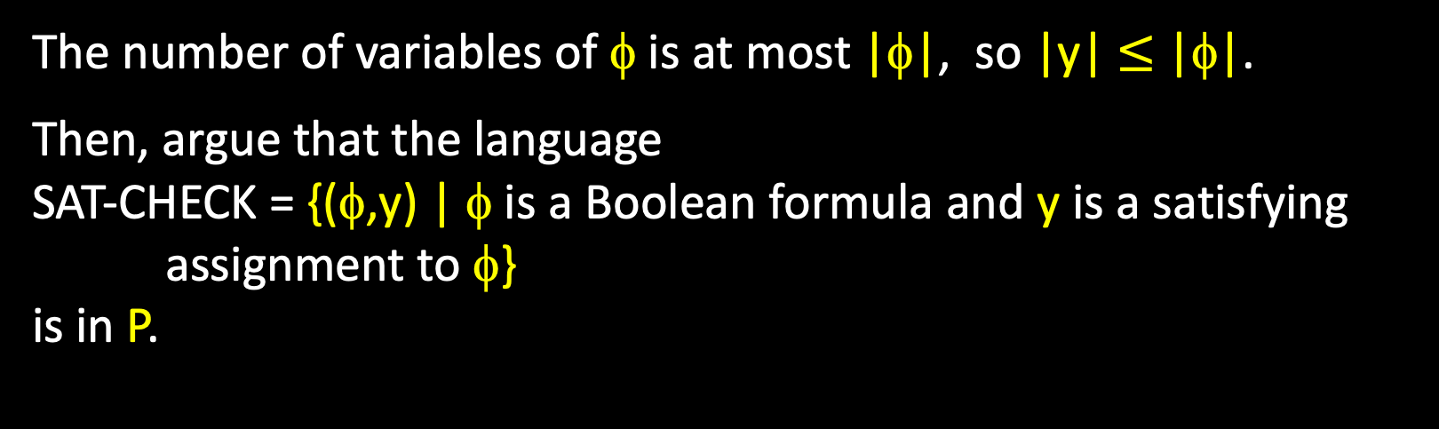
Theorem: SAT ∈ NP
We can express SAT as
SAT =
{ φ | φ is a Boolean formula and ∃ string y that encodes a satisfying assignment to φ }
The number of variables of φ is at most |φ|, so |y| $≤$ |φ|.
Then, argue that the language
SAT-CHECK = {(φ,y) | φ is a Boolean formula and y is a satisfying assignment to φ}
is in P.

Slide 33

SAT is NP-hard
Let A be a problem in NP. How to show that A ≤_{P} SAT?
Let N be a NTM deciding A in time n^{k}
w in A $⇔$ $∃$ an accepting computing history of N on w

Slide 34
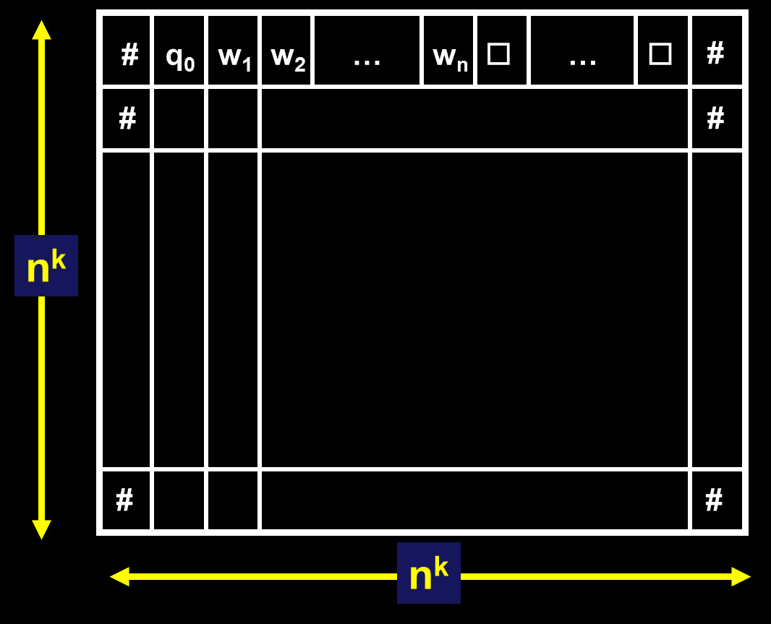
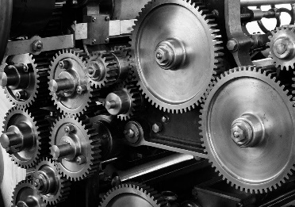

A tableau for N on w is an n^{k} × n^{k} table whose rows are the configurations of some possible computation history of N on w
Each “cell” contains a
$σ∈$ Q ∪ Γ ∪ { # }

Slide 35

Use Boolean formula to check computation histories
We now devise a Boolean formula f, such that
f is satisfiable $⇔$ $∃$ an accepting computing history of N on w
The first row is of the form #q₀w₁…w_{n} □… □#
The last row contains q_{accept}
The transitions are valid
Variables of f: x_{i,j,s} where i, j in {1,…,n^{k}}, and s in Q ∪ Γ ∪ { # }
The meaning of x_{i,j,s} : 1 if the (i, j)th cell contains s
Goal: use these variables to check if it is a valid computation history

Slide 36
Idea: Make φ so that every satisfying assignment to the variables x_{i,j,s} corresponds to an accepting tableau for N on w (an assignment to all cell[i,j]’s of the tableau)
The formula φ will be the AND of four formulas:
φ = φ_{cell} ∧ φ_{start} ∧ φ_{accept} ∧ φ_{move}
φ_{cell} : for all i, j, there is a unique s ∈ C with x_{i,j,s} = 1
φ_{start} : the first row of the table equals the start configuration of N on w
φ_{accept} : the last row of the table has an accept state
φ_{move} : every row is a configuration that yields the configuration on the next row

Slide 37
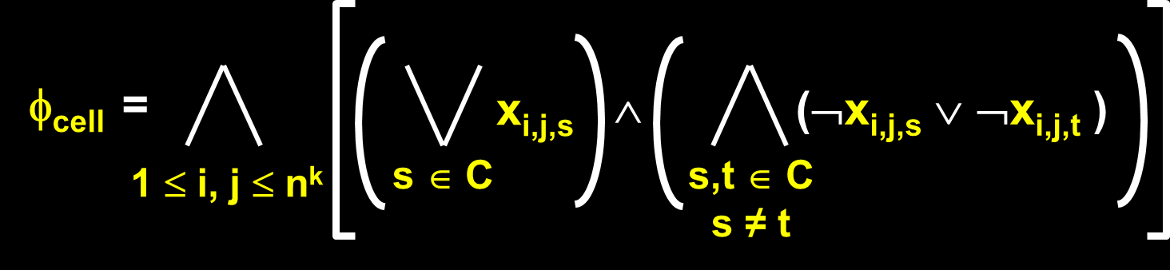
φ_{cell} : for all i, j, there is a unique s ∈ C with x_{i,j,s} = 1
for all i,j
at least one x_{i,j,s} is set to 1
at most one x_{i,j,s} is set to 1

Slide 38
φ_{move} : every row is a configuration that yields the configuration on the next row
Key Question: If one row yields the next row, how many cells can be different between the two rows?
Answer: at most three cells
#
b
a
a
q₁
b
c
b
#
#
b
a
q₂
a
c
c
b
#

Slide 39
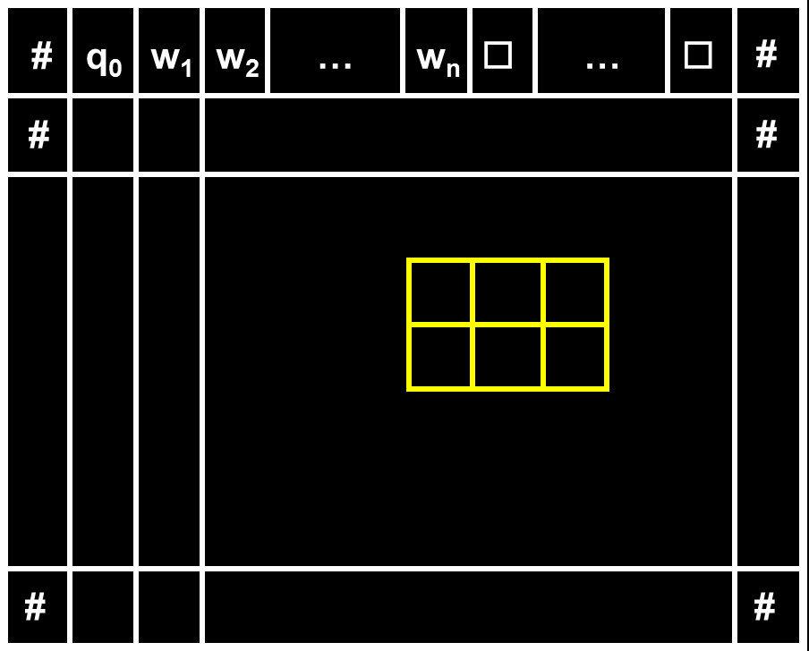
φ_{move} : every row is a configuration that yields the configuration on the next row
Idea: check that every 2 × 3 “window” of cells is legal (consistent with the transition function of N)

Slide 40
Much more is needed
We saw how to use Boolean formulas to check
for all i, j, there is a unique s ∈ C with x_{i,j,s} = 1
We also saw the basic idea of verifying valid transitions
Focus on 2x3 windows
The rest is not easy, but can be done with these hints
  Checking the first row is in the desired form?
  Checking the last row has q_{accept}?
  Checking the valid transitions? Examine when the 2x3 windows are allowed…

Slide 41

Summary: SAT is NP-complete
The fact that SAT is NP-complete was surprising
  SAT is a practically useful problem
  NP is a rather abstract notion
The basic principle: computation is ”local”
  The 2x3 windows are enough to check if a computation history is accepting
Assuming P$≠$NP, SAT does not admit a poly-time algorithm
To prove that P=NP, it is enough to demonstrate a poly-time algorithm for SAT

Slide 42
From SAT to 3SAT

Slide 43

A special case of SAT
A special case of Boolean formulas is Conjunctive Normal Form (CNF)
A CNF uses AND to connect clauses
  F=C₁ ∧ C₂ ∧ … ∧ C_{m}
A CNF clause uses OR to connect literals
  C=L₁ ∨ L₂ ∨ … ∨ L_{k}
A literal is either a variable, or the negation of a variable
  L=x_{i} or $¬$x_{i}
If $k≤c$ for every clause, this formula is called $c$CNF-formula
cSAT={ F : F is a cCNF-formula, and F is satisfiable}

Slide 44
A 3CNF-formula has the form:
(x₁ ∨ ¬x₂ ∨ x₃) ∧ (x₄ ∨ x₂ ∨ x₅) ∧ (x₃ ∨ ¬x₂ ∨ ¬x₁)
literals
clauses
3SAT = { φ | φ is a satisfiable 3CNF-formula }

Slide 45
3SAT is NP-complete
Theorem. 3SAT is NP-complete.
Proof.
It is in NP by the same argument that SAT is in NP.
To show that it is NP-hard, we reduce SAT to 3SAT.
In the proof that SAT is NP-hard, the resulting Boolean formula is actually in CNF form
But each clause may involve more than 3 literals

Slide 46
Reduce the number of literals
Suppose we have a clause C=(a₁ ∨ a₂ ∨ … ∨ a_{t}), t>3
Let z be a new boolean variable
Consider F=(a₁ ∨ a₂ ∨ z) ∧ (¬ z ∨ a₃ ∨ … ∨ a_{t})
C is true if and only if at least of a_{i} is true
F is true if and only if:
If z is 1, then at least one of a₃, …, a_{t} is true
If z is 0, then at least one of a₁ or a₂ is true
So F is true if and only if one of a_{i} is true

Slide 47
3SAT is NP-hard
We just saw the trick of reducing the number of literals
From a SAT instance F, and construct a 3SAT instance G, such that
F is satisfiable if and only if G is satisfiable
This construction can be done in polynomial time
C=(a₁ ∨ a₂ ∨ … ∨ a_{t}) is turned to
This shows that 3SAT is NP-hard
(a₁ ∨ a₂ ∨ z₁) ∧ (¬z₁ ∨ a₃ ∨ z₂) ∧ (¬z₂ ∨ a₄ ∨ z₃) … ∧ (¬z_{t-3} ∨ a_{t-1} ∨ a_{t})

Slide 48
What’s the total length of φ?
φ = φ_{cell} ∧ φ_{start} ∧ φ_{accept} ∧ φ_{move}
O(n^{2k}) clauses
O(n^{k}) clauses
O(n^{k}) clauses
O(n^{2k}) clauses

Slide 49
Summary. We proved:
Every A in NP has a polynomial time reduction to 3SAT
For every A in NP, we know A is decided by some nondeterministic n^{k}-time Turing machine N
We gave a generic method to reduce (N, w) to a 3SAT formula φ of O(|w|^{2k}) clauses such that satisfying assignments to the variables
of φ directly correspond to accepting computation histories of N on w
The formula φ is the AND of four 3CNF formulas:
φ = φ_{cell} ∧ φ_{start} ∧ φ_{accept} ∧ φ_{move}

Slide 50
Summary
Big Oh and algorithm running times
Polynomial-time reductions and NP-complete
SAT and 3SAT are NP-complete

Slide 51

Thanks!

