Slide 1
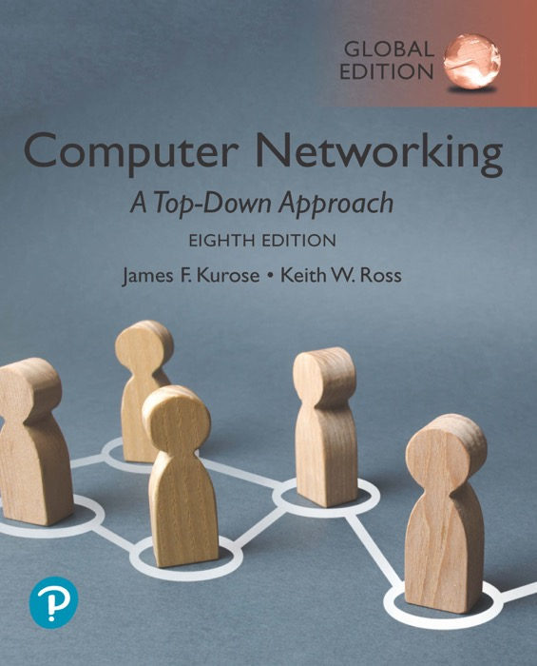
Chapter 5
Network Layer: Control Plane
Adapted by renping.liu@uts.edu.au on 23 April 2023
A note on the use of these PowerPoint slides:
We’re making these slides freely available to all (faculty, students, readers). They’re in PowerPoint form so you see the animations; and can add, modify, and delete slides (including this one) and slide content to suit your needs. They obviously represent a lot of work on our part. In return for use, we only ask the following:
If you use these slides (e.g., in a class) that you mention their source (after all, we’d like people to use our book!)
If you post any slides on a www site, that you note that they are adapted from (or perhaps identical to) our slides, and note our copyright of this material.
For a revision history, see the slide note for this page.
Thanks and enjoy! JFK/KWR
All material copyright 1996-2020
J.F Kurose and K.W. Ross, All Rights Reserved
Computer Networking: A Top-Down Approach
8th Edition, Global Edition
Jim Kurose, Keith Ross
Copyright © 2022 Pearson Education Ltd
Notes:
Version History
8.0 (May 2020)
All slides reformatted for 16:9 aspect ratio
All slides updated to 8th edition material
Use of Calibri font, rather that Gill Sans MT
Add LOTS more animation throughout
lighter header font
Re-do of network management slides; redo of Bellman-Ford slides

Slide 2

Network layer: “control plane” roadmap
5.1 introduction
5.2 routing protocols
5.3 intra-ISP routing: OSPF
5.4 routing among ISPs: BGP
5.5 SDN control plane
5.6 Internet Control Message Protocol
5.7 network management, configuration

Slide 3
Network-layer functions
forwarding: move packets from router’s input to appropriate router output
data plane
routing: determine route taken by packets from source to destination
control plane
Two approaches to structuring network control plane:
per-router control (traditional)
logically centralized control (software defined networking)

Slide 4

Per-router control plane
Individual routing algorithm components in each and every router interact in the control plane
Routing
Algorithm
control
plane
data
plane
values in arriving
packet header
0111
1
3
2

Slide 5
Software-Defined Networking (SDN) control plane
Remote controller computes, installs forwarding tables in routers
Remote Controller
control
plane
data
plane
CA
CA
CA
CA
CA
values in arriving
packet header
0111
1
3
2

Slide 6
Network layer: “control plane” roadmap
5.1 introduction
5.2 routing protocols
  link state
  distance vector
5.3 intra-ISP routing: OSPF
5.4 routing among ISPs: BGP
5.5 SDN control plane
5.6 Internet Control Message Protocol
5.7 network management, configuration

Slide 7







Routing protocols
mobile network
Routing protocol goal: determine “good” paths (equivalently, routes), from sending hosts to receiving host, through network of routers
path: sequence of routers packets traverse from given initial source host to final destination host
“good”: least “cost”, “fastest”, “least congested”
routing: a “top-10” networking challenge!
national or global ISP
application
transport
network
link
physical
network
link
physical
network
link
physical
network
link
physical
network
link
physical
network
link
physical
datacenter
network
application
transport
network
link
physical
enterprise
network

Slide 8
Graph abstraction: link costs
5
c_{a,b}: cost of direct link connecting a and b
e.g., c_{w,z} = 5, c_{u,z} = ∞
v
3
w
2
5
u
z
Link cost c_{a,b} defined by ISP:
  could always be 1, or
  related to distance, or
  related to delay and congestion, or
  inversely related to bandwidth
2
1
3
1
2
x
y
1
graph: G = (N,E)
N: set of routers = { u, v, w, x, y, z }
E: set of links ={ (u,v), (u,x), (v,x), (v,w), (x,w), (x,y), (w,y), (w,z), (y,z) }

Slide 9
Graph abstraction: link costs
5
Link cost c_{a,b} defined by ISP:
  could always be 1, or
  related to distance, or
  related to delay and congestion, or
  inversely related to bandwidth
v
3
w
2
5
u
2
1
z
3
1
2
x
y
1
cost of path (x₁, x₂, x₃,…, x_{p}) = c(x₁,x₂) + c(x₂,x₃) + … + c(x_{p-1},x_{p})
key question: what is the least-cost path between u and z ?
routing algorithm: algorithm that finds that least cost path

Slide 10
Routing algorithm classification
global: all routers have complete topology, link cost info
“link state” algorithms
dynamic: routes change more quickly
  periodic updates or in response to link cost changes
How fast do routes change?
static: routes change slowly over time
decentralized: iterative process of computation, exchange of info with neighbors
routers initially only know link costs to attached neighbors
“distance vector” algorithms
global or decentralized information?

Slide 11
Network layer: “control plane” roadmap
5.1 introduction
5.2 routing protocols
  link state
  distance vector
5.3 intra-ISP routing: OSPF
5.4 routing among ISPs: BGP
5.5 SDN control plane
5.6 Internet Control Message Protocol
5.7 network management, configuration

Slide 12
Dijkstra’s link-state routing algorithm
centralized: network topology, link costs known to all nodes
  accomplished via “link state broadcast”
  all nodes have same info
computes least cost paths from one node (“source”) to all other nodes
  gives forwarding table for that node
iterative: after k iterations, know least cost path to k destinations
notation
c_{x,y}: direct link cost from node x to y; = ∞ if not direct neighbors
D(v): current estimate of cost of least-cost-path from source to destination v
p(v): predecessor node along path from source to v
N': set of nodes whose least-cost-path definitively known

Slide 13
Dijkstra’s algorithm: example
Step
N*
D(v)p(v)
D(w)p(w)
D(x)p(x)
D(y)p(y)
D(z)p(z)
0. Init: N*={source: u}
LOOP:
List neighbors of N*
- write/update: D(n)p(n)
Select shortest path neighbor ➔ N*
until N* has all nodes
0
u
7u
3u
5u
inf
inf
1
uw
6w
5u
11w
inf
2
uwx
6w
11w
14x
3
uwxv
10v
14x
uwxvy
updated
new neighb
4
12y
5
uwxvyz
x
9
ties can exist (can be broken arbitrarily)
5
7
notation:
N*: set of nodes whose least cost path are known, initial ‘u’
D(n): current value of least cost path from source ‘u’ to ‘n’
p(n): predecessor node along the path from source ‘u’ to ‘n’
4
8
u
3
w
y
z
2
3
7
4
v

Slide 14
Dijkstra’s algorithm: example
Step
N*
D(v)p(v)
D(w)p(w)
D(x)p(x)
D(y)p(y)
D(z)p(z)
0. Init: N*={source: u}
LOOP:
List neighbors of N*
- write/update: D(x)p(x)
Select shortest path neighbor ➔ N*
until N* has all nodes
0
u
7u
3u
5u
∞
∞
1
uw
6w
5u
11w
∞
2
uwx
6w
11w
14x
3
uwxv
10v
14x
4
uwxvy
12y
5
uwxvyz
x
9
build shortest paths:
construct shortest path tree by tracing predecessor nodes: p(n)
example: u → … → z
5
7
4
8
u
3
w
y
z
2
3
w →
v →
y →
7
4
u →
z
v

Slide 15
Dijkstra’s link-state routing algorithm
1 Initialization:
2 N' = {u} /* compute least cost path from u to all other nodes */
3 for all nodes v
4 if v adjacent to u /* u initially knows direct-path-cost only to direct neighbors */
5 then D(v) = c_{u,v} /* but may not be minimum cost! */
6 else D(v) = ∞
7
8 Loop
9
10
11
12
13
14
15 until all nodes in N'
find w not in N' such that D(w) is a minimum
add w to N'
update D(v) for all v adjacent to w and not in N' :
D(v) = min ( D(v), D(w) + c_{w,v} )
/* new least-path-cost to v is either old least-cost-path to v or known
least-cost-path to w plus direct-cost from w to v */

Slide 16
Dijkstra’s algorithm: another example
Step
0
1
2
3
4
5
N*
u
ux
uxy
uxyv
uxyvw
uxyvwz
D(v)p(v)
2u
2u
2u
D(w)p(w)
5u
4x
3y
3y
D(x)p(x)
1u
D(y)p(y)
∞
2x
D(z)p(z)
∞
∞
4y
4y
4y
ties can exist (can be broken arbitrarily)
5
v
3
w
2
5
u
2
1
z
3
1
2
x
y
1

Slide 17
Mid-break
  ☕️
Q&A

Slide 18
Network layer: “control plane” roadmap
5.1 introduction
5.2 routing protocols
  link state
  distance vector
5.3 intra-ISP routing: OSPF
5.4 routing among ISPs: BGP
5.5 SDN control plane
5.6 Internet Control Message Protocol
5.7 network management, configuration

Slide 19
Distance vector algorithm
Decentralized routing algorithm:
  No global topology info
  Only neighbouring info
  Rely on neighbour’s route to dest.
Example: Sydney to Brisbane:
  which route, how far? Ask neighbours:
  via Newcastle = 200km + 800km = 1000km
  via Orange = 300km + 1000km = 1300km
  via Goulbourn = 400km + 1200km = 1600km
  via Wollongong = 100km + 1100km = 1200km
Orange
Goulbourn

Slide 20
Distance vector algorithm
Based on Bellman-Ford (BF) equation (dynamic programming):
shift routing responsibility
to neighbours
Bellman-Ford equation
Let D_{x}(y): cost of least-cost path from x to y.
Then:
D_{x}(y) = min_{v} { c_{x,v} + D_{v}(y) }
neighbor v’s least-cost-path cost to y
min taken over all neighbors v of x
direct cost of link from x to neighbor v

Slide 21
Bellman-Ford Example
Suppose that u’s neighboring nodes, x,v,w, know that for destination z:
D_{v}(z) = 5
D_{w}(z) = 3
Bellman-Ford equation says:
5
D_{u}(z) = min { c_{u,v} + D_{v}(z),
c_{u,x} + D_{x}(z),
c_{u,w} + D_{w}(z) }
v
3
w
2
5
u
2
1
z
3
= min {2 + 5,
1 + 3,
5 + 3} = 4
1
2
x
y
1
D_{x}(z) = 3
node achieving minimum (x) is next hop on estimated least-cost path to destination (z)

Slide 22
Distance vector algorithm
key idea:
from time-to-time, each node sends its own distance vector estimate to neighbors
when x receives new DV estimate from any neighbor, it updates its own DV using B-F equation:
D_{x}(y) ← min_{v}{c_{x,v} + D_{v}(y)} for each node y ∊ N
under minor, natural conditions, the estimate D_{x}(y) converge to the actual least cost d_{x}(y)

Slide 23
Distance vector algorithm:
each node:
iterative, asynchronous: each local iteration caused by:
local link cost change
DV update message from neighbor
wait for (change in local link cost or msg from neighbor)
recompute DV estimates using DV received from neighbor
distributed, self-stopping: each node notifies neighbors only when its DV changes
  neighbors then notify their neighbors – only if necessary
  no notification received, no actions taken!
if DV to any destination has changed, notify neighbors

Slide 24
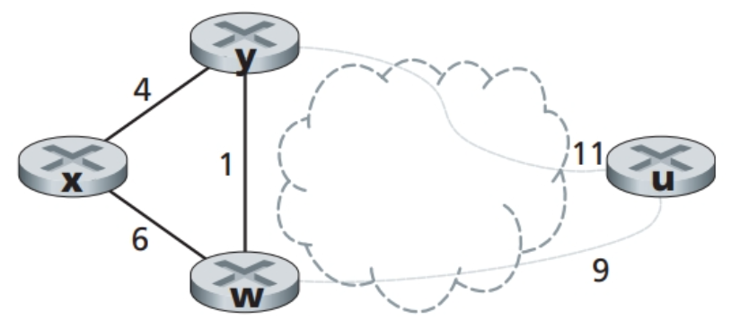
Distance vector algorithm:
Path cost: D_{x}(u):
D_{x}(u) = min {C_{x,y} + D_{y}(u), C_{x,w} + D_{w}(u)}
= min {4+10, 6+9} = 14
Link cost changes:
In Fig.1, if C_{x,y}= 6, D_{x}(u) = ?
In Fig.1, if C_{y,w}= 3, D_{x}(u) = ?
In Fig.1, if C_{x,w}= 9, D_{x}(u) = ?
In Fig.1, if C_{x,w}= 3, D_{x}(u) = ?
15
15
14
12
Fig.1 Distance Vector algorithm

Slide 25
Comparison of LS and DV algorithms
message complexity
  LS: n routers, O(n²) messages sent
  DV: exchange between neighbors; convergence time varies
robustness: what happens if router malfunctions, or is compromised?
LS:
  router can advertise incorrect link cost
  each router computes only its own table
DV:
  DV router can advertise incorrect path cost (“I have a really low cost path to everywhere”): black-holing
  each router’s table used by others: error propagate thru network
speed of convergence
LS: O(n²) algorithm, O(n²) messages
  may have oscillations
DV: convergence time varies
  may have routing loops
  count-to-infinity problem

Slide 26
Chapter 5-part1: summary
global or centralized:
  all routers have complete topology, link cost info
  “link state” algorithms: Dijkstra
decentralized or distributed:
  router knows physically-connected neighbors, link costs to neighbors
  iterative process of computation, exchange of info with neighbors
  “distance vector” algorithms: Bellman-Ford

Slide 27
Lab: Build a Network
Lab: network building exercise
  Watch “Introduction to Internetworking Lab” video before lab!
  Your chance to build a REAL network!
Some REAL NetFun – finally!☺

Slide 28
Assignment3: Network Layer, 5%
Based on weeks 7,8,9 learning materials
Answer in required format - strictly!
Due: Monday 1st May - no late submission accepted

Slide 29
Lecture done
  ✅
Q&A

