Slide 1

Chapter 3
Transport Layer
Adapted by renping.liu@uts.edu.au on 19 March 2023
A note on the use of these PowerPoint slides:
We’re making these slides freely available to all (faculty, students, readers). They’re in PowerPoint form so you see the animations; and can add, modify, and delete slides (including this one) and slide content to suit your needs. They obviously represent a lot of work on our part. In return for use, we only ask the following:
If you use these slides (e.g., in a class) that you mention their source (after all, we’d like people to use our book!)
If you post any slides on a www site, that you note that they are adapted from (or perhaps identical to) our slides, and note our copyright of this material.
For a revision history, see the slide note for this page.
Thanks and enjoy! JFK/KWR
All material copyright 1996-2020
J.F Kurose and K.W. Ross, All Rights Reserved
Computer Networking: A Top-Down Approach
8th Edition, Global Edition
Jim Kurose, Keith Ross
Copyright © 2022 Pearson Education Ltd
Notes:
Version History
8.0 (April 2020)
All slides reformatted for 16:9 aspect ratio
All slides updated to 8th edition material
Use of Calibri font, rather that Gill Sans MT
Add LOTS more animation throughout
added new 8th edition material on QUIC, CUBIC, delay-based congestion control
lighter header font

Slide 2
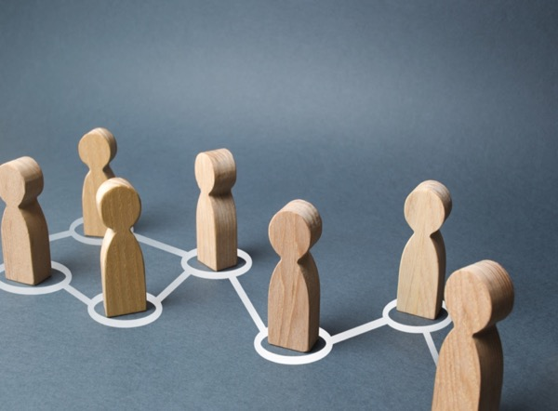
Transport layer: roadmap
3.1 Transport-layer services
3.2 Multiplexing and demultiplexing
3.3 Connectionless transport: UDP
3.4 Principles of reliable data transfer
3.5 Connection-oriented transport: TCP
3.6 Principles of congestion control
3.7 TCP congestion control
3.8 Evolution of transport-layer functionality

Slide 3







Transport services and protocols
application
transport
network
data link
physical
provide logical communication between application processes running on different hosts
mobile network
national or global ISP
transport protocols actions in end systems:
  sender: breaks application messages into segments, passes to network layer
  receiver: reassembles segments into messages, passes to application layer
logical end-end transport
local or regional ISP
home network
content
provider
network
application
transport
network
data link
physical
datacenter
network
two transport protocols available to Internet applications
  TCP, UDP
enterprise
network
Notes:
By logical communication , we
mean that from an application’s perspective, it is as if the hosts running the processes
were directly connected; in reality, the hosts may be on opposite sides of the
planet, connected via numerous routers and a wide range of link types. Application
processes use the logical communication provided by the transport layer to send
messages to each other, free from the worry of the details of the physical infrastructure
used to carry these messages.
Let’s look at each of these three (logical communications, actions,

Slide 4
Transport Layer Actions
Sender:
sender
process
application
application
is passed an application-layer message
app. msg
determines segment header fields values
T_{h}
transport
app. msg
transport
T_{h}
creates segment (segmentation)
network (IP)
network (IP)
passes segment to IP
link
link
physical
physical

Slide 5
Transport Layer Actions
receiver
process
Receiver:
application
receives segment from IP
application
checks header values
transport
transport
app. msg
extracts application-layer message (reassembly)
network (IP)
network (IP)
demultiplexes message up to application via socket
link
link
physical
physical
app. msg
T_{h}

Slide 6
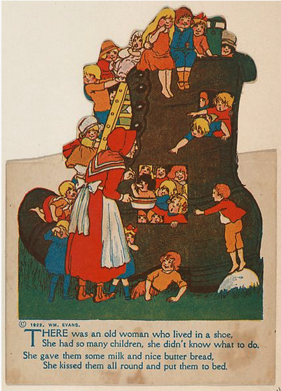
Transport vs. network layer services and protocols
household analogy:
12 kids in Ann’s house sending letters to 12 kids in Bill’s house:
hosts = houses
processes = kids
app messages = letters in envelopes
transport protocol = Ann and Bill who demux to in-house siblings
network-layer protocol = postal service

Slide 7
Transport vs. network layer services and protocols
network layer: logical communication between hosts
transport layer: logical communication between processes
  relies on, enhances, network layer services
household analogy:
12 kids in Ann’s house sending letters to 12 kids in Bill’s house:
hosts = houses
processes = kids
app messages = letters in envelopes
transport protocol = Ann and Bill who demux to in-house siblings
network-layer protocol = postal service

Slide 8
Two principal Internet transport protocols
application
transport
network
data link
physical
TCP: Transmission Control Protocol
  reliable, in-order delivery
  congestion control
  flow control
  connection setup
UDP: User Datagram Protocol
  unreliable, unordered delivery
  no-frills extension of “best-effort” IP
services not available:
  delay guarantees
  bandwidth guarantees
mobile network
national or global ISP
logical end-end transport
local or regional ISP
home network
content
provider
network
application
transport
network
data link
physical
datacenter
network
enterprise
network

Slide 9
Transport layer: roadmap
3.1 Transport-layer services
3.2 Multiplexing and demultiplexing
3.3 Connectionless transport: UDP
3.4 Principles of reliable data transfer
3.5 Connection-oriented transport: TCP
3.6 Principles of congestion control
3.7 TCP congestion control
3.8 Evolution of transport-layer functionality

Slide 10





HTTP server
client
application
application
HTTP msg
transport
transport
network
transport
network
link
network
link
physical
link
physical
physical

Slide 11
HTTP server
client
application
application
HTTP msg
transport
H_{t}
HTTP msg
transport
network
transport
network
link
network
link
physical
link
physical
physical

Slide 12
HTTP server
client
application
application
HTTP msg
transport
H_{t}
HTTP msg
H_{n}
H_{t}
network
transport
HTTP msg
transport
network
link
network
link
physical
link
physical
physical

Slide 13
HTTP server
client
application
application
transport
transport
network
transport
network
link
network
link
physical
link
physical
physical
H_{n}
H_{t}
HTTP msg

Slide 14

HTTP server
client₁
client₂
application
P-client₁
P-client₂
application
transport
transport
network
transport
network
link
network
link
physical
link
physical
physical

Slide 15


Multiplexing/demultiplexing
multiplexing at sender:
demultiplexing at receiver:
handle data from multiple
sockets, add transport header (later used for demultiplexing)
use header info to deliver
received segments to correct
socket
application
application
P1
P2
application
socket
P3
transport
P4
12000
15000
process
transport
network
transport
network
link
network
link
physical
link
physical
physical

Slide 16
How demultiplexing works
host receives IP datagrams
  each datagram has source IP address, destination IP address
  each datagram carries one transport-layer segment
  each segment has source, destination port number
host uses IP addresses &
port numbers to direct segment to appropriate socket
32 bits
source port #
dest port #
other header fields
application
data
(payload)
TCP/UDP segment format

Slide 17
Connectionless (UDP) demultiplexing
Recall:
when creating socket, must specify host-local port #:
serverSock.bind((‘’, 12000));
when receiving host receives UDP segment:
  checks destination port # in segment
  directs UDP segment to socket with that port #
when creating datagram to send into UDP socket, must specify
  destination IP address
  destination port #
IP/UDP datagrams with same dest. port #, but different source IP addresses and/or source port numbers will be directed to same socket at receiving host

Slide 18

Connectionless (UDP) demultiplexing: an example
serverSocket=socket
(AF_INET,SOCKET_DGRAM)
serverSocket.bind((‘’,12000));
mySocket2=socket
(AF_INET,SOCKET_DGRAM)
mySocket.bind((‘’,9157));
mySocket1=socket
(AF_INET,SOCKET_DGRAM
mySocket.bind((‘’,5775));
application
application
P1
application
P3
P4
transport
transport
network
transport
network
link
network
link
physical
link
physical
physical
source port: 12000
dest port: 9157
source port: ?
dest port: ?
source port: 9157
dest port: 12000
source port: ?
dest port: ?

Slide 19
Connection-oriented (TCP) demultiplexing
TCP socket identified by 4-tuple:
  source IP address
  source port number
  dest IP address
  dest port number
server may support many simultaneous TCP sockets:
  each socket identified by its own 4-tuple
  each socket associated with a different connecting client
demux: receiver uses all four values (4-tuple) to direct segment to appropriate socket

Slide 20
Connection-oriented (TCP) demultiplexing: example
HTTP Server
PS
application
80
application
P4
P5
P6
application
P1
P2
P3
9157
transport
5775
9157
transport
network
transport
network
link
network
link
physical
link
physical
server: IP address B
physical
host: IP address A
source IP,port: B,80
dest IP,port: A,9157
host: IP address C
source IP,port: C,5775
dest IP,port: B,80
source IP,port: A,9157
dest IP, port: B,80
source IP,port: C,9157
dest IP,port: B,80
Three segments, all destined to IP address: B,
dest port: 80 are demultiplexed to different sockets

Slide 21
Summary of MUX/DEMUX
Multiplexing, demultiplexing: based on segment, datagram header field values
UDP: demultiplexing using destination port number (only)
TCP: demultiplexing using 4-tuple: source and destination IP addresses, and port numbers
Multiplexing/demultiplexing happen at all layers

Slide 22
Transport layer: roadmap
3.1 Transport-layer services
3.2 Multiplexing and demultiplexing
3.3 Connectionless transport: UDP
3.4 Principles of reliable data transfer
3.5 Connection-oriented transport: TCP
3.6 Principles of congestion control
3.7 TCP congestion control
3.8 Evolution of transport-layer functionality

Slide 23
UDP: User Datagram Protocol
Why is there a UDP?
“no frills,” “bare bones” Internet transport protocol
“best effort” service, UDP segments may be:
  lost
  delivered out-of-order to app
no connection establishment (which can add RTT delay)
simple: no connection state at sender, receiver
small header size
no congestion control
  UDP can blast away as fast as desired!
  can function in the face of congestion
connectionless:
  no handshaking between UDP sender, receiver
  each UDP segment handled independently of others

Slide 24
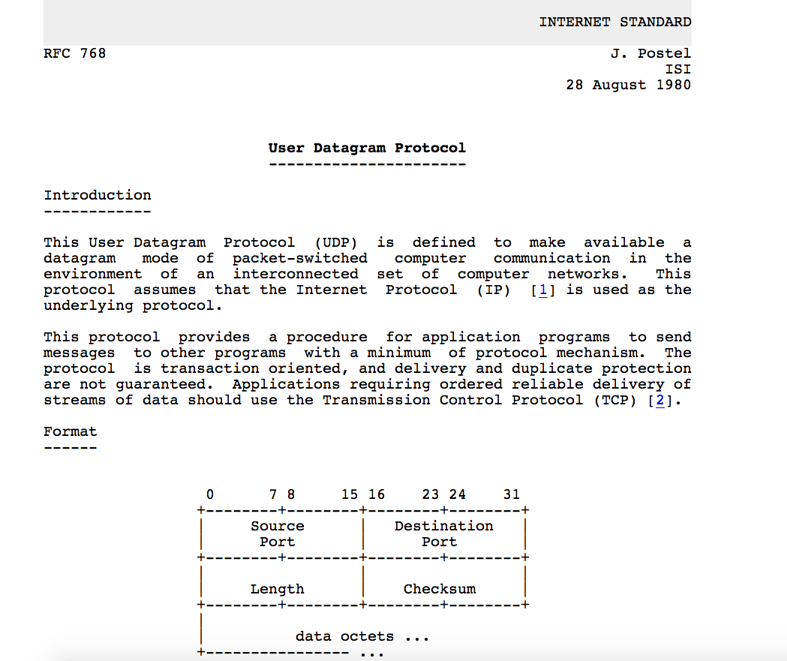
UDP: User Datagram Protocol [RFC 768]
UDP use:
  streaming multimedia apps
  (loss tolerant, rate sensitive)
  DNS
  SNMP
  HTTP/3
if reliable transfer needed over UDP (e.g., HTTP/3):
  add needed reliability at application layer
  add congestion control at application layer

Slide 25
UDP: Transport Layer Actions
SNMP client
SNMP server
application
application
transport
(UDP)
transport
(UDP)
network (IP)
network (IP)
link
link
physical
physical

Slide 26
UDP: Transport Layer Actions
SNMP client
SNMP server
UDP sender actions:
application
application
is passed an application-layer message
SNMP msg
transport
(UDP)
transport
(UDP)
determines UDP segment header fields values
UDP_{h}
SNMP msg
UDP_{h}
creates UDP segment (segmentation
network (IP)
network (IP)
link
link
passes segment to IP
physical
physical

Slide 27
UDP: Transport Layer Actions
SNMP client
SNMP server
UDP receiver actions:
application
receives segment from IP
application
checks UDP checksum header value
transport
(UDP)
transport
(UDP)
SNMP msg
extracts application-layer message (reassembly)
network (IP)
network (IP)
SNMP msg
UDP_{h}
demultiplexes message up to application via socket
link
link
physical
physical

Slide 28
UDP segment header
32 bits
source port #
dest port #
Header length: 8 bytes
length
checksum
application
data
(payload)
length, in bytes of UDP segment, including header
data to/from application layer
UDP segment format

Slide 29

UDP checksum
Goal: detect errors (i.e., flipped bits) in transmitted segment
1st number
2nd number
sum
9
Transmitted: 3 6
9
Received: 2 6
receiver-computed
checksum
=
sender-computed
checksum (as received)

Slide 30
Internet checksum
Goal: detect errors (i.e., flipped bits) in transmitted segment
sender:
treat contents of UDP segment (including UDP header fields and IP addresses) as sequence of 16-bit integers
checksum: addition (one’s complement sum) of segment content
checksum value put into UDP checksum field
receiver:
compute checksum of received segment
check if computed checksum equals checksum field value:
  not equal - error detected
  equal - no error detected. But maybe errors nonetheless? More later ….

Slide 31
Internet checksum: an example
example: add two 16-bit integers
1 1 1 0 0 1 1 0 0 1 1 0 0 1 1 0
1 1 0 1 0 1 0 1 0 1 0 1 0 1 0 1
wraparound
1 1 0 1 1 1 0 1 1 1 0 1 1 1 0 1 1
Note: when adding numbers, a carryout from the most significant bit needs to be added to the result
sum
1 0 1 1 1 0 1 1 1 0 1 1 1 1 0 0
checksum
0 1 0 0 0 1 0 0 0 1 0 0 0 0 1 1
At the Transmitter end:
compute the sum from data (above)
send data with checksum (complement of sum) to Receiver
Error Checking at the Receiver end:
compute the “sum” from the received data
Add “sum” with received “checksum” == all ‘1’ ➔Correct
* Check out the online interactive exercises for more examples: http://gaia.cs.umass.edu/kurose_ross/interactive/

Slide 32
Internet checksum: weak protection!
example: add two 16-bit integers
0 1
1 1 1 0 0 1 1 0 0 1 1 0 0 1 1 0
1 0
1 1 0 1 0 1 0 1 0 1 0 1 0 1 0 1
wraparound
1 1 0 1 1 1 0 1 1 1 0 1 1 1 0 1 1
Even though numbers have changed (bit flips), no change in checksum!
sum
1 0 1 1 1 0 1 1 1 0 1 1 1 1 0 0
checksum
0 1 0 0 0 1 0 0 0 1 0 0 0 0 1 1

Slide 33
Summary of UDP
“no frills” protocol:
  segments may be lost, delivered out of order
  best effort service: “send and hope for the best”
UDP has its plusses:
  no setup/handshaking needed (no RTT incurred)
  can function when network service is compromised
  helps with reliability (checksum)
build additional functionality on top of UDP in application layer (e.g., HTTP/3)

Slide 34
Mid-break
  ☕️
Q&A

Slide 35
Transport layer: roadmap
3.1 Transport-layer services
3.2 Multiplexing and demultiplexing
3.3 Connectionless transport: UDP
3.4 Principles of reliable data transfer
3.5 Connection-oriented transport: TCP
3.6 Principles of congestion control
3.7 TCP congestion control
3.8 Evolution of transport-layer functionality

Slide 36

Principles of reliable data transfer
sending process
receiving process
application
data
data
transport
reliable channel
reliable service abstraction
Notes:
note arrows through reliable data transfer channel is just one way – reliably send from sender to receiver

Slide 37

Principles of reliable data transfer
sending process
receiving process
sending process
receiving process
application
data
data
application
data
data
transport
transport
reliable channel
sender-side of
reliable data transfer protocol
receiver-side
of reliable data transfer protocol
reliable service abstraction
transport
network
unreliable channel
reliable service implementation
Notes:
Spend some time talking about how its to the sender and receiver side protocol that IMPLEMENTS reliable data transfer
Communication over unreliable channel is TWO-way: sender and receiver will exchange messages back and forth to IMPLEMENT one-way reliable data transfer

Slide 38
Principles of reliable data transfer
sending process
receiving process
application
data
data
transport
sender-side of
reliable data transfer protocol
receiver-side
of reliable data transfer protocol
Complexity of reliable data transfer protocol will depend (strongly) on characteristics of unreliable channel (lose, corrupt, reorder data?)
transport
network
unreliable channel
reliable service implementation
Notes:
So we have a sender side and a receiver side. How much work they’ll have to do depends on the IMPAIRMENTS introduced by channel – if the channel is perfect – no problem!

Slide 39

Principles of reliable data transfer
sending process
receiving process
application
data
data
transport
sender-side of
reliable data transfer protocol
receiver-side
of reliable data transfer protocol
Sender, receiver do not know the “state” of each other, e.g., was a message received?
unless communicated via a message
transport
network
unreliable channel
reliable service implementation
Notes:
Here’s a point of view to keep in mind – it’s easy for US to look at sender and receiver together and see what is happening. OH – that message sent was lost.
But think about it say from senders POV How does the sender know if its transmitted message over the unreliable channel got though?? ONLY if receiver somehow signals to the sender that it was received.
The key point here is that one side does NOT know what is going on at the other side – it’s as if there’s a curtain between them. Everything they know about the other can ONLY be learned by sending/receiving messages.
Sender process wants to make sure a segment got through. But it can just somehow magically look through curtain to see if receiver got it. It will be up to the receiver to let the sender KNOW that it (the receiver) has correctly received the segment.
How will the sender and receiver do that – that’s the PROTOCOL.
Before starting to develop a protocol, let’s look more closely at the interface (the API if you will)

Slide 40
Reliable data transfer: getting started
We will:
incrementally develop sender, receiver sides of reliable data transfer protocol (rdt)
consider only unidirectional data transfer
  but control info will flow in both directions!
use finite state machines (FSM) to specify sender, receiver
event causing state transition
actions taken on state transition
state: when in this “state” next state uniquely determined by next event
state
1
state
2
event
actions
Notes:
SO let’s get started in developing our reliable data transfer protocol, which we’ll call rdt (need a good acronym for protocol – like HTTP, TCP, UDP, IP)
Bullet points 1 and 2
NOW if we are going to develop a protocol, so we’ll need some way to SPECIFY a protocol. How do we do that?
We could write text, but as all know, that’s prone to misinterpretation, and might be incomplete. You might write a specification, and then think “oh yeah – I forgot about that case”
What we need is more formal way to specify a protocol. In fact, with a formal specification there may be ways to PROVE PROPERTIES about a specification. But that’s an advanced topic we won’t get into here. We’ll start here by adopting a fairly simple protocol specification technique known as finite state machines (FSM)
And as the name might suggest, a central notion of finite state machines is the notion of STATE
<talk about state>

Slide 41

rdt1.0: reliable transfer over a reliable channel
underlying channel perfectly reliable
  no bit errors
  no loss of packets
sender
receiver
send pkt
pkt
rcv pkt
Notes:
We’ll start with the simplest case possible - an unreliable channel that is, in fact perfect – no segments are lost, corrupted, dupplicated or reordered. The sender just sends and it pops out the other side(perhaps after some delay) perfectly.

Slide 42
rdt2.0: channel with bit errors
underlying channel may flip bits in packet
  checksum (e.g., Internet checksum) to detect bit errors
the question: how to recover from errors?
How do humans recover from “errors” during conversation?

Slide 43
rdt2.0: channel with bit errors
underlying channel may flip bits in packet
  checksum to detect bit errors
the question: how to recover from errors?
  acknowledgements (ACKs): receiver explicitly tells sender that pkt received OK
  negative acknowledgements (NAKs): receiver explicitly tells sender that pkt had errors
  sender retransmits pkt on receipt of NAK
stop and wait
sender sends one packet, then waits for receiver response

Slide 44
rdt2.0: in action
stop and wait
sender sends one packet, then waits for receiver response, then transmit the next packet
sender
receiver
sender
receiver
send pkt
pkt
send pkt
pkt
rcv pkt
rcv pkt
ack
send ack
ack
send ack
rcv ack
rcv ack
send pkt
pkt
send pkt
pkt
error
rcv pkt
X
ack
send ack
nak
rcv ack
nak
resend pkt
send pkt
pkt
pkt
rcv pkt
rcv pkt
ack
send ack
ack
send ack
rcv ack
send pkt
pkt
rcv pkt
(a) no error
(b) packet error

Slide 45
rdt2.0 has a fatal flaw!
what happens if ACK/NAK corrupted?
sender doesn’t know what happened at receiver!
can’t just retransmit:
possible duplicate!
sender
receiver
send pkt
pkt
rcv pkt
ack
send ack
rcv ack
send pkt
pkt
rcv pkt
ack
send ack
ack error
X
error
retransmit pkt
pkt
rcv pkt
(duplicate!)

Slide 46
rdt2.1: discussion
sender:
seq # added to pkt
two seq. #s (0,1) will suffice. Why?
must check if received ACK/NAK corrupted
twice as many states
  state must “remember” whether “expected” pkt should have seq # of 0 or 1
receiver:
must check if received packet is duplicate, Old or New
  state indicates whether 0 or 1 is expected pkt seq #
note: receiver can not know if its last ACK/NAK received OK at sender

Slide 47
rdt2.1: Add sequence number
sender adds sequence number to each pkt
receiver discards (doesn’t deliver up) duplicate pkt
sender
receiver
send pkt0
pkt0
rcv pkt0
ack0
send ack0
rcv ack0
send pkt1
pkt1
rcv pkt1
error
ack1
send ack1
ack error
resend pkt1
X
pkt1
rcv pkt1
ack1
(detect duplicate)
rcv ack1
send ack1
send pkt0
pkt0
rcv pkt0
ack0
send ack0

Slide 48
rdt2.2: a NAK-free protocol
sender
receiver
same functionality as rdt2.1, using ACKs only
instead of NAK, receiver sends ACK for last pkt received OK
  receiver must explicitly include seq # of pkt being ACKed
Duplicate ACK at sender results in same action as NAK: retransmit current pkt
send pkt0
pkt0
rcv pkt0
ack0
send ack0
rcv ack0
send pkt1
pkt1
error
X
error pkt1
ack0
send ack0
ack0
resend pkt1
pkt1
rcv pkt1
ack1
send ack1
rcv ack1
send pkt0
pkt0
rcv pkt0
Duplicate ACK
As we will see, TCP uses this approach to be NAK-free

Slide 49
rdt3.0: channels with errors and loss
New channel assumption: underlying channel can also lose packets (data, ACKs)
  checksum, sequence #s, ACKs, retransmissions will be of help … but not quite enough
Q: How do humans handle lost sender-to-receiver words in conversation?

Slide 50
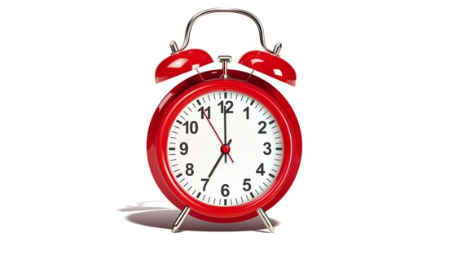
rdt3.0: channels with errors and loss
Approach: sender waits “reasonable” amount of time for ACK
retransmits if no ACK received in this time
if pkt (or ACK) just delayed (not lost):
    retransmission will be duplicate, but seq #s already handles this!
    receiver must specify seq # of packet being ACKed
use countdown timer to interrupt after “reasonable” amount of time
timeout

Slide 51

rdt3.0 in action
sender
receiver
sender
receiver
send pkt0
pkt0
send pkt0
pkt0
rcv pkt0
rcv pkt0
ack0
send ack0
ack0
send ack0
rcv ack0
rcv ack0
send pkt1
pkt1
send pkt1
pkt1
rcv pkt1
X
ack1
send ack1
loss
rcv ack1
send pkt0
pkt0
rcv pkt0
timeout
resend pkt1
ack0
send ack0
pkt1
rcv pkt1
ack1
send ack1
rcv ack1
send pkt0
pkt0
(a) no loss
rcv pkt0
ack0
send ack0
(b) packet loss

Slide 52
rdt3.0 in action
sender
receiver
sender
receiver
send pkt0
pkt0
rcv pkt0
send pkt0
pkt0
send ack0
rcv pkt0
rcv ack0
ack0
ack0
send ack0
send pkt1
pkt1
rcv ack0
rcv pkt1
send pkt1
pkt1
send ack1
rcv pkt1
ack1
ack1
send ack1
X
timeout
resend pkt1
loss
pkt1
rcv pkt1
timeout
resend pkt1
rcv ack1
(detect duplicate)
pkt1
rcv pkt1
send ack1
send pkt0
pkt0
ack1
(detect duplicate)
rcv pkt0
rcv ack1
send ack1
rcv ack1
ack1
ack0
send ack0
send pkt0
pkt0
(ignore)
rcv pkt0
ack0
send ack0
pkt1
(c) ACK loss
(d) premature timeout/ delayed ACK

Slide 53
Performance of rdt3.0 (stop-and-wait)
  U _{sender}: utilization – fraction of time sender busy sending
example: 1 Gbps link, 15 ms prop. delay, 8000 bit packet
  time to transmit packet into channel:
L
8000 bits
D_{trans} =
=
=
8 microsecs
R
10⁹ bits/sec
Notes:
if RTT=30 msec, 1KB pkt every 30 msec: 33kB/sec thruput over 1 Gbps link
network protocol limits use of physical resources
Let’s develop a formula for utilization

Slide 54
rdt3.0: stop-and-wait operation
sender
receiver
first packet bit transmitted, t = 0
first packet bit arrives
RTT
last packet bit arrives, send ACK
ACK arrives, send next
packet, t = RTT + L / R

Slide 55
rdt3.0: stop-and-wait operation
sender
receiver
L / R
=
L/R
U_{sender}
RTT
+ L / R
.008
RTT
=
30.008
=
0.00027
rdt 3.0 protocol performance stinks!
Protocol limits performance of underlying infrastructure (channel)

Slide 56
Pipelining: increased utilization
sender
receiver
first packet bit transmitted, t = 0
last bit transmitted, t = L / R
first packet bit arrives
RTT
last packet bit arrives, send ACK
last bit of 2nd packet arrives, send ACK
last bit of 3rd packet arrives, send ACK
ACK arrives, send next
packet, t = RTT + L / R
3-packet pipelining increases
utilization by a factor of 3!
Notes:
two generic forms of pipelined protocols: go-Back-N, selective repeat

Slide 57
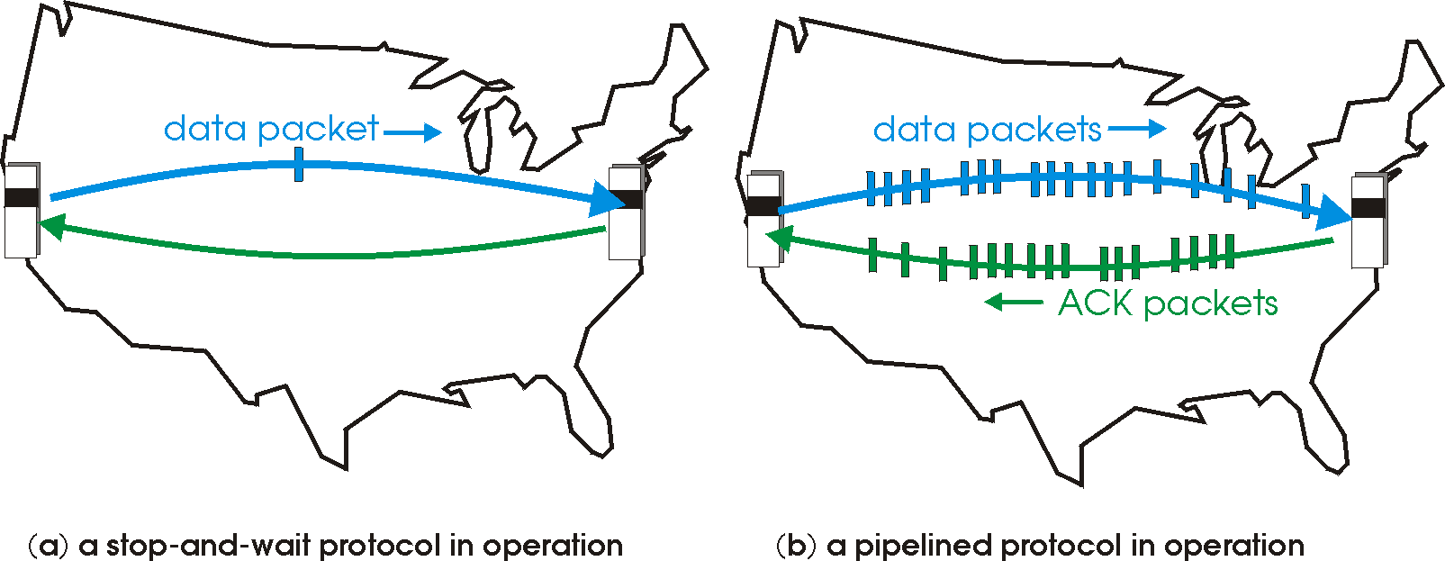

rdt3.0: pipelined protocols operation
pipelining: sender allows multiple, “in-flight”, yet-to-be-acknowledged packets
  range of sequence numbers must be increased
  buffering at sender and/or receiver

Slide 58
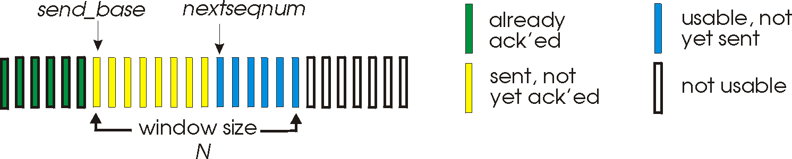
Go-Back-N: sender
sender: “window” of up to N, consecutive transmitted but unACKed pkts
  k-bit seq # in pkt header
cumulative ACK: ACK(n): ACKs all packets up to, including seq # n
  on receiving ACK(n): move window forward to begin at n+1
timer for oldest in-flight packet
timeout(n): retransmit packet n and all higher seq # packets in window
Notes:
window size of 14, 8 have been sent but are not yet ackowledgedm 6 sequence numbers are available for us. In woindow, but no calls from above to use them.
Note – we’ll skip the Go-Back-N FSM specification you can chack that out in powerpoitn slides or book)
TCP uses cumulative ACK

Slide 59
Go-Back-N: receiver
ACK-only: always send ACK for correctly-received packet so far, with highest in-order seq #
  may generate duplicate ACKs
❌
#71
#74,73,72
#70
#69
#68
A68, 69,70, 70,70,70,70,...
Notes:
Note – we’ll skip the Go-Back-N FSM specification (actually it’s

Slide 60
Go-Back-N in action
sender window (N=4)
sender
receiver
0 1 2 3 4 5 6 7 8
send pkt0
send pkt1
send pkt2
send pkt3
(wait)
0 1 2 3 4 5 6 7 8
receive pkt0, send ack0
receive pkt1, send ack1
receive pkt3, discard,
(re)send ack1
0 1 2 3 4 5 6 7 8
X
0 1 2 3 4 5 6 7 8
loss
0 1 2 3 4 5 6 7 8
rcv ack0, send pkt4
rcv ack1, send pkt5
0 1 2 3 4 5 6 7 8
receive pkt4, discard,
(re)send ack1
ignore duplicate ACK
receive pkt5, discard,
(re)send ack1
GBN
pkt 2 timeout
0 1 2 3 4 5 6 7 8
send pkt2
send pkt3
send pkt4
send pkt5
0 1 2 3 4 5 6 7 8
0 1 2 3 4 5 6 7 8
rcv pkt2, deliver, send ack2
rcv pkt3, deliver, send ack3
rcv pkt4, deliver, send ack4
rcv pkt5, deliver, send ack5
0 1 2 3 4 5 6 7 8
Notes:
Let’s skip FSM specification for GBN – check out the book or ppt – and let’s watch GBN sender and receivers in action.
Let assume a window size of 4. at t=0, sender sends packets 0, 1, 2 3, 4, and packet 2 will be lost
At the receiver:
Packet 0 received ACK0 generated
Packet 1 received ACK1 generated
Packet 2 is lost, and so when packet 3 is received, ACK 1 is sent – that’s the cumulative ACK, re-Acknowledging the receipt of packet 1. and in this implementation packet 3 is discarded

Slide 61
Selective repeat
receiver individually acknowledges all correctly received packets
  buffers packets, as needed, for eventual in-order delivery to upper layer
sender times-out/retransmits individually for unACKed packets
  sender maintains timer for each unACKed pkt
sender window
  N consecutive seq #s
  limits seq #s of sent, unACKed packets
Optional – not tested
Notes:
An important mechanism of GBN was the use of the cumulative acknowledgements, and as we mentioned, cumulative ACKs are used in TCP
An alternate ACK mechanism would be for the receiver to indiviually acknowledge specific packets as they are received. This mechanism is at the heart of the Selective repeat protocol.

Slide 62
Week5 summary
principles behind transport layer services:
  multiplexing, demultiplexing
  reliable data transfer
  flow control
  congestion control
instantiation, implementation in the Internet
  UDP
  TCP
Up next:
leaving the network “edge” (application, transport layers)
into the network “core”
two network-layer chapters:
  data plane
  control plane

Slide 63
Project 1
Project1 – 5%
  Task Sheet in Canvas Week4 module
  example web page: simpleWeb.html
Project1 due in Week5 in your lab class
  Group work, individually assessed.
  demonstrate running code as a group – group work
  show your individual work – individual assessment
  May complete Project1 in week4 if you can.

Slide 64
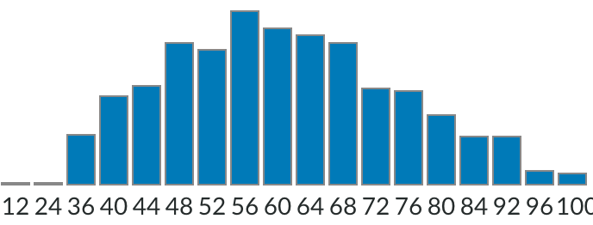
Quiz Results
Average score: 60
Well Done!

Slide 65
Student Feedback Survey (SFS)
Your voice on Teaching and Learning:
  lectures, learning materials: helpful?
  assignment, tutorial / lab / UPass: adding value?
Please Complete the survey
  at www.sfs.uts.edu.au
  if you are happy: what’s going well?
  any issues: what can be improved?
Your feedback appreciated!

Slide 66
Lecture done
  ✅
Q&A

