Slide 1
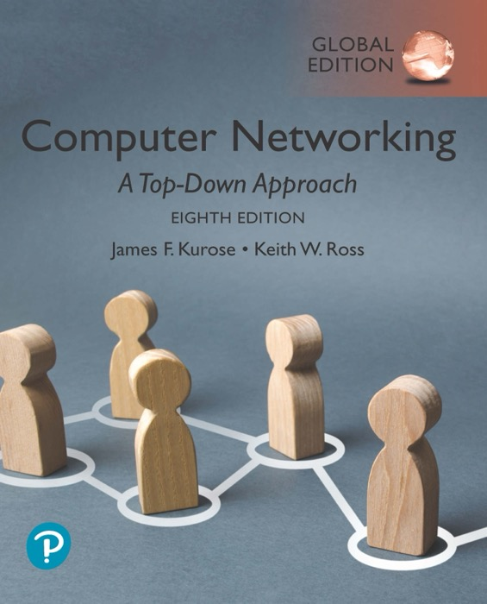
Chapter 2
Application Layer
Adapted by renping.liu@uts.edu.au on 12 March 2022
A note on the use of these PowerPoint slides:
We’re making these slides freely available to all (faculty, students, readers). They’re in PowerPoint form so you see the animations; and can add, modify, and delete slides (including this one) and slide content to suit your needs. They obviously represent a lot of work on our part. In return for use, we only ask the following:
If you use these slides (e.g., in a class) that you mention their source (after all, we’d like people to use our book!)
If you post any slides on a www site, that you note that they are adapted from (or perhaps identical to) our slides, and note our copyright of this material.
For a revision history, see the slide note for this page.
Thanks and enjoy! JFK/KWR
All material copyright 1996-2020
J.F Kurose and K.W. Ross, All Rights Reserved
Computer Networking: A Top-Down Approach
8th Edition, Global Edition
Jim Kurose, Keith Ross
Copyright © 2022 Pearson Education Ltd
Notes:
Version History
8.0 (April 2020)
All slides reformatted for 16:9 aspect ratio
All slides updated to 8th edition material
Use of Calibri font, rather that Gill Sans MT
Add LOTS more animation throughout

Slide 2
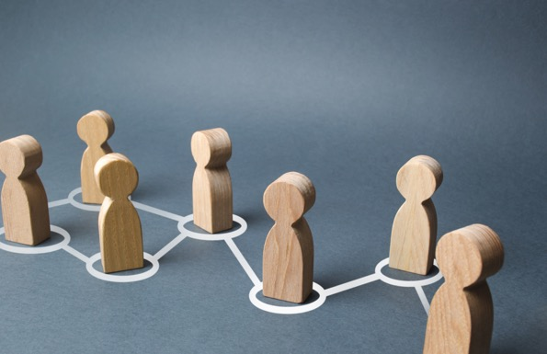
Application layer: overview
2.5 P2P applications
2.6 video streaming and content distribution networks
2.7 socket programming with UDP and TCP
2.1 Principles of network applications
2.2 Web and HTTP
2.3 E-mail, SMTP, IMAP
2.4 The Domain Name System DNS

Slide 3

E-mail
outgoing
message queue
user mailbox
user
agent
Three major components:
user agents
mail servers
simple mail transfer protocol: SMTP
User Agent
a.k.a. “mail reader”
composing, editing, reading mail messages
e.g., Outlook, iPhone mail client
outgoing, incoming messages stored on server
mail
server
user
agent
SMTP
mail
server
user
agent
SMTP
SMTP
user
agent
mail
server
user
agent
user
agent

Slide 4
E-mail: mail servers
outgoing
message queue
user mailbox
user
agent
mail servers:
mailbox contains incoming messages for user
message queue of outgoing (to be sent) mail messages
SMTP protocol between mail servers to send email messages
  client: sending mail server
  “server”: receiving mail server
mail
server
user
agent
SMTP
mail
server
user
agent
SMTP
SMTP
user
agent
mail
server
user
agent
user
agent

Slide 5
E-mail protocol: SMTP (RFC5321)
uses TCP to reliably transfer email message from client (mail server initiating connection) to server, port 25
direct transfer: sending server (acting like client) to receiving server
three phases of transfer
  handshaking (greeting)
  transfer of messages
  closure
command/response interaction (like HTTP)
  commands: ASCII text
  response: status code and phrase
messages must be in 7-bit ASCII

Slide 6
Sample SMTP interaction
telnet mail.abc.com 25
Can be:
<anonymous@anywhere.com
S: 220 mail.abc.com
C: HELO pc1.isp1.com
S: 250 Hello pc1.isp1.com, pleased to meet you
C: MAIL FROM: <alice@isp1.com>
S: 250 alice@isp1.com... Sender ok
C: RCPT TO: <bob@hamburger.edu>
S: 250 bob@hamburger.edu ... Recipient ok
C: DATA
S: 354 Enter mail, end with "." on a line by itself
C: From: alice@crepes.fr
C: To: bob@hamburger.edu
C: Subject: Searching for the meaning of life.
C: Do you like ketchup?
C: How about pickles?
C: .
S: 250 Message accepted for delivery
C: QUIT
S: 221 mail.abc.com closing connection
contact server
Can be different from header
<president@whitehouse.gov>
beginning of
mail message
end of
mail message

Slide 7
Mail message format
SMTP: protocol for exchanging e-mail messages, defined in RFC 531 (like HTTP)
RFC 822 defines syntax for e-mail message itself (like HTML)
header lines,
  SMTP MAIL FROM:, RCPT TO: commands!
Body: the “message” , ASCII characters only
  The “To: From: Subject:” within the body can be different from SMTP MAIL FROM:, RCPT TO: commands!
  end with a “ . ” in an empty line
header
blank
line
body
.

Slide 8


Scenario: Alice sends e-mail to Bob
1) Alice uses UA to compose e-mail message “to” bob@someschool.edu
4) SMTP client sends Alice’s message over the TCP connection
2) Alice’s UA sends message to her mail server; message placed in message queue
5) Bob’s mail server places the message in Bob’s mailbox
3) client side of SMTP opens TCP connection with Bob’s mail server
6) Bob invokes his user agent to read message
user
agent
mail
server
user
agent
1
mail
server
2
3
6
4
Alice’s mail server
5
Bob’s mail server

Slide 9
Mail access protocols
user
agent
e-mail access
protocol
user
agent
SMTP
SMTP
e.g., POP3 IMAP
sender’s e-mail
server
receiver’s e-mail
server
SMTP: delivery/storage of e-mail messages to receiver’s server
mail access protocol: retrieval from server
  POP3, IMAP: provides retrieval, deletion of stored messages on server
HTTP: gmail, Hotmail, Yahoo!Mail, etc. provides web-based interface on top of STMP (to send), IMAP (or POP) to retrieve e-mail messages

Slide 10
SMTP: closing observations
comparison with HTTP:
HTTP: pull
SMTP: push
POP3 and IMAP: pull or push?
both have ASCII command/response interaction, status codes
SMTP uses persistent connections
SMTP requires message (header & body) to be in 7-bit ASCII
SMTP server uses . in one line by itself to signal the end of message

Slide 11
Application layer: overview
2.5 P2P applications
2.6 video streaming and content distribution networks
2.7 socket programming with UDP and TCP
2.1 Principles of network applications
2.2 Web and HTTP
2.3 E-mail, SMTP, IMAP
2.4 The Domain Name System DNS

Slide 12
DNS: Domain Name System
people: many identifiers:
  SSN, name, passport #
Internet hosts, routers:
  IP address (32 bit) - used for addressing datagrams
  “name”, e.g., cs.umass.edu - used by humans
Q: how to map between IP address and name, and vice versa ?
Domain Name System:
distributed database implemented in hierarchy of many name servers
application-layer protocol: hosts, name servers communicate to resolve names (address/name translation)
  note: core Internet function, implemented as application-layer protocol
  complexity at network’s “edge”

Slide 13
DNS: services, structure
DNS services
hostname to IP address translation
host aliasing
  canonical, alias names: one IP address corresponds to multiple host names
mail server aliasing
load distribution
  replicated Web servers: many IP addresses correspond to one name
Q: Why not centralize DNS?
single point of failure
traffic volume
distant centralized database
maintenance
A: doesn‘t scale!
Comcast DNS servers alone: 600B DNS queries per day

Slide 14
DNS: a distributed, hierarchical database
Root DNS Servers
Root
…
…
.com DNS servers
.au DNS servers
.edu DNS servers
Top Level Domain
…
…
…
…
yahoo.com
DNS servers
amazon.com
DNS servers
com.au. edu.au
DNS servers
nyu.edu
DNS servers
umass.edu
DNS servers
Authoritative
Client wants IP address for www.amazon.com; 1st approximation:
client queries root server to find .com DNS server
client queries .com DNS server to get amazon.com DNS server
client queries amazon.com DNS server to get IP address for www.amazon.com

Slide 15
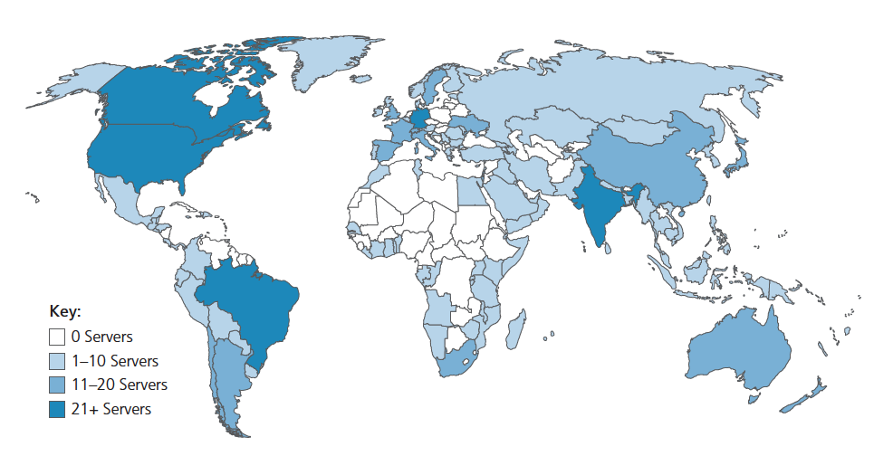
DNS: root name servers
official, contact-of-last-resort by name servers that can not resolve name
incredibly important Internet function
  Internet couldn’t function without it!
  DNSSEC – provides security (authentication and message integrity)
ICANN (Internet Corporation for Assigned Names and Numbers) manages root DNS domain
13 logical root name “servers” worldwide each “server” replicated many times (~200 servers in US)

Slide 16
TLD: authoritative servers
Top-Level Domain (TLD) servers:
  responsible for .com, .org, .net, .edu, .aero, .jobs, .museums, and all top-level country domains, e.g.: .au, .cn, .uk, .fr, .ca, .jp
  Network Solutions: authoritative registry for .com, .net TLD
  Educause: .edu TLD
Authoritative DNS servers:
  organization’s own DNS server(s), providing authoritative hostname to IP mappings for organization’s named hosts
  can be maintained by organization or service provider

Slide 17
Local DNS name servers
does not strictly belong to hierarchy
each ISP (residential ISP, company, university) has one
  also called “default name server”
when host makes DNS query, query is sent to its local DNS server
  has local cache of recent name-to-address translation pairs (but may be out of date!)
  acts as proxy, forwards query into hierarchy

Slide 18

DNS name resolution: iterated query
root DNS server
Example: host at engineering.nyu.edu wants IP address for gaia.cs.umass.edu
2
3
TLD DNS server
Iterated query:
contacted server replies with name of server to contact
“I don’t know this name, but ask this server”
1
4
8
5
requesting host at
feit9372.uts.edu.au
local DNS server
dns.uts.edu.au
gaia.cs.umass.edu
7
6
authoritative DNS server
dns.cs.umass.edu

Slide 19
Mid-break
  ☕️
Q&A

Slide 20
Application layer: overview
2.5 P2P applications
2.6 video streaming and content distribution networks
2.7 socket programming with UDP and TCP
2.1 Principles of network applications
2.2 Web and HTTP
2.3 E-mail, SMTP, IMAP
2.4 The Domain Name System DNS

Slide 21

Socket programming
goal: learn how to build client/server applications that communicate using sockets
socket: door between application process and end-end-transport protocol
application
socket
application
controlled by
app developer
process
process
transport
transport
Server
network
network
controlled
by OS
link
Internet
link
physical
physical
Client

Slide 22
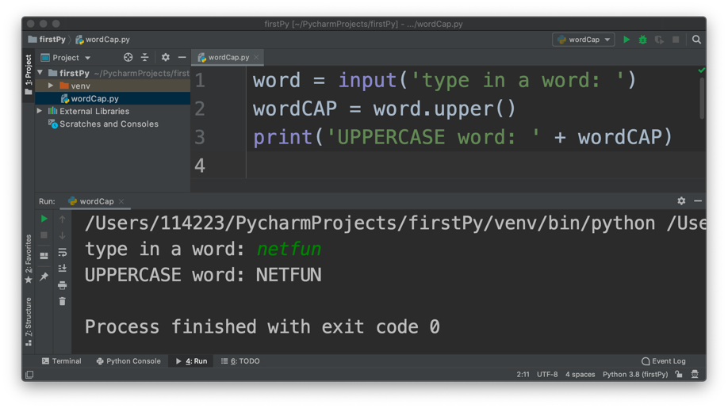
Create and Run your first Python!
In PyCharm: + Create New Project: firstPy
  Create new file: wordCap.py

Slide 23

Socket programming
  Two socket types for two transport services:
  UDP: unreliable datagram
  TCP: reliable, byte stream-oriented
This week’s Lab!
hello
  Application Example:
client reads a line of characters (data) from its keyboard and sends data to server
server receives and converts characters to uppercase
server sends modified data to client
client receives modified data and displays line on its screen
hello
⬅
Client
Server
hello
HELLO
⬅
HELLO
➔
HELLO
HELLO
➔

Slide 24
Socket programming with UDP
UDP: no “connection” between client & server
no handshaking before sending data
sender explicitly attaches IP destination address and port # to each packet
receiver extracts sender IP address and port# from received packet
UDP: transmitted data may be lost or received out-of-order
Application viewpoint:
UDP provides unreliable transfer of groups of bytes (“datagrams”) between client and server

Slide 25

Client/server socket interaction: UDP
server (running on serverIP)
client
create socket:
create socket, port= x:
clientSocket =
socket(AF_INET,SOCK_DGRAM)
serverSocket =
socket(AF_INET,SOCK_DGRAM)
Create datagram with server IP and
port=x; send datagram via
clientSocket
read datagram from
serverSocket
write reply to
serverSocket
specifying
client address,
port number
read datagram from
clientSocket
close
clientSocket

Slide 26
Example app: UDP server
Python UDPServer
include Python’s socket library
from socket import *
serverPort = 12000
serverSocket = socket(AF_INET, SOCK_DGRAM)
serverSocket.bind(('', serverPort))
print("The server is ready to receive")
while True:
message, clientAddress = serverSocket.recvfrom(2048)
modifiedMessage = message.decode().upper()
serverSocket.sendto(modifiedMessage.encode(), clientAddress)
UDP
create UDP socket
bind socket to local port number 12000
loop forever
Read from UDP socket into message, getting client’s address (client IP and port)
send upper case string back to this client

Slide 27
Example app: UDP client
Python UDPClient
from socket import *
serverName = '192.168.0.20'
serverPort = 12000
clientSocket = socket(AF_INET, SOCK_DGRAM)
message = input('Input lowercase sentence:')
clientSocket.sendto(message.encode(), (serverName, serverPort))
modifiedMessage, serverAddress = clientSocket.recvfrom(2048)
print(modifiedMessage.decode())
clientSocket.close()
The destination
create UDP socket for client
get user keyboard input
Attach server name, port to message; send into socket
read reply characters from
socket into string
print out received string and close socket

Slide 28
Socket programming with TCP
Client must contact server
server process must first be running
server must have created socket (door) that welcomes client’s contact
Client contacts server by:
Creating TCP socket, specifying IP address, port number of server process
when client creates socket: client TCP establishes connection to server TCP
when contacted by client, server TCP creates new socket for server process to communicate with that particular client
  allows server to talk with multiple clients
  source port numbers used to distinguish clients (more in Chap 3)
Application viewpoint
TCP provides reliable, in-order
byte-stream transfer (“pipe”)
between client and server

Slide 29
Client/server socket interaction: TCP
server (running on hostid)
client
create socket,
port=x, for incoming request:
serverSocket = socket()
wait for incoming
connection request
TCP
connection setup
create socket,
connect to hostid, port=x
connectionSocket =
serverSocket.accept()
clientSocket = socket()
send request using
clientSocket
read request from
connectionSocket
write reply to
connectionSocket
read reply from
clientSocket
close
connectionSocket
close
clientSocket

Slide 30
Example app: TCP server
from socket import *
serverPort = 12000
serverSocket = socket(AF_INET, SOCK_STREAM)
serverSocket.bind(('', serverPort))
serverSocket.listen(1)
print("The server is ready to receive")
while True:
connectionSocket, addr = serverSocket.accept()
sentence = connectionSocket.recv(1024).decode()
capitalizedSentence = sentence.upper()
connectionSocket.send(capitalizedSentence.encode())
connectionSocket.close()
create TCP welcoming
socket
server begins listening for incoming TCP requests
loop forever
server waits on accept() for incoming requests, new socket created on return
read bytes from new socket
Send back message
(no need for client address – why?)
close connection to this client (but not serverSocket)

Slide 31
Example app: TCP client
from socket import *
serverName = '192.168.0.20'
serverPort = 12000
clientSocket = socket(AF_INET, SOCK_STREAM)
clientSocket.connect((serverName, serverPort))
sentence = input('Input a lower case sentence : ')
clientSocket.send(sentence.encode())
modifiedSentence = clientSocket.recv(1024)
print('From Server : ' + modifiedSentence.decode())
clientSocket.close()
create TCP server socket
connect to remote server
at port 12000
No need to attach server name, port
Wait to receive from server
print out received string and close connection

Slide 32
Chapter 2: Summary
our study of network application layer is now complete!
application architectures
  client-server
  P2P
application service requirements:
  reliability, bandwidth, delay
Internet transport service model
  connection-oriented, reliable: TCP
  unreliable, datagrams: UDP
specific protocols:
  HTTP
  SMTP, IMAP
  DNS
  P2P: BitTorrent
video streaming, CDNs
socket programming:
TCP, UDP sockets

Slide 33
Lab, Project 1
Note: client and server hosts should be in the same network
Lab: Socket Programming
  Use Lab PCs or your Laptops
Project1 – 5%
  Task Sheet in Canvas Week4 module
  example web page: simpleWeb.html
Project1 due in Week5 in your lab class
  Group work, individually assessed.
  demonstrate running code as a group – group work
  show your individual work – individual assessment
  May complete Project1 in week4 if you can.

Slide 34
Week4 Quiz - 20%
Time: 10:00-22:00, Friday 17th March. Duration: 90 minutes
  must submit within the quiz window (before 22:00)
  If your Internet is down during quiz, switch to mobile phone hotspot to continue
Format: online open book.
  Please answer questions in specified format - strictly!
Access: “Quiz_Week4” in Week4 module.
Preparation:
  Scope: week 1-4 Learning Materials, lecture notes, textbook, review questions, tutorial problems, labs, assignment.
  “Quiz_Practice” in Week4 module, Canvas “Discussions” board
  Consultation @NetFun Lecture Zoom, 2:00pm Thursday 16th March

Slide 35
Lecture done
  ✅
Q&A

