Slide 1
31269: Business Requirements Modelling
Week 9 Lecture
Object Oriented Modelling - Class Modelling

Slide 2
Objectives
  Appreciate how Object Oriented (OO) modelling techniques can help to understand the working of business systems
  Discover why system specifications are important and how OO modeling can be used to specify systems and user requirements
  Use object-oriented system analysis techniques to develop a system model (Class Diagram/Model)

Slide 3
Topics
Components of a Class Diagram
Relationship between Classes
Rules for Class Diagram

Slide 4
Class Diagram
A Class Diagram is a type of static structure diagram that describes the structure of a system by showing the system's classes, their attributes, operations (or methods), and the relationships among classes/objects.
A class diagram is the main building block of object-oriented modelling.
Class Diagram is used both for general conceptual modelling of the application, and for detailed modelling translating the models into programming code.
Class diagram is not only used for visualizing, describing and documenting different aspects of a system but also for constructing executable code of the software application.
The basic constructs/parts of a Class Diagram are:
Classes are a description of a set of objects that share the same attributes and methods
  Attributes are properties which describe the state of a class.
  Methods describe the behaviour of a class.
  Relationships are associations between the classes.
  Multiplicity is a numerical relationship between two classes.
  Source: https://en.wikipedia.org/wiki/Class_diagram

Slide 5
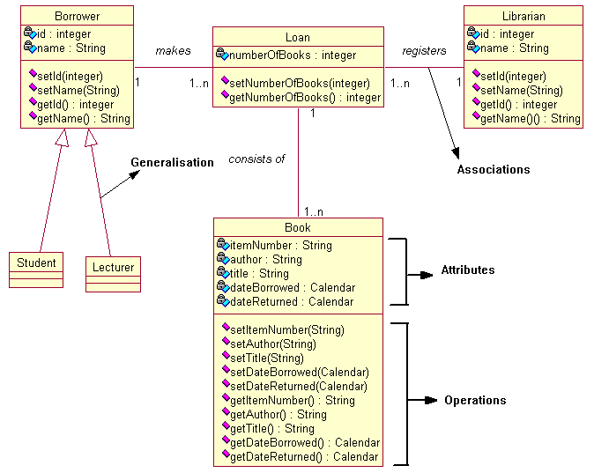
Class Diagram Example 1

Slide 6
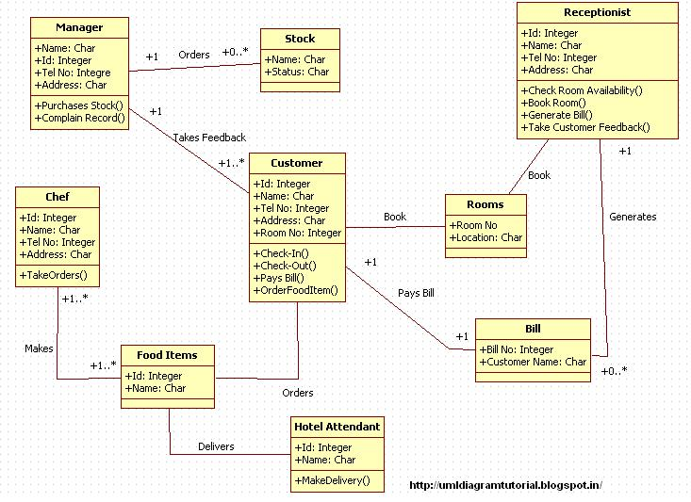
Class Diagram Example 2
Hotel Management System
Source: http://umldiagramtutorial.blogspot.com.au/2012/10/hotel-management-system-class-diagram.html
Attributes and methods should start with lowercase

Slide 7
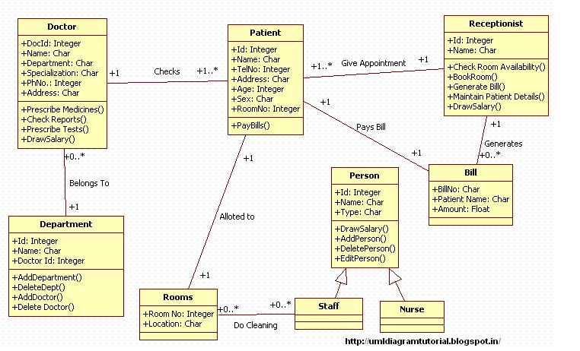
Class Diagram Example 3
Hospital Management System
Source: http://umldiagramtutorial.blogspot.com.au/2012/10/hospital-management-system-class-diagram.html
Attributes and methods should start with lowercase

Slide 8
Class
A class is an abstract definition of an object.
A class is a plan or a blueprint from which one or more objects can be created. Whereas an object represents real world things, both tangible and intangible.
A class is a description of a set of objects that share the same:
  Attributes
  Operations
  Relationships
Graphically, a class is rendered as a rectangle, usually including its name, attributes, and operations in separate, designated compartments.

Slide 9
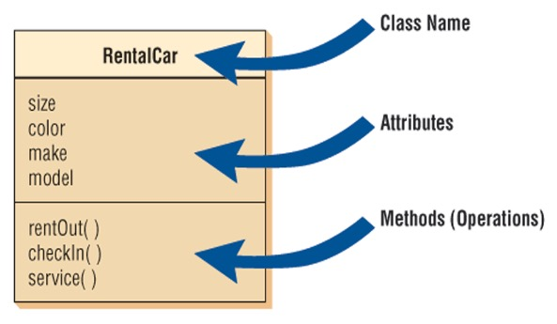
Class
A class is comprised of attributes and operations (methods) that manipulate these attributes.
Real-world objects share two characteristics: They all have state (attributes/fields) and behavior (methods/operations).

Slide 10
Attributes/fields
Attributes: Attributes describe the characteristics or are a description of a class. In the class diagram, attributes appear in the second compartment just below the name-compartment.
Person
A class stores its state in attributes and the keyword to identify attributes from a specification is ‘has’, indicating what a class has.
You must specify the data type for each attribute.
name : String
address : String
birthdate : Date
age : Int
Notes:
Intro to OOP with Java, C. Thomas Wu
©The McGraw-Hill Companies, Inc.
10

Slide 11
Class Operations/Methods
Operations describe the behavior of a class and they appear in the third compartment.
They are actions that can be carried out by, or on, a class/object and the keyword to identify methods from a specification is ‘can’, indicating what an object can do.
You must specify a method by stating its signature: listing the name, return type, and default value of all parameters.
Method names should start with lower case and all other words with initial capitals. For example, checkRoomAvailability( ), bookRoom( ), placeOrder( ), etc
Person
name : String
address : String
birthdate : Date
age : Int
eat( )
sleep( )
work( )
play( )
Notes:
Syntax for defining a method.
Modifier ReturnType MethodName (Parameters)
public void setExchange (double rate) {
exchangeRate = rate;
}

Slide 12
Relationships
There are four kinds of relationships between classes:
  Associations
  Aggregation
  Composition
  Generalisations

Slide 13
Association Relationship
An association is a relationship between classes that indicates meaningful and interesting connection.
An association is represented as a bold unbroken line between two classes.
Example: “A Person works for a Company”
To clarify its meaning, an association is named.
  The name is represented as a label placed midway along the association line.
  Usually a verb or a verb phrase.
Association name
works for
Person
Company

Slide 14
Associations Multiplicity
Multiplicity
  Numerical relationship between classes.
  An indication of how many objects may participate in the given relationship.
  Multiplicity is shown at the ends of an association.
  A person works for one company.
  A company has one or more people working in it.
Person
1..*
works for
1
Company

Slide 15
Common Multiplicity
Multiplicity Indicators
Exactly one | 1
Zero or more | (0..*)
One or more | 1..*
Zero or one | 0..1
Specified range | 2..4
Exactly three, five or eight | 3,5,8

Slide 16
Aggregation and Composition Relationships
Aggregation and Composition relationship between classes is a special form of association that models a whole-part relationship between the whole and its parts.

Slide 17
Aggregation
A special form of association that models a whole-part relationship between an aggregate (the whole) and its parts.
  Models a “is a part of” relationship.
2..*
1..*
Car
Door
House
Whole
Part

Slide 18
Aggregation
Aggregation is a “has a” temporary structural relationship (weak association).
Consists of a whole and its parts
Examples:
  Library has Books
  Subject has Students
  Constituency has Voters
If the whole is removed, the part may still exist.
    e.g. If Library is closed/removed, the Books may still exist
    e.g. If Subject is closed/removed, the Students still exist
Represented by a hollow white diamond at the end of the line that is not filled in, points to the class that holds the other class.
1
has
Engine
Part
1..*

Slide 19
Composition
A strong form of relationship.
Shown with a filled-in black diamond at the end of a line.
The whole has a responsibility for the parts.
If the whole is removed, the parts are also removed.
The life time of the part is dependent upon the whole.
  The composite must manage the creation and destruction of its parts. Water is a part-of a Pond. (Pond is a composition of water)
Composition
Pond
Water
Duck
Fish

Slide 20


Composition vs Aggregation
(A and B are classes)
There is a whole part relationship between classes/objects in both.
The distinction between aggregation and composition relationship depends on context of the problem.
Example1:
Composition: Water is a part-of a Pond. (Pond is a composition of water)
Aggregation: Pond has ducks and fishes (Pond aggregates ducks and fishes)
Example2:
Composition (Person, Heart, Hand), "sub objects" (Heart, Hand) will be destroyed as soon as Person is destroyed (dead).
Aggregation (City, Tree, Car) "sub objects" (Tree, Car) may NOT be destroyed when City is destroyed.
The bottom line is, composition stresses on mutual existence, and in aggregation, this property is NOT required.
Read notes section below
Notes:
The distinction between aggregation and composition depends on context.
Take the car example - yes, it is true that a car exhaust can stand "on its own" so may not be in composition with a car - but it depends on the application. If you build an application that actually has to deal with stand alone car exhausts (a car shop management application?), aggregation would be your choice. But if this is a simple racing game and the car exhaust only serves as part of a car and will be destroyed as soon as the car is destroyed- well, composition would be quite fine.
Chess board? Same problem. A chess piece doesn't exist without a chess board, only in certain applications. In others (like that of a toy manufacturer), a chess piece can surely not be composed into a chess board and hence aggregation would be the choice.
coincident lifetimes in composition,
composition stresses on mutual existence
objects share a lifespan

Slide 21
Generalization Relationships
superclass
A generalization relationship connects a subclass (child class) to its superclass (parent class).
It denotes an inheritance of attributes and methods from the superclass to the subclass and indicates a specialization in the subclass of the more general superclass.
Person
Student
subclass

Slide 22
Generalisation/Specialisation Relationships
Inherits from
subClass
superClass
Vehicle
Passenger
Vehicle
Goods
Vehicle
Inherits from Vehicle
Inherits from Vehicle
Inherits from Passenger Vehicle
Bicycle
Car
Bus

Slide 23
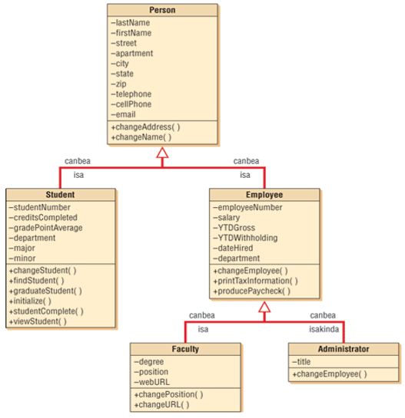
A gen/spec diagram is a refined form of a class diagram.
Academic Staff

Slide 24
Summary of Relationships between classes in a Class Diagram
association
aggregation
generalisation
composition

Slide 25
Steps in Developing a Class Diagram
Identify Classes
  Nouns, concepts, place, people
  E.g. Subject, Teacher, Administrator, Enrolment
Identify Attributes
  Possessive phrases; look for the word “has”
  E.g. Student’s name, id, code of the course
Identify Operations/Methods
  Verbs, verbal phrases; look for the word “can”
  E.g. Student can enrol in a Subject
Identify Relationships between classes
  Association, composition, aggregation and generalisation
Define Multiplicities

Slide 26
What do we have at this stage?
Use Case Diagram
  Use cases
  Use Case Scenarios/ Narratives
  Agreed by the users or their representatives

Slide 27
Putting it all together – Steps in the development of a Class Diagram
User Stories (two weeks ago)
Use Case Diagram (last week)
Use Case Scenarios or Narratives (last week)
Class Diagram (one diagram for the whole system)
Read the use case narratives for all use cases and identify Classes and its attributes and methods.

Slide 28
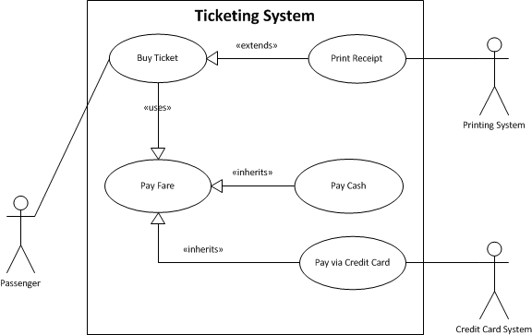
Use Case Diagram for Ticketing System
Remember the Ticketing System Example from last class?

Slide 29
Steps in Drawing a Class Diagram for Online Ticketing System
  Refer the Buy Ticket use case narrative, available in week 8 folder.
  Read the narrative and follow the following steps:
    Find Classes/Objects (look for nouns)
    Identify attributes and methods for each class
    Identify the relationship and multiplicities between classes.

Slide 30
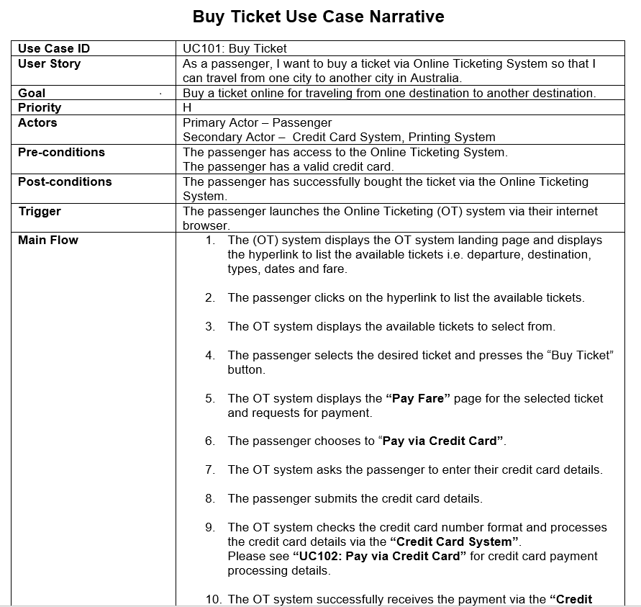
Buy Ticket Use Case Narrative – from Week 8 Class
Read this narrative and follow the “Steps in drawing a Class Diagram”

Slide 31
Exercise – Draft Class Diagram for Online Ticketing System
  Homework: Identify the missing associations, attributes and methods for each class in the above diagram.
Notes:
Remember, you draw one Class Diagram capturing the whole system and you go through a few iterations/drafts of your class diagram with your initial draft containing the Candidate Classes.
In the later drafts of your class diagram, you revisit the identified candidate classes and its attributes and methods, and you add or delete classes, attributes and methods based on your better understanding of the system.

Slide 32
Summary
Class Diagram is the basis for the object-oriented software.
Class diagram is not only used for visualizing, describing and documenting different aspects of a system but also for constructing executable code of the software application.

Slide 33
Assignment 4 – Improved COS
Object Oriented Requirements Analysis and Specification Report – 30 Marks
Same Case Study as Assignment 1: Customer Onboarding System (COS) for Streamable
Functional and non-functional requirements
  Functional requirements using:
    User Story Map
    User Stories, Use Cases (narratives) and Use Case Diagram (Project boundary)
    Sequence Diagram
  Data Requirements using:
    Class Diagram
    State Transition Diagram
  Non-functional requirements:
    User Interface requirements using wireframes
    Security requirements
    Performance requirements

Slide 34
Class Diagram for Assignment 4
So far you should have finished your User Stories and Use Case Narratives for assignment 2.
Document one Class Diagram for the improved COS covering the entire case study, i.e. covering all your user stories and use cases (not just the six you have chosen to narrate).
Two approaches in drawing a class diagram (use both):
  Approach 1: Convert ERD into a Class Diagram
  Approach 2: Follow the steps in drawing a class diagram.
Read all the use case narratives for assignment 2 and identify Classes and its attributes and methods. Then identify the relationships between them and the multiplicity. Also, read the interview with Kate Jones and follow the above steps.
Make sure to provide the data types for each attribute.
Make sure to provide return types and parameters for methods. Use proper naming conventions for a method.

Slide 35
Assignment 4 Template: Template adapted in this subject
1. Document Management
1.1 Revision History
1.2 Intended Audience
1.3 Reference Documents
1.4 Glossary
2. Introduction
2.1 Document Purpose
2.2 Project Purpose
2.3 Project Scope (use case diagram)
2.3.1 In Scope
2.3.2 Out of Scope
2.4 Assumptions
3. Functional Requirements
3.1 User Stories
3.2 User Story Map
3.3 Use Cases
3.2.1 Use Case: Name of the Use Case
3.2.2 Use Case:
3.3 Sequence Diagrams
4. Data Requirements
4.1 Class Diagram
4.2 State Transition Diagram
5. Non-functional requirements
5.1 User Interface Requirements
5.2 Security Requirements
5.3 Performance Requirements
6. Bibliography
7. Appendices
Notes:
This is the template we will use for assignment 2 to specify requirements using the agile approach.

Slide 36
Conclusion
THIS WEEK
  Class Topic: “Class Modelling”
Next Week
  Interaction modelling

