Slide 1
31269: Business Requirements Modeling
Week 7 Lecture - Agile Development with User Stories

Slide 2
Objectives
A deeper look at how user stories can be used to specify software requirements
Understand how user stories are estimated and prioritised.

Slide 3
Requirements Process
Negotiation, Prioritising & Management
Planning & Elicitation
Modelling & Analysis
Specification & Documentation
Validation & Inspection

Slide 4
THIS WEEK
Lecture Topic: “Agile Development with User Stories”
  Quiz 7 – Agile development and User Stories (3.5 marks)
  Pre-Work for this week
    a) Read the tute document and prepare for the tute tasks.
    b) Read assessment 3 case study and make detailed notes and identify User Stories.
    c) Watch reference videos

Slide 5
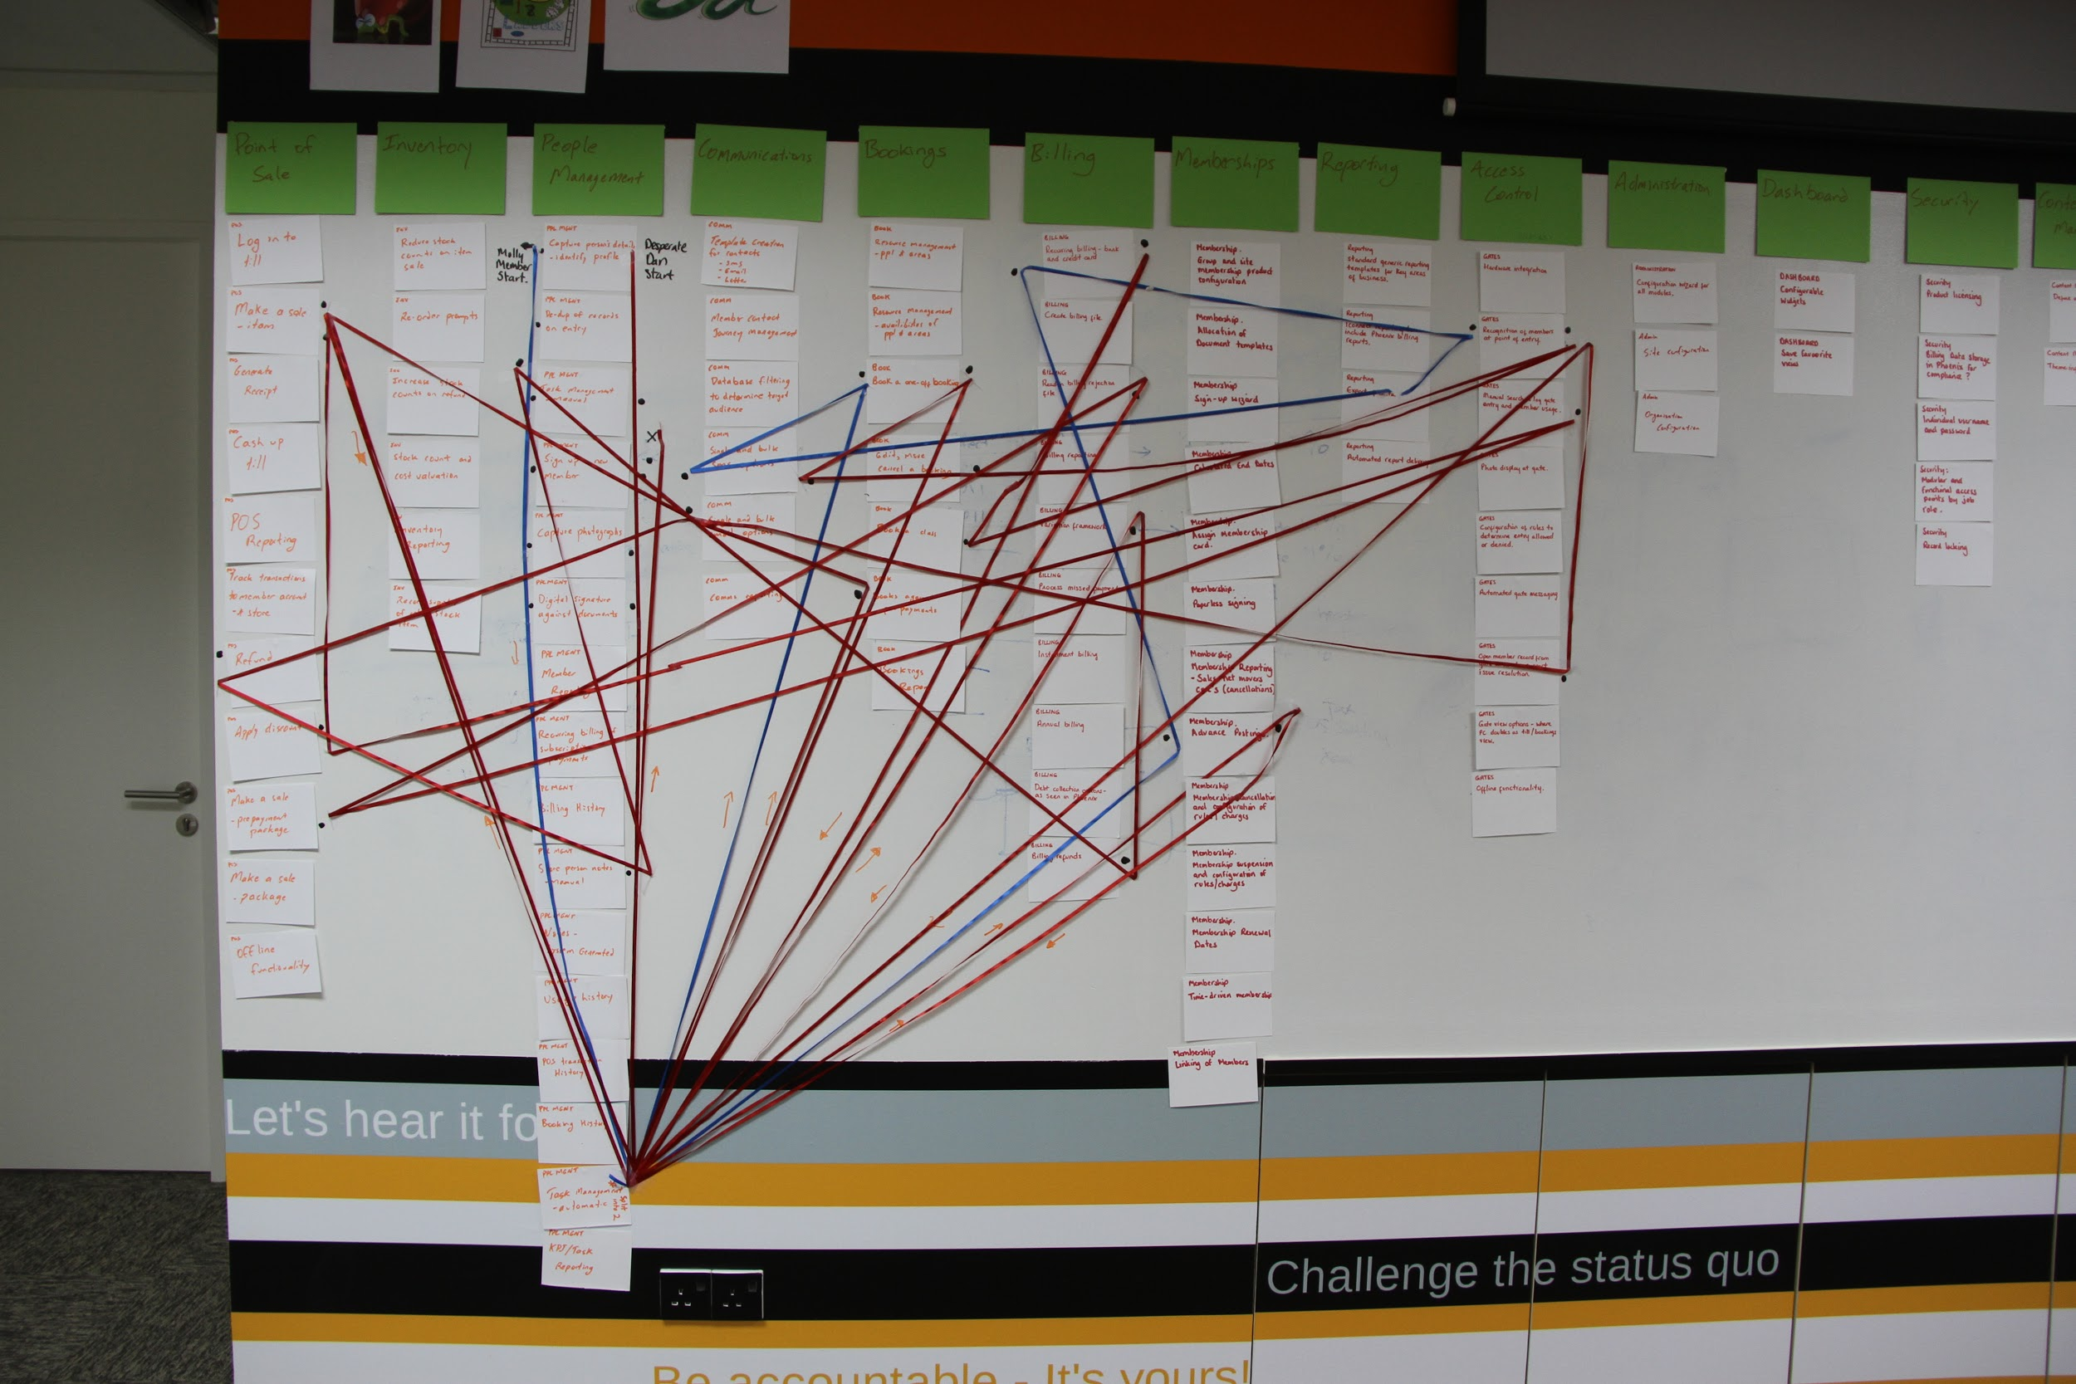
User Stories
User stories are short descriptions of a feature told from the perspective of the person who desires the new capability, usually a user or customer of the system. They typically follow a simple template:
As a <role>
I want <goal/desire>
so that <benefit>
User stories are often sticky notes and arranged on walls or tables to facilitate planning and discussion. As such, they strongly shift the focus from writing about features to discussing them. In fact, these discussions are more important than whatever text is written.
Notes:
[as above]

Slide 6
User Story Template and Examples
User Story Template
  As a <type of user>, I want/need/can <some goal> so that <some reason>.
  Three parts to a user story: who, what and why
    (http://www.mountaingoatsoftware.com/topics/user-stories)
User Story Examples:
  As a student, I want to download BRM subject lecture notes from the UTSOnline System so that I can prepare for the final exam.
  As a lecturer, I want to upload BRM subject lecture notes on the UTSOnline System so that I can deliver lecture.
  As a passenger, I want to buy a ticket via Online Ticketing System so that I can travel from one city to another city in Australia.
  As a user closing the application, I want to be prompted to save anything that has changed since the last save so that I can preserve useful work and discard erroneous work.

Slide 7
User stories – who and when
Anyone can write user stories. It's the product owner's responsibility to make sure a product backlog of user stories exists but you expect to have user story examples written by each team member.
User stories are written throughout the agile project. Usually a story-writing workshop is held near the start of the agile project. Everyone on the team participates with the goal of creating a product backlog that fully describes the functionality to be added over the course of the project.
A product backlog can be thought of as a replacement for the requirements document of a traditional project, but better to think of it as a pointer to the real requirement. User stories could point to a diagram depicting e.g use cases, etc..
Notes:
- Anyone on the team can write a user story. Who writes a user story is far less important than who is involved in the discussions of it.
- User stories are triggers for discussions [in themselves they are not enough]

Slide 8
User stories – How
Detail can be added to user stories in two ways:
- By splitting a user story into multiple, smaller user stories: User stories will cover large amounts of functionalities. These large user stories are generally known as epics set to later decomposed. Or by adding “conditions of satisfaction.”
e.g. 1 As a user, I can backup my entire hard drive ➔
As a user, I can specify files to backup based on file size, date created and date modified.
As a user, I can indicate folders not to backup so that my backup drive isn't filled up with things I don't need
As a tourist operator want to select a holiday season to be used when reviewing the performance of past advertising campaigns so that I can identify profitable ones
Adding condition of satisfaction (acceptance test): make sure it works with these holidays: Christmas, Easter, Mother’s Day, and Father’s Day

Slide 9
User stories: Guidelines
Write your stories so that they are easy to understand.
Keep them simple and concise. Avoid using multiple sentences in each user story (one sentence only).
Avoid using conjunctions such as ‘and’, ‘or’, ‘but’, etc. Also avoid using limiting phrases such as ‘unless’, ‘except’, ‘without’, etc.
Avoid confusing and ambiguous terms, and use active voice.
Keep user stories short and simple with one functionality only – otherwise decompose.
User stories should be clear, feasible, and testable and comfortably fit into a sprint.
User stories should have acceptance criteria. Acceptance criteria for a user story allow analyst to describe the conditions that have to be fulfilled so that the story is done/completed. The criteria enrich the story, they make it testable, and they ensure that the story can be demoed or released to the users and other stakeholders.
https://www.romanpichler.com/blog/10-tips-writing-good-user-stories/

Slide 10
User stories: Acceptance Tests
Acceptance Tests show how the customer or product owner will confirm that the story has been implemented to their satisfaction. In other words, acceptance tests represents the conditions of satisfaction that will be applied to determine whether or not the story fulfills the intent as well as the more detailed requirements.
Testable: In properly done agile, all code is tested code, so it follows that stories must be testable. If a story does not appear to be testable, then the story is probably ill formed, overly complex, or perhaps dependent on other stories in the backlog.
In user stories, vague words such as quickly, manage, nice, clean, etc. are easy to write, but very difficult to test because they mean different things to different people, and therefore should be avoided.
Source: White Paper titled “User Story Primer” by Dean Leffingwell

Slide 11
User Stories: Estimation and Prioritisation
Each User story is:
  estimated in terms of time taken to complete/implement a user story by the development team.
  prioritised (importance) to be included in a certain release (which user stories should be included in each release)

Slide 12
User Stories: Estimation of effort
Common methods to estimate the time/effort to complete each user story include:
  T-shirt sizes (S, M, L, XL and XXL)
  Powers of 2 (1, 2, 4, 8)
  The Fibonacci sequence (1, 2, 3, 5, 8, 13, etc.)
  Story Point (1 to 10)
  Note: In Sprint Planning meeting, each team member makes commitment to the tasks they would perform to finish a user story. The total of all the team members lets us know the time required by the team to complete a user story.
Notes:
By definition, the first two numbers in the Fibonacci sequence are 1 and 1, or 0 and 1, depending on the chosen starting point of the sequence, and each subsequent number is the sum of the previous two. 1, 1, 2, 3, 5, 8, 13, 21, 34, etc.

Slide 13
Prioritisation of user stories
Requirements prioritisation is used in software development for determining which candidate requirements of a software product should be included in a certain release.
User stories are prioritized to also minimise risk during development so that the most important or high-risk requirements (user stories) are implemented first.
The Product Owner prioritises the user stories and decides on which user stories will be included in a certain release in consultation with the development team.
Watch http://www.youtube.com/watch?v=b_WeHcZcx1w
http://en.wikipedia.org/wiki/Requirement_prioritization

Slide 14
User Stories Prioritisation
Common methods to prioritise (importance) each user story include:
  MoSCoW method (Must, Should, Could, Would/Won’t) http://en.wikipedia.org/wiki/MoSCoW_method
  Weighted Shortest Job First (WSJF) [i.e. maximum benefits per unit effort first]
  http://agile102.blogspot.com.au/2013/01/weighted-shortest-job-first-bit-of-safe.html
  http://www.scaledagileframework.com/wsjf/
  High, Medium, Low (HML) - (method used in this subject)

Slide 15
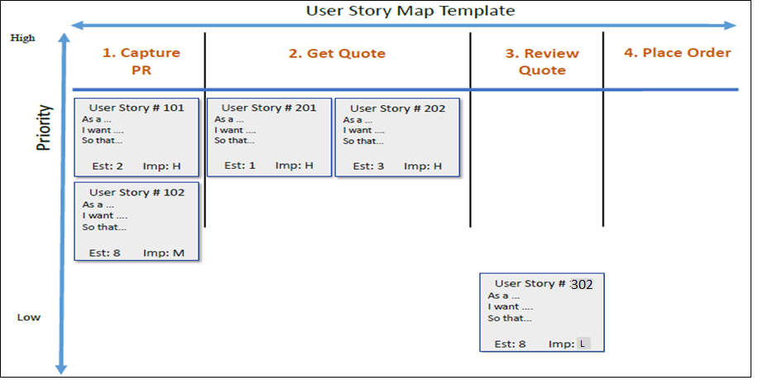
User Story Map: Case Study
Epics and Journeys
User Activities and Tasks – also called ‘Backbone’
L
User Story Map is a way to organise user stories.
Structure user stories into user or business workflow left to right, then decompose and prioritise them from top to bottom with high priority user stories in the top row, medium priority user stories in the middle rows, and low priority user stories in the lower rows.
Notes:
Sequence of Epics is called ‘backbone’
Each Epic belongs to a stakeholder (sometime called ‘persona’)
The first slice is the ‘walking skeleton’ – or first release, second slide is second release and so forth

Slide 16
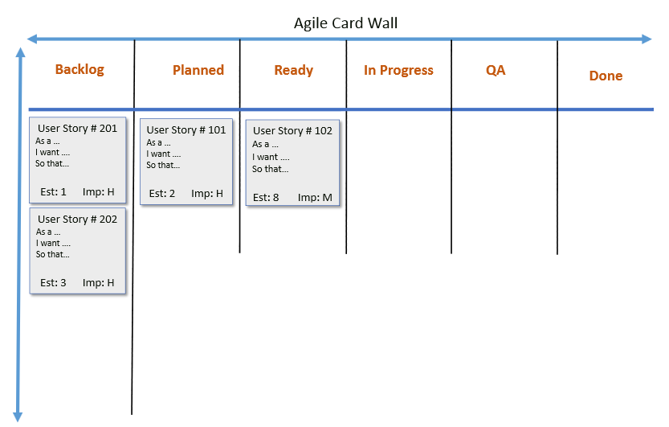
Agile Card Wall
Agile Card Wall shows the progress of the team as well as what the team is currently working on.
It is clearly visible to anybody who visits the team area, which includes stakeholders, project managers, team or anybody from the organisation.

Slide 17
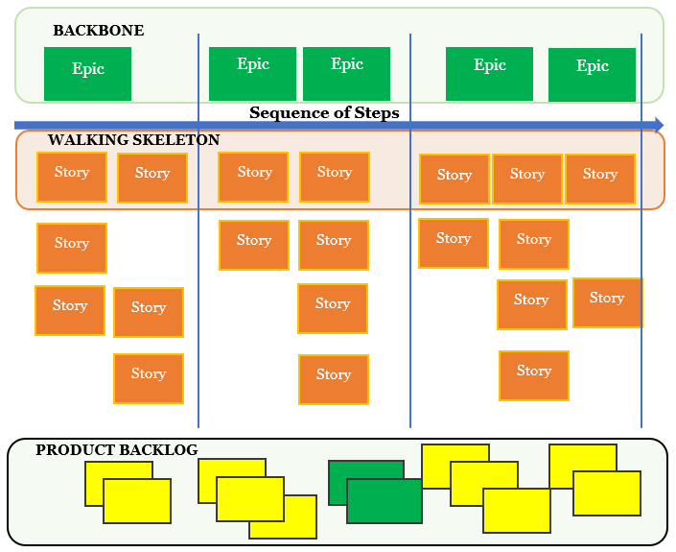
Story maps and backlog
Notes:
The product backlog is just below the story map with a set of index cards which are the backlog items.
When needed, prioritized stories can go into the story map.
Lumped-up cards in the backlog need to be ordered

Slide 18
Tools
MS Office
Rally
IBM Jazz Hub
JIRA
Mingle

Slide 19
Assessment 4 Template: Template adapted in this subject
1. Document Management
1.1 Revision History
1.2 Intended Audience
1.3 Reference Documents
1.4 Glossary
2. Introduction
2.1 Document Purpose
2.2 Project Purpose
2.3 Project Scope (use case diagram)
2.3.1 In Scope
2.3.2 Out of Scope
2.4 Assumptions
3. Functional Requirements
3.1 User Stories
3.2 User Story Map
3.3 Use Cases
3.2.1 Use Case: Name of the Use Case
3.2.2 Use Case:
3.3 Sequence Diagrams
4. Data Requirements
4.1 Class Diagram
4.2 State Transition Diagram
5. Non-functional requirements
5.1 User Interface Requirements
5.2 Security Requirements
5.3 Performance Requirements
6. Bibliography
7. Appendices
Notes:
This is the template we will use for assignment 2 to specify requirements using the agile approach.

Slide 20
Summary
Traditional IEEE SRS are now replaced with User Stories on Agile projects.
User stories must be testable and have Acceptance Criteria.
Each user story must be estimated and prioritised.

