Slide 1
31269: Business Requirements Modeling
Week 6 : Lecture- Software Requirements Specification (SRS) and Agile Development

Slide 2
Objectives
Understand the difference between agile and traditional software requirement specification (IEEE SRS).
Discover how user stories can be used to specify software requirements
Understand how user stories are estimated and prioritised.

Slide 3
Requirements Process
Negotiation, Prioritising & Management
Planning & Elicitation
Modelling & Analysis
Specification & Documentation
Validation & Inspection

Slide 4
Requirements Analysis
Last few weeks - How to analyse and model the elicited requirements?
  Process Model (BPD) and Data Model (ERD)
This week - How do we analyse and document the software requirements?
  How do we use these business processes to identify the user stories?
Topics of today:
Software Requirements Specification (SRS)
SRS content and structure
User Stories (Agile approach)

Slide 5
Software Requirements Specification (SRS)
Software Requirements Specification (SRS) is a document that provides the detailed description of what the system should do.
structured document setting out the system services and capabilities in detail.
  sometimes called as functional specification.
  often serves as a contract between the client and vendor.
To analyse the elicited requirements.
Define what designers/developers have to build.
  Validate that they are indeed what stakeholders want.
Baseline for evaluating the software.
  Support for testing (verification and validation).

Slide 6
SRS: Role and Purpose
A legal document. A contractual device for judging the completion of the specified job.
Functional device for improving the understanding of the customer’s real needs (both in business and technical terms).
So, it is a communication device that conveys an understanding between different teams in the software development process.
Used as basis for a user manual for the customer
Statement of commitment. Validation device for validating the requirements stated in a formal manner.
Used to develop test cases.
Notes:
Deliverables from each phase: How does SRS differ?
1. Legal document (sign offable) - specifies a job to be done, acts as the basis for judging completion of the job ( and hence payment)
2. Improve understanding of the customer’s real needs both in the business and technical terms - So it is a communication device that conveys an understanding between different teams in the software development process
3. In many circumstances acts as users manual or generally a document that the customer will use to understand how the delivered system fits together. It is used for generating test cases.
4. It acts as the basis for project planning and project management activities, you need a good set of requirements
5. It is a statement of commitment

Slide 7
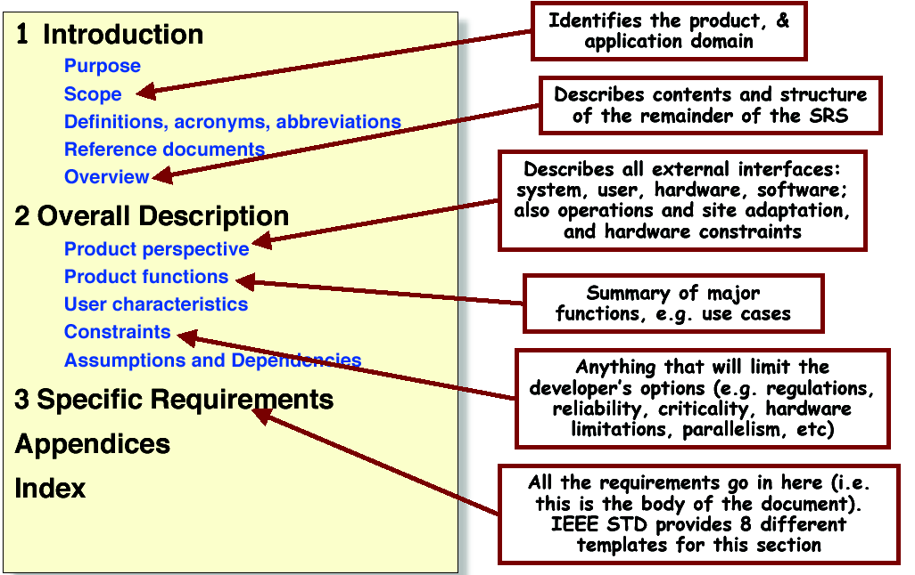
IEEE Standard for SRS
(not used in this subject, but a good read)
Source: Adapted from IEEE-STD-830-1993

Slide 8
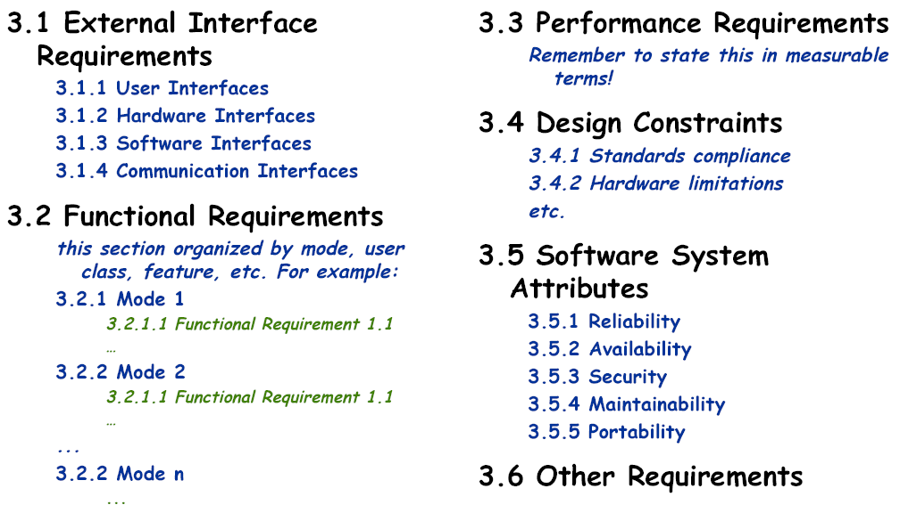
IEEE standard - section 3 example
Source: Adapted from IEEE-STD-830-1993
Notes:
Functionality
What is the software supposed to do?
External interfaces
How does the software interact with people, the system's hardware, other hardware, and software?
What assumptions can be made about these external entities?
Performance
What is the speed, availability, response time, recovery time of various software functions, and so on?
Attributes
What are the portability, correctness, maintainability, security, and other considerations?
Design constraints imposed on an implementation
Are there any required standards in effect, implementation language, policies for database integrity, resource limitation, operating environment and so on?

Slide 9
Agile SRS: Template adapted and used in this subject
1. Document Management
1.1 Revision History
1.2 Intended Audience
1.3 Reference Documents
1.4 Glossary
2. Introduction
2.1 Document Purpose
2.2 Project Purpose
2.3 Project Scope
2.3.1 In Scope
2.3.2 Out of Scope
2.4 Assumptions
3. Functional Requirements
3.1 User Story Map
3.2 User Stories and Use Cases
3.2.1 Use Case: Name of the Use Case
3.2.2 Use Case:
3.3 Sequence Diagrams
4. Data Requirements
4.1 Class Diagram
4.2 State Transition Diagram
5. Non-functional requirements
5.1 User Interface Requirements
5.2 Security Requirements
5.3 Performance Requirements
6. Bibliography
7. Appendices
Notes:
This is the template we will use for assignment 2 to document requirements using the agile approach.

Slide 10
Requirements Specification
Traditional approach using IEEE template
  Upfront and detailed
  Simple plain language requirements statements
  Structured use cases (later in Week 8)
Agile approach (used in this subject)
  Iterative and incremental
  User stories: card, conversation, confirmation
  User story map
  User story estimation and prioritisation
  User story or agile card wall

Slide 11
Agile Manifesto - Values
The Agile framework was introduced in 2001 and was named “Agile Manifesto”
We are uncovering better ways of developing software by doing it and helping others do it. Through this work we have come to value:
1) Individuals and interactions over processes and tools.
2) Working software over comprehensive documentation.
3) Customer collaboration over contract negotiation.
4) Responding to change over following a plan.
Source: https://www.smartsheet.com/comprehensive-guide-values-principles-agile-manifesto
Notes:
Promotes adaptive planning, evolutionary development, early delivery, continuous improvement, encourages rapid and flexible response to change.

Slide 12
Twelve Agile Manifesto - Principles
Customer satisfaction through early and continuous delivery
Welcome changing requirements, even late in development
Working software is delivered frequently (weeks rather than months)
Close, daily cooperation between business people and developers
Build projects around motivated individuals
Face-to-face conversation is the best form of communication (co-location)
Working software is the principal measure of progress
Agile processes promote sustainable development
Continuous attention to technical excellence and good design enhances agility.
Simplicity--the art of maximizing the amount of work not done--is essential.
Self-organizing teams
Regular adaptation to changing circumstance
Source: https://www.smartsheet.com/comprehensive-guide-values-principles-agile-manifesto

Slide 13
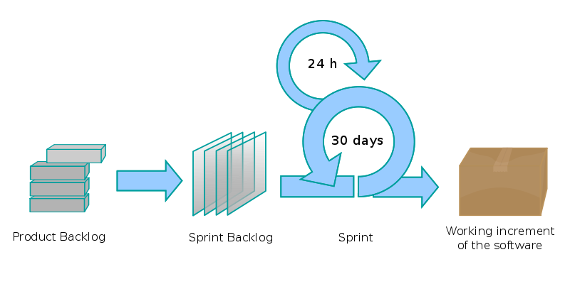
Agile System Development Process
Scrum – Iterative Process
Initial Requirements or User Stories
Detail Requirements or User Stories
Subset/portion of requirements
Source: http://en.wikipedia.org/wiki/Scrum_(development)
Notes:
Agile software development is a group of software development methods in which requirements and solutions evolve through collaboration between self-organizing, cross-functional teams. It promotes adaptive planning, evolutionary development, early delivery, continuous improvement and encourages rapid and flexible response to change. It is a conceptual framework that focuses on delivering working software with the minimum amount of work.
http://en.wikipedia.org/wiki/Agile_software_development
Scrum is an iterative and incremental agile software development framework for managing product development. It defines "a flexible, holistic product development strategy where a development team works as a unit to reach a common goal", challenges assumptions of the "traditional, sequential approach" to product development.
A key principle of Scrum is its recognition that during a project the customers can change their minds about what they want and need (often called "requirements churn"), and that unpredicted challenges cannot be easily addressed in a traditional predictive or planned manner.
Sprint
The Scrum process
A sprint (or iteration) is the basic unit of development in Scrum. The sprint is a "timeboxed" effort; that is, it is restricted to a specific duration. The duration is fixed in advance for each sprint and is normally between one week and one month, although two weeks is typical.
Each sprint is started by a planning meeting, where the tasks for the sprint are identified and an estimated commitment for the sprint goal is made, and ended by a sprint review-and-retrospective meeting, where the progress is reviewed and lessons for the next sprint are identified.
Iterative and incremental development (http://en.wikipedia.org/wiki/Iterative_and_incremental_development)
The basic idea behind this method is to develop a system through repeated cycles (iterative) and in smaller portions at a time (incremental), allowing software developers to take advantage of what was learned during development of earlier parts or versions of the system. Learning comes from both the development and use of the system, where possible key steps in the process start with a simple implementation of a subset of the software requirements and iteratively enhance the evolving versions until the full system is implemented.
Incremental development slices the system functionality into increments (portions). In each increment, a slice of functionality is delivered through cross-discipline work, from the requirements to the deployment.

Slide 14

SCRUM roles - Product owner
Represents the stakeholders and is the voice of the customer and is accountable for ensuring that the team delivers value to the business.
Defines the features of the product. Writes (or has the team write) customer-centric items (typically user stories), ranks and prioritizes them, and adds them to the product backlog.
Responsible for the profitability of the product (ROI). Prioritizes features according to market value in the Product Backlog Items.
Adjusts features and priority every iteration, as needed.
Accepts or rejects work results.

Slide 15
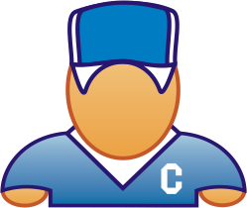
The ScrumMaster
Is a Facilitator.
Responsible for enacting Scrum values and practices.
Removes impediments and shields the team from external interferences.
Ensure that the team is fully functional and productive.
Enables close cooperation across all roles and functions.

Slide 16





The Team
Typically 5-9 people
Cross-functional:
  Programmers, testers, user experience designers, etc.
The development team is responsible for delivering potentially shippable increments (PSIs) of product at the end of each sprint (the sprint goal).
Teams are self-organizing
  Ideally, no titles but rarely a possibility
Membership should change only between sprints

Slide 17
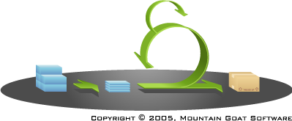

Product Backlog
The requirements/features
A list of all desired work on the project
Collection of user stories: a wish list of all the user stories of a product.
Ideally expressed such that each item has value to the users or customers of the product
This is the product backlog

Slide 18
A Sample Product Backlog
Backlog item | Estimate
Allow a guest to make a reservation | 3
As a guest, I want to cancel a reservation. | 5
As a guest, I want to change the dates of a reservation. | 3
As a hotel employee, I can run RevPAR reports (revenue-per-available-room) | 8
Improve exception handling | 8
... | 30
... | 50

Slide 19
Sprint Backlog
Individuals sign up for work of their own choosing - Work is never assigned
Estimated work remaining is updated daily
Create sprint backlog (tasks) from product backlog items (user stories / features)
A list of tasks required to complete/implement the user stories/features.
Tasks
Mon
Tues
Wed
Thur
Fri
Code the user interface
8
4
8
Code the middle tier
16
12
10
4
Test the middle tier
8
16
16
11
8
Write online help
12
Write the foo class
8
8
8
8
8
Add error logging
8
4

Slide 20
SRS: An agile approach - User Story
User stories are short, simple descriptions of a feature or functionality told from the perspective of the user/person who desires the new capability –that are valuable to either a user of the software or the customer of the software.
(http://www.gatherspace.com/static/use_case_example.html; http://www.mountaingoatsoftware.com/agile/user-stories)

Slide 21
User Story Template and Examples
User Stories (e.g. feature, epic, scenario) follow a simple template:
  "As a -role-, I want -goal/desire- so that -benefit-“
  Three parts to a user story: who, what and why
  As a <type of user>, I want/need/can <some goal> so that <some reason>.
    (http://www.mountaingoatsoftware.com/topics/user-stories)
User Story Examples:
  As a student, I want to download BRM subject lecture notes from the Canvas System so that I can prepare for the final exam.
  As a lecturer, I want to upload BRM subject lecture notes on the Canvas System so that I can deliver lecture.
  As a passenger, I want to buy a ticket via Online Ticketing System so that I can travel from one city to another city in Australia.
  As a user closing the application, I want to be prompted to save anything that has changed since the last save so that I can preserve useful work and discard erroneous work.

Slide 22
User stories: Purpose
User Story is not a whole requirement,
  It serves as placeholders for conversations about the users’ detailed needs. It is a starting point of conversation and confirmation between the analyst and stakeholders (e.g. product owner or process owner).
  Based on the User Story, you have further conversations with the user or proxy user and identify the additional details. The Product Owner has further conversations with developers.
  they strongly shift the focus from writing about features to discussing them. These discussions are more important than whatever text is written in user stories.
  Is planned for project releases and iterations.
  Is written on a story card, index cards or sticky notes.
  stored in a shoe box, and arranged on walls or tables to facilitate planning (releases and iterations) and discussion.
http://www.gatherspace.com/static/use_case_example.html

Slide 23
Assignment 2 Template: Template adapted in this subject
1. Document Management
1.1 Revision History
1.2 Intended Audience
1.3 Reference Documents
1.4 Glossary
2. Introduction
2.1 Document Purpose
2.2 Project Purpose
2.3 Project Scope (use case diagram)
2.3.1 In Scope
2.3.2 Out of Scope
2.4 Assumptions
3. Functional Requirements
3.1 User Stories
3.2 User Story Map
3.3 Use Cases
3.2.1 Use Case: Name of the Use Case
3.2.2 Use Case:
3.3 Sequence Diagrams
4. Data Requirements
4.1 Class Diagram
4.2 State Transition Diagram
5. Non-functional requirements
5.1 User Interface Requirements
5.2 Security Requirements
5.3 Performance Requirements
6. Bibliography
7. Appendices
Notes:
This is the template we will use for assignment 2 to specify requirements using the agile approach.

Slide 24
Summary
SRS has many roles and purposes
SRS has different audiences
Good SRS are hard to write: they have to conform to some quality attributes
There are different structures one can use for writing SRS
Traditional IEEE SRS are now replaced with User Stories on Agile projects.
Each user story form a big part of the SRS in an agile approach.

Slide 25
Conclusion
THIS WEEK
  Topic: “Software Requirements Specification (SRS) and Agile Development ”
  Quiz 6 – SRS and Agile Development (3.5 marks)
NEXT WEEK
Topic: “Agile Development with User Stories ”
  Quiz 7 – Agile Development and User Stories (3.5 marks)

