Slide 1
31269: Business Requirements Modelling
Week 5 : Lecture - Data Modelling

Slide 2
Objectives
Appreciate how modelling techniques can help understand the working of business systems
Discover how modelling can be used to specify system and user requirements
Discover how Entity Relationship Diagram (ERD) can be used to model, analyse and understand the data requirements of an organisation

Slide 3
Topic
Requirements Analysis & Modelling
  Data Modelling using ERD

Slide 4
Requirements Process
Negotiation, Prioritising & Management
Planning & Elicitation
Modelling & Analysis
Specification & Documentation
Validation & Inspection

Slide 5
Requirements Analysis
Previously - How are the requirements collected?
  Interviews, workshops, prototypes, surveys, observation, document review, etc.
This Week - How do we analyse and model these requirements collected so far?
  Data Modelling (Entity Relationship Diagram)

Slide 6
Data Model
A data model:
  identifies the entities or objects that the organisation will need to hold data about.
  identifies the data that must be captured, stored and retrieved.
  describes the data in a logical (conceptual) manner.
  creates a graphical representation of the entities, and the relationships between entities.
  Focuses on what data is required and how it should be organised.
  is a plan for building a database.

Slide 7
Entity Relationship Diagram (ERD) as a Data Model
ERD as a “Data Model” is
  an abstraction of the data the organisation works with
  a way to organise the data of interest into a standardised structure
ERD is a graphical representation of the data requirements for a database.
ERD is a graphical representation of the entities relevant to a chosen problem domain, the relationships between them, and their attributes.
The Entity-Relationship Model is a conceptual data model that views the real world as consisting of entities and relationships.
The basic constructs/parts of an ERD are:
  Entities are anything about whom you want to record or store data; concepts, real or abstract, about which information is collected.
  Relationships are associations between the entities.
  Attributes are properties which describe the entities.
  Cardinality is a numerical relationship between two entities.
  Keys are the basis of the relationship between entities and are used to identify another entity that the current one wishes to be associated with.

Slide 8
Why ERD?
Describe data requirements of the business
Represent the business rules that apply to an organizations data
Confirm business and data requirements and provide direction to the architecture and design team as they move forward with database design

Slide 9
ERD vs Process Model
Focus of ERDs is to capture the important data in the organisation, whereas the focus of Process Models is to capture the business processes in an organisation.
ERDs focus on the data to be stored and retrieved in an efficient manner. It shows the relationship between the data. Whereas a process model shows the business processes so that the processes can be analysed and improved.

Slide 10
Example of an ERD
Network structure
Entities are located at the nodes of the network
Connections between the nodes define the relationships and cardinality
FACULTY
OFFERS
SUBJECT
STUDENT
ENROLS IN

Slide 11
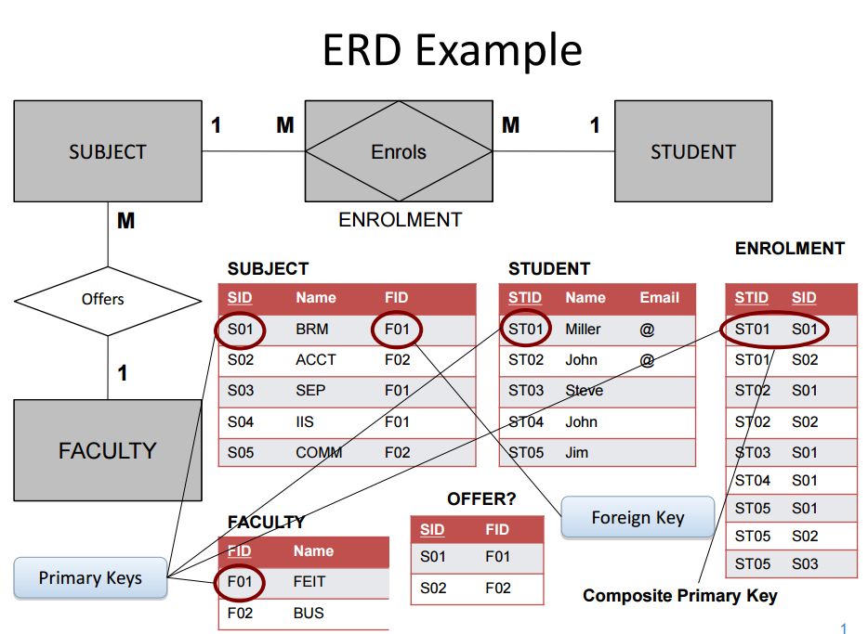
Example of an ERD and a Database
This is an example of an ERD. The database experts in your IT development team will convert our ERD into a proper database. We work with them.
This is a database showing its tables. It is not an ERD. Your database experts will convert the ERD into these tables in a database.

Slide 12
Entity Types
An entity is a place, person, thing or an event or a concept about which we wish to record information.
Entities will become a table in a database, one table for each entity.
Entities can be classified into different types.
Entity Types classify things about which we want to store data: e.g.
  Places – e.g. Country, Park, Shopping Centre
  People – e.g. Customer, Student, Employee
  Things – e.g. Product, Vehicle, Building
  Events – e.g. Purchase, Accident, Treatment
  Concepts – e.g. Law, Crime, Tax, Fault
Hint: Look for NOUNS to identify Entities
Identify the entities/nouns in specification, requirements documents, interview
transcripts, etc. that are important to the business.
Notes:
Classification or types of Entities

Slide 13
Attributes
All Entities have attributes (properties) that describe the characteristics or are a description of an entity. For example, a Student entity has Student Id, Name, Address, etc., as its attributes.
All instances of an Entity type/set have the same attributes. For example, all Students will have student id, name, address , etc attributes.
However the values of the Attributes will vary for each instance. For e.g., the student ids and student names will be different for each student instance.
Attributes will become columns (fields) in a table in a database.

Slide 14
Attributes: examples
Examples:
Student (Entity): Student Id, Name, DOB, etc
Order (Entity): Order number, Quantity, Amount, etc
Staff (Entity): Staff Id, Name, Department, etc
Do not make an exhaustive list of attributes for each entity. Instead store only those attributes that are important to the organisation and the ones that are in scope of that particular project.
Each instance of an entity (for example, each individual student instance or each individual order) will become a row or record in a table in a database. So, in a database, a row/record contains the data for one student (or one order, or one staff member).

Slide 15
Entity Keys
KEYS
  are the basis of the relationship between entities
  is a logical (and physical) pointer
  is used to identify another entity that the current one wishes to be associated with
Finding and identifying keys is an important step in understanding requirements for an information system.

Slide 16
Entity Keys – Primary Key
Primary Key: an attribute or group of attributes that uniquely identifies an instance of an entity.
  For example, Student Id is a primary key since it identifies an individual Student instance.
  Another example; an Employee Id is a primary key for the Employee entity as it uniquely identifies each employee.
The Primary key must be unique
  absolutely no duplicates
  Very often are numeric
    have to be created to be unique

Slide 17
Entity Keys – Foreign Key
Foreign Key: are attributes that are used to identify an instance of another Entity Type.
When a Primary Key of one entity is used in another Table, it is referred to as a 'Foreign Key'. For eg the primary key Department Id being used in Employee table
Employee table
    Employee Id (Primary key)
    Name
    Address
    Drivers licence
    Tax File Number
    Department Id (Foreign key)
Department table
    Department Id (Primary key)
    Department Name
    Location

Slide 18
Relationship
A Relationship connects entities to each other. It is an association among two or more entities. A relationship is indicated by a verb connecting two or more entities.
Relationships are significant business associations between entities.
Examples:
  Each faculty offers many subjects
  Each student enrols in many subjects
FACULTY
OFFERS
SUBJECT
STUDENT
ENROLS IN

Slide 19
Cardinality
Cardinality is a
  business rule to indicate how many entities may participate in the given relationship between entities.
  way to specify the number of occurrences of one entity in a data model that are linked to a second entity.
  way to specify how many times one instance of entity type can participate in relationships with the instances of another entity type.
  Numerical relation
    One department has many employees (1:M)
    One subject has one lecturer (1:1)
    Many tutors teach many subjects (M:N)

Slide 20
Cardinality Types
Types :
  1:0 (Employee : Department) An Employee may or may not be assigned to a Department
  1:1 (must be one – Manager : Department) Each Manager heads one Department and vice versa
  1:N (Company : Addresses) Each company has many addresses
  M:N (Tutor : Subject) One Tutor teaches many Subjects, one Subject has many Tutors
  M:N (Student : Subject) One Student enrols in many Subjects, one Subject has many Students

Slide 21
M:N Relationships (Associative Entity)
If you have a M:N (many to many) relationship you will need to create a new entity called Associative Entity (ENROLMENT) between the two entities that have M:N relationship.
M N
The new Associative entity (bridge entity) in most cases will have a composite primary key.
ENROLMENT
1 M M 1
enrol in
STUDENT
SUBJECT
STUDENT
enrol in
SUBJECT

Slide 22
Composite Primary Keys
Mainly used for M:N (many to many) relations
A composite primary key uniquely identifies Student Subject attributes
Student Subject Relationship (is called “Enrolment” – Associative Entity)
  Student ID (part of Composite Primary Key)
  Subject ID (part of Composite Primary key)
  Semester
  Mark
  Grade

Slide 23
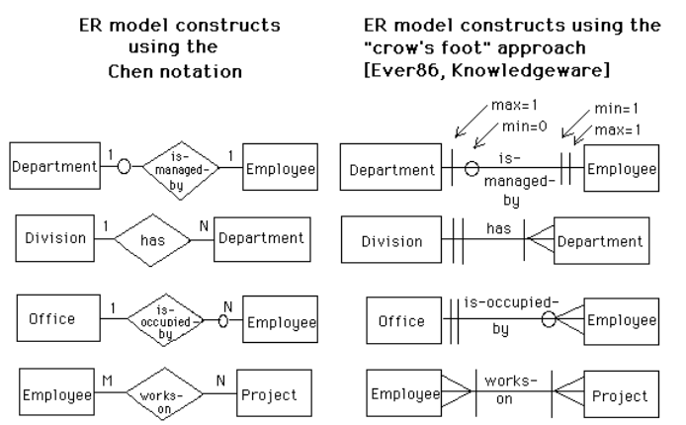
Chen and Crows Foot Notations for ERD
Note: You can use either notation, but be consistent and do not use both notation styles in the same diagram.

Slide 24
An ERD Example (first draft)
M
1
PERSON
PART
supplies
SUPPLIER
M
N
M
N
stored in
has
manage
USE
1
M
WAREHOUSE
1
M
DEPARTMENT
PROJECT
ERD often contains many entities and relationship sets

Slide 25
Associative Entity and Composite Keys
PERSON-ID NAME ADDRESS
Attributes specific to the Person entity
PERSON
1
M
Composite Primary key
Works
For
PERSON-ID PROJECT-ID TIME-SPENT
ASSIGNMENT
WORK
M
Attributes specific to the relationship
1
PROJECT
PROJECT-ID START-DATE BUDGET
Attributes specific to the Project entity

Slide 26
Steps for Drawing Entity Relationship Diagram
Identify the entities/nouns in specification, requirements documents, interview transcripts, etc
Identify the attributes for each entity
Identify the relationship between entities
  Name with a verb such that the diagram reads in simple sentences
Identify cardinality for each relationship between entities as 1:1, 1:M, M:N, 0:1, 0:N
Identify keys (primary and foreign keys) for each entity
  Identify the attributes -The attributes(s) that uniquely identifies the entity
  Identify the composite primary keys, if any associative entities exist

Slide 27
Data Dictionary
Is a centralized repository of information about data such as meaning, relationships to other data, origin, usage, and format.
A file that defines the basic organization of a database.
A data dictionary contains a list of all files in the database, the number of records in each file, and the names and types of each field.
Contains a read-only set of tables that provides information about the database.

Slide 28
Data Dictionary Example
Can hold letters and numbers (alpha numeric)
Ref. | Data Element | Format | Length | Description
01. Department
DE-1001 | Department ID | Number | 3 | Primary Key, Mandatory data field, must be numeric and must not be less than 3 digits i.e. 101
DE-1002 | Department Name | Varchar | 20 | Name of the department. Sales, Marketing, Procurement Management
02. Staff
DE-2001 | Staff ID | Numeric | 6 | Primary Key, Mandatory data field, must be numeric and must not be less than 6 digits i.e. 100001
DE-2002 | Staff Name | Varchar | 50 | Name of the Staff as Last Name, First Name i.e. Smith, John
DE-2003 | Department ID | Numeric | 3 | Foreign Key, Refer to the Department ID attribute in the Department entity/table
03. Item
DE-3001 | Item ID | Varchar | 10 | Primary Key, Mandatory data field, must be alpha-numeric and must not be less than 10 digits i.e. COM-000001, LAT-000002
DE-3002 | Item Name | Varchar | 30 | Name of the Item as Computer, Laptop etc.
04. Purchase Request (PR)
DE-4001 | PR ID | Varchar | 10 | Primary Key, Mandatory data field, must be alpha-numeric and must not be less than 10 alpha-digits i.e. PR-0000001
DE-4002 | PR Date | Date | 8 | Mandatory field, must be in the following format dd/mm/yy
DE-4003 | Staff ID | Numeric | 6 | Foreign Key, Refer to the Staff ID attribute in the Staff entity/table
05. PR Detail
DE-5001 | PR ID | Varchar | 10 | Composite Key (part of a composite key), Refer to PR ID in the PR entity/table
DE-5002 | Item ID | Varchar | 10 | Composite Key (part of a composite key), Refer to Item ID in the Item entity/table
De-5003 | Quantity | Numeric | 3 | Mandatory data field, must be numeric and must not be less than 0

Slide 29
Database Design
Direct database design
  Entities are implemented as relational tables. For example, an Employee table.
  Properties of Entities are implemented as columns (attributes) in the relational tables. For example, Employee Id, Name, Designation, etc.
  Composite primary key of an associative entity is a primary key of a new relational table, primary key is also a foreign key here.

Slide 30
Summary
ERDs are the basis for the database design
ERDs capture the data requirements of the system
ERDs are structured around unique keys

Slide 31
Conclusion
THIS WEEK
  Topic: “Data Modelling”
  Quiz 5 – Data Modelling (3.5 marks)
NEXT WEEK
Topic: “Software Requirement Specification (SRS) and Agile Development”
  Quiz 6 – Requirements Specification (3.5 marks)

