Slide 1
31269: Business Requirements Modelling
Week 1 Lecture – Introduction to Business Requirements Modelling
What is Business Requirements Modelling?
Role of a Business Analyst (BA)
References for this topic
    Mastering The Requirements Process - Chapter 1
    BABOK Guide Version 3.0 - Chapter 1

Slide 2
31269 Business Requirements Modelling
Welcome!
Subject Outline and processes
  Refer the PDF document on Canvas online. Read it thoroughly to understand what is involved in this subject and how is it going to be assessed.
Understand what is involved in the subject Business Requirements Modelling (BRM)
Understand the role of a Business Analyst (BA)

Slide 3
Pre work for this week
THIS WEEK :
  Pre-Work for this week:
    a) Read Subject Outline and Week 1 Presentation
    b) Watch the reference videos available on Canvas.
    c) Prepare a one page summary for - Role of a BA and BA Skills
  Quiz 1 – Practice Quiz: What is BRM?
  No tutorial classes this week. Tutorials start next week.

Slide 4
A BA Scenario
So you want to be an IT business analyst…..
UTS would like to offer BScIT course online. They need to upgrade their existing system or develop new system to support the online course.
You are assigned as a business analyst to this project
advisor and mediator between the business (who are these) and IT.
You need to capture and model requirements or changes for the existing/new system to support online course delivery
You need to provide estimates for the requirements task
You need to provide estimates for the whole project development.
What would you do………………………………….?
A BA project is a response to a change in the world!

Slide 5
Subject Learning Objectives (SLOs)
  Upon successful completion of this subject students should be able to:
  Identify stakeholders, understand their needs, and learn what/how to capture requirements in the system development process.
  Apply modelling and systems analysis techniques that help understand the working of a business system.
  Document and specify various requirements via Software Requirements Specification (SRS).
  Develop various models using a range of systems analysis techniques to analyse and specify system and user requirements.
  Work effectively in a small team.

Slide 6
Who are Stakeholders?
Stakeholders
  An individual, team or organisation who have interest in, or participate in the development of requirements and relative software system
  Stakeholders have different roles based on their interest and responsibility in an organisation
  Project Manager, Business Analyst, Sponsor, End User, Owner, Subject Matter Expert, etc.
  Failure to discover all stakeholders can mean failure to discover all their needs.
  More details on Stakeholders in next week’s lecture.
Notes:
Failure to discover all stakeholders can mean failure to discover all their needs. Find all parties who will be affected by the product, and find their requirements/needs.
For more details see BABOK Guide Chapter1.
More details about this topic in Week2 Seminar (next week).

Slide 7
What are Requirements?
A requirement is:
  a condition or capability needed by a stakeholder to solve a business problem or achieve an objective (BABOK v2.0).
  A requirement is a usable representation of a need. Requirements focus on understanding what kind of value could be delivered if a requirement is fulfilled. The nature of the representation may be a document (or set of documents), but can vary widely depending on the circumstances (BABOK v3.0).
  Or
  a statement of need that must be met by a particular product or service to solve a business problem or achieve an objective (Robertson & Robertson 2012)

Slide 8
Requirements Examples
Examples
  a customer must be able to place an order for a book on the phone in less than 5 minutes between 9:00 AM and 5:00 PM (Monday to Friday).
  Or/And
  a customer must be able to place an order for a book via a 24/7 online system in less than 3 minutes
  Requirement = People + Process + Data + Software System + Quality + Assumption + …

Slide 9
Why Requirements?
Requirements are needed for:
  The world is always changing!
  developing a new or altering an existing business process, service or product e.g., order management process
  developing a new or altering an existing software system e.g., online order processing system

Slide 10
What is Modelling?
Model
  Is an abstraction..
  is a representation of a real world entity or object or subject of interest (TOGAF 9.1) (The Open Architecture Enterprise Framework) standard. Examples of models are a business process model, data model, software system model, etc.
  AS IS (Current State) and TO BE (Future State) Models

Slide 11
What is Business Requirements Modelling?
Business Requirements Modelling:
Involves understanding the client’s business problems and needs (requirements), and developing a set of diagrams known as requirements models, each of which focuses on a different aspect of the users' needs (business needs). e.g.
  People or Stakeholders (Modelling)
  Process (Modelling)
  Data (Modelling)
  Object Oriented Modelling
  Recall:
  Requirement = People + Process + Data + Software System + Quality + Assumption + …

Slide 12
Business Requirements Models –
Stakeholders Modelling
Example: People or Stakeholders List/Map/Register
  Source: https://www.youtube.com/watch?v=BkUCcJwwvAQ&t=373s
  More details next week
  Source: https://www.youtube.com/watch?v=BkUCcJwwvAQ&t=373s
  More details in next Seminar
Name | Position | Project Role | Contact Information | Level of Interest | Level of Influence | Potential Management Strategies
Mike Sundby | VP of HR | Project Champion | msundy@globalconstruction.com | High | High | Mike is very outgoing and visionary. Great traits for a project champion. He is concerned about financials and has an MBA. Keep him informed and ask for his advice as needed.
Lucy Camerena | Training Director | Project Sponsor | lcamerena@globalconstruction.com | High | High | Lucy has a PhD in Education and knows training at this company. She is very professional and easy to work with, but she can stretch out conversations. Make sure she reviews important work before showing it to other managers.
Ron Ryan | Senior HR staff member | Led the Phase I project | rryan@globalconstruction.com | Medium | Medium | Ron led the phase I project and is upset that he was not asked to lead this phase II project. He's been with the company for over 20 years and can be a good resource but he can also sabotage the project. Ask Lucy to talk to him to avoid problems. Perhaps give him a small consulting role on the project.
Xxx Yyyy
Yyy Zzz

Slide 13
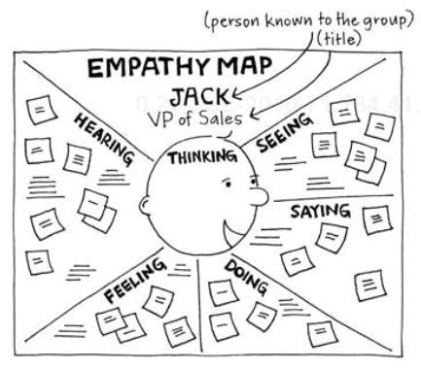
Business Requirements Models –
Stakeholders Modelling
Example: Empathy Map
  Source: http://www.cooper.com/journal/2014/05/persona-empathy-mapping

Slide 14
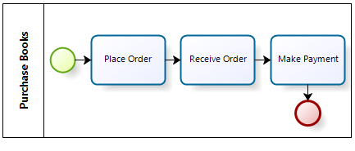
Business Requirements Models –
Process Modelling
Process (Modelling): is the analytical representation or illustration of an organization’s business processes.
Time sequencing is at the heart of BPM
It is used to map out an organization’s current (or “as-is”) processes to create a baseline for process improvements and to design future (or “to-be”) processes
  Example (Business Process Model)
  More details in Week 4 Seminar

Slide 15
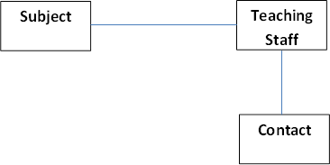
Business Requirements Models –
Data Modelling
Data models model people, things, places and concepts about whom data is required.
Data model identifies the entities or objects that the organisation will need to hold data about
  Example (Entity Relationship Diagram ERD)
  More details in Week 5

Slide 16
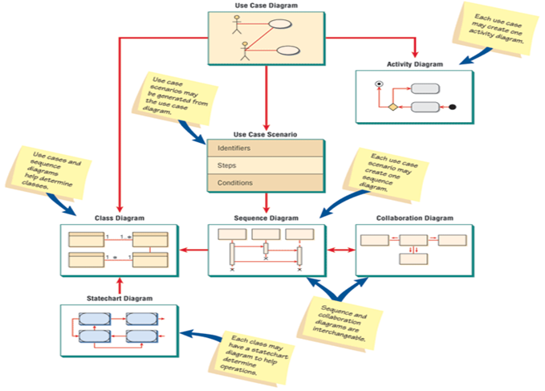
Business Requirements Models –
Object Oriented Modelling
Object Oriented Models (OO models) using Unified Modelling Language (UML)
Examples of OO models are:
  Use Case Diagram
  Class Diagram
  Sequence Diagram
  State and Event Diagrams, etc
  More details in Weeks 8 to 11

Slide 17
What is Business Analysis?
The world is constantly changing!
Business analysis is the practice of enabling change in an enterprise by defining its needs and rationale for change, and then design, describe and recommend solutions that deliver value to its stakeholders.
Business Analysis can be used to understand the current state, to define the future state, and to determine the activities required to move from the current to the future state.
  Source: BABOK Guide, Section 1.2

Slide 18
Role of a Business Analyst (BA)
BAs do not ask “what are your requirements…? Rather a ‘surgical’ analysis
Tasks/Activities
  Business/domain knowledge: Understand what does the business do
  Understand problems and needs of business (requirements)
  Manage stakeholders and communication with them
  Modelling: Develop and communicate business requirements models
  Review business requirements with stakeholders
  Obtain Sign Off
  Recommend software solutions, alternatives and cost estimates
  Engage in Software testing

Slide 19
Business Analyst (BA) Skills/Competencies
BA Skills
  Analytical Thinking and Problem Solving Skills
    Creative thinking, Decision making, Learning, Problem solving, Systems thinking, Conceptual thinking, Visual thinking
  Behavioural Characteristics/Skills
    Ethics, Accountability, Trustworthiness, Organisation and time management, Adaptability (part of ACS accreditation)
  Business Knowledge
    Business acumen, Industry knowledge, Organisation knowledge, Solution knowledge, Methodology knowledge
  For more details, see section 9 of BABOK Guide.

Slide 20
Business Analyst (BA) Skills/Competencies (2)
  Communication Skills
    Verbal Communication, Non-Verbal Communication, Written Communication, Listening
  Interaction Skills
    Facilitation, Leadership and Influencing, Teamwork, Negotiation and Conflict Resolution, Teaching
  Tools and Technology
    Office Productivity Tools and Technology, Business Analysis Tools and Technology, Communication Tools and Technology

Slide 21
Techniques used by a BA
  Interviews
  Surveys/Questionnaires
  Requirements Workshops
  Observation
  Prototyping
  Modelling:
    Stakeholders Modelling
    Process Modelling via BPMN 2.0
    Data Modelling via ERD and Data Dictionary
    Object Oriented Modelling
      Use Case Diagram, Class Diagram, Sequence Diagram, State Transition Diagram, etc
  Watch “Intro to Business Analysis” https://www.youtube.com/watch?v=XsKdzHVEXig

Slide 22
Conclusion
NEXT WEEK
  Topic: Requirements Process
  Prework Quiz 2 - Requirements Process (3.5 marks)
  Pre-Work for Tutorial:
    Watch the reference videos available on Canvas
    Read tutorial notes before the start of your tutorial class.

