Slide 1
Thermal Physics part 2
Prof. Charlene Lobo
Resources:
Halliday, Resnick and Walker, “Fundamentals of Physics – 10th edition” Wiley. This is your assigned text. (HRW)
Available free at the library.
https://ebookcentral.proquest.com/lib/uts/detail.action?docID=3059079&pq-origsite=primoLinks to an external site.

Slide 2
Ideal Gas Equation
Measurements of P, V, T and n of gases show:
Volume is proportional to n, number of moles, when pressure and temperature are kept constant.
Volume is inversely proportional to absolute pressure, p when temperature and number of moles are constant.
Pressure is proportional to temperature when volume and number of moles are kept constant.
p is in Pa (N/m²), T in K, V is in m³
R= 8.314 J mol⁻¹ K^{-1,} 1 atm=1.01325x10⁵ Pa

Slide 3
pV diagrams of ideal gases
P-V diagrams represent the change in pressure with volume of a gas at constant temperature, T_{n}. Each curve is called an Isotherm (meaning ‘constant temperature’).
P-V diagrams that do not obey the Ideal Gas Equation
Below isotherm T_{C}, a flat region occurs
where material can be compressed
with no pressure change.
At this point, the gas undergoes a phase change (
(condenses to liquid).

Slide 4
Problem 1
How many moles of gas are contained in an 11.0 L container at a pressure of 0.600 atm and temperature of 42.0 °C?

Slide 5
Ideal Gas Equation
mass gas (m_{total}) = moles (n) × molecular weight (M)
For a constant mass (constant n)
Standard Temperature and Pressure (STP)
Defined to be a temperature of 0 °C = 273.15 K and pressure of 1.013 × 10⁵ Pa
(=1 atmosphere=760mm Hg).
A mole of any ideal gas at STP has a volume V = 0.0224 m³ = 22.4 L

Slide 6
Problem 2
A typical engine has a 9.00 to 1.00 compression ratio (i.e.gas is compressed to 1/9 original volume). The initial pressure is 1.00 atm and initial temperature 27.0 °C. If the pressure after compression is 21.7 atm, find the final temperature.

Slide 7
Dalton’s Law of Partial Pressures
“ For a mixture of gases in a container, the total pressure exerted is the sum of the pressures that each gas would exert if it were alone.”
Expressed mathematically:
Assuming each gas behaves ideally, we can use the ideal gas law to calculate the partial pressures:

Slide 8
Dalton’s Law of Partial Pressures
So Dalton’s Law of Partial Pressures becomes:
where n_{Total} is the sum of the numbers of moles of the various gases.

Slide 9

Temperature and molecular motion
Temperature is in fact a fundamental physical property of a system, which can be defined in terms of probability and statistics of the very large number of atoms or molecules that make up the system.
This field is known as Statistical mechanics.
Notes:
Play and discuss Boltzmann gas simulation.

Slide 10
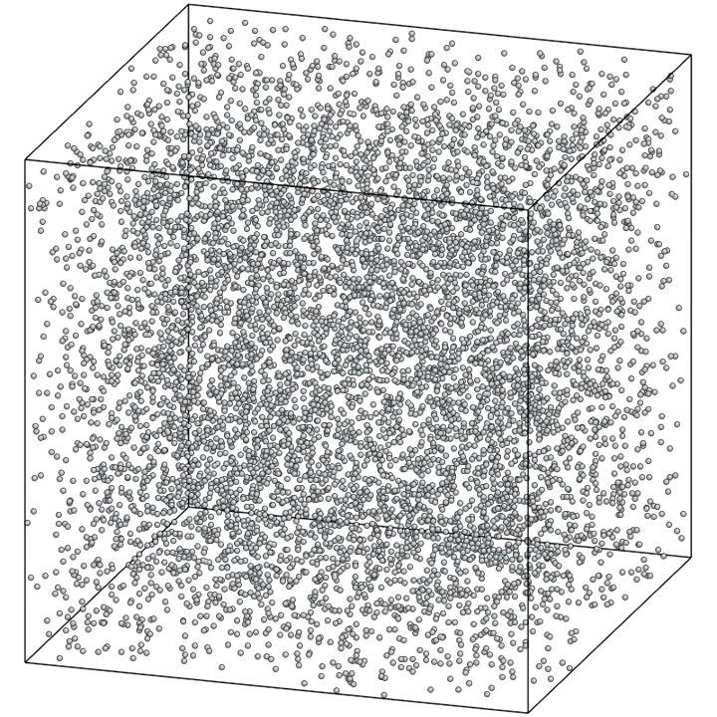
Kinetic-Molecular Model of an Ideal Gas
The kinetic-molecular model represents the gas as a large number of particles bouncing about in a closed container.
Model Assumptions
Container, volume V, contains N molecules of mass m.
The molecules behave as point particles i.e. they are small compared to the distance between them.
Molecules are in constant motion, obey Newton’s Laws and have elastic collisions with the container walls.
The container walls are rigid, infinitely massive and do not move.

Slide 11
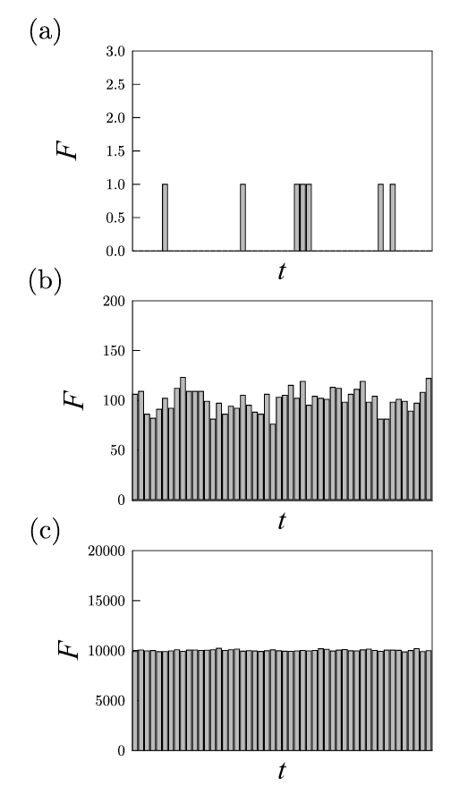
Thermodynamic limit
When the number of particles (eg. gas molecules) in a system approaches infinity, macroscopic properties such as pressure, temperature, can be regarded as constant.
This is known as the thermodynamic limit.
The pressure of a gas on a box wall with area A is the sum of the forces exerted by all of the individual molecules, leading to the expression P=F/A
Force on a roof as a function of time due to falling raindrops.
Notes:
Add simulation of Maxwell-Boltzmann distribution, https://scipython.com/blog/the-maxwellboltzmann-distribution-in-two-dimensions/

Slide 12

Mean kinetic energy
The mean kinetic energy of a gas molecule is given by:
This means that the mean kinetic energy of a gas molecule is only dependent on temperature.
Notes:
Add simulation of Maxwell-Boltzmann distribution https://scipython.com/blog/the-maxwellboltzmann-distribution-in-two-dimensions/

Slide 13
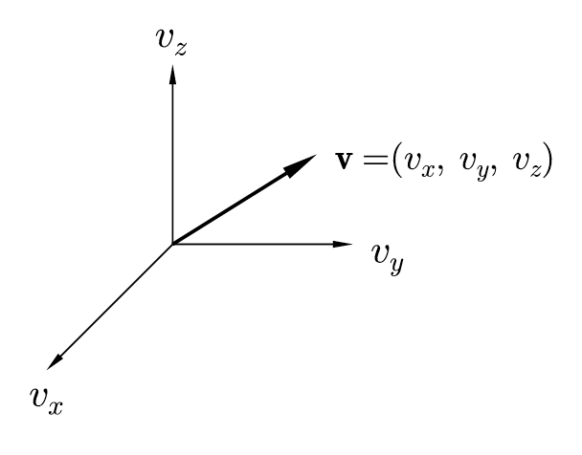
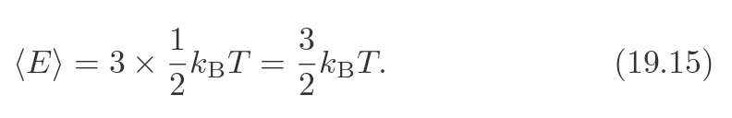
Example-Kinetic energy of monatomic gases
Question: Calculate the mean kinetic energy in eV at room temperature of a gaseous (a) He atom, (b) Xe atom, (c) Ar atom and (d) Kr atom.
[Hint: do you have to do four separate calculations?]
Answer: These are all monatomic gases so only have translational kinetic energy. The mean energy is:
Evaluating this at T=20C (293 K) gives:
<E>= (1.5.1.38x10⁻²³.293) J
= 6.06x10⁻²¹ J
= 6.06x10⁻²¹/1.602x10⁻¹⁹ eV
= 0.0378 eV

Slide 14
Heat Capacities of Monatomic Gases
Given the kinetic energy, we can now derive the heat capacity of a monatomic gas.
Given molecule motion in only one direction (translational), and for a small temperature change, dT:
Here, C_{v} is the molar heat capacity at constant volume. This is the amount of heat required to produce a 1K temperature rise at constant volume (units J/mol.K).
This is the same for all monatomic gases!

Slide 15
Signs for Heat and Work in Thermodynamics
The energy flows in any thermodynamic process are described in terms of:
Quantity of heat, Q, added to the system
The work, W, done by the system.
Q and W can be positive, negative or zero
 | Positive | Negative | Zero
Q | Heat flow INTO system | Heat flow OUT of system | No heat flow
W | Work done BY (gas) system against surround (energy leaves system) | Work done ON THE GAS by surrounds (energy entering system) | No work done

Slide 16
Internal Energy (U) and First law of Thermodynamics
Matter consists of atoms and molecules made up of particles (electrons etc) having kinetic and potential (not gravitational) energies. The internal energy U of a system is roughly the sum of the kinetic energies of the particles and the potential energies of interaction among them.
‘The change in internal energy of a system during any thermodynamic process depends only on the initial and final states, not on the path taken.’
ΔU=U₂ – U_{1.}
‘The change in internal energy of a system is equal to the heat added minus the work done by the system’. ΔU = Q – W. This is the 1st Law of Thermodynamics.
The First Law can also be written as:
U₂ – U₁ = ΔU = Q – W or Q= ΔU + W

Slide 17
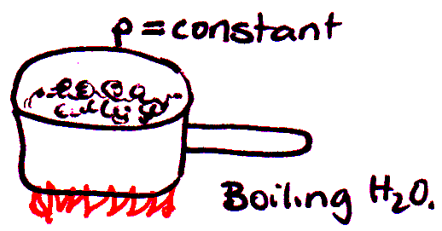
Classes of Thermodynamic Processes
Isobaric Processes: a constant pressure process. ΔU , W and Q are all non-zero.
W = p(V₂ – V₁)
Isochoric Processes: constant volume, e.g. heating a gas in a closed container
=> W = 0
U₂ – U₁ = ΔU = Q
Isothermal Process: constant temperature process. Heat flow is slow enough to keep temperature constant. Generally ΔU , Q, nor W are non-zero.
Adiabatic Processes: has no heat transfer in or out of the system Q = 0
(

Slide 18
Graphic Representation of Thermodynamic Processes

Slide 19
Work done during volume changes
Consider a quantity of gas enclosed in a cylinder with a movable piston (used in internal – combustion engines, steam engines, compressors etc)
work done in a
volume change

Slide 20
Calculating Work from Area under PV diagrams
Work done= area under the PV curve
System (gas) undergoing expansion dV > 0 W is positive | System undergoing compression dV < 0 W is negative | Expansion at constant pressure dV > 0

Slide 21
Cyclic processes and isolated systems
Cyclic processes: a process which eventually returns a system to its initial state.
e.g. sleep > wake > eat > work > eat > sleep
For cyclic processes the total internal energy change is zero therefore:
U₂ = U₁ and Q = W
Isolated systems: does no work on its surrounds nor exchanges energy with its surrounds i.e. W = Q = 0
U₂ = U₁ = ΔU = 0
Internal energy of an isolated system is constant.
An example of where this is applies is an isothermal process (eg. free expansion) of an ideal gas, where the T remains constant.

Slide 22
Work done during cyclic processes
The work done by the system depends not only on the initial and final states but also on the path taken.
A system going through a
series of states and returning
to the initial state does work
determined by the area
enclosed by the ‘loop’!
CYCLIC PROCESS

Slide 23
Problem 3
One gram of water (1 cm³) is vaporized at a constant pressure of 1 atm. (L_{V} = 2.256 × 10⁶ J kg⁻¹). Find:
(a) the work done by the water when it vaporizes and
(b) the increase in internal energy during the vaporization.

Slide 24
Heat Capacities of an Ideal Gas
It is easiest to measure the heat capacity of a gas in a closed container under constant volume.
This gives the molar heat capacity at constant volume, C_{V}.
For solids and liquids heat capacity measurements are usually made at constant atmospheric pressure.
This gives the molar heat capacity at constant pressure, C_{p}.
C_{p} of a gas is measured by letting container expand slowly to keep pressure constant as temperature rises (e.g. a piston).
Notes:
Run mathematica simulation

Slide 25
Why is C_{P}>C_{V}
C_{V} - system does no work, W = 0 therefore
Q_{V} = ΔU
C_{p} - system expands, W > 0 therefore
Q_{p} = ΔU + W
* Except H₂O between 0 ºC and 4 ºC (Q_{p} < Q_{V} )

Slide 26
C_{V} and C_{p} for an ideal gas
Constant volume, dW = 0, dQ = nC_{V}dT therefore dQ_{V} = dU = nC_{V}dT
Constant pressure, dW ≠ 0 = pdV = nRdT, dQ_{p} = nC_{p}dT
dQ_{p} = dU + nRdT
dU is dependent on temperature only, since dU = nC_{V}dT is valid for one process, it must be valid for all therefore:
nC_{p}dT = nC_{V}dT + nRdT => C_{p} = C_{V} + R

Slide 27
C_{V}=3/2R=12.47 J/mol/K for a monatomic gas with only translational motion. Diatomic and polyatomic gases also have rotational and vibrational degrees of freedom.
Type of Gas | Gas | C_{V} (J.mol⁻¹.K⁻¹)
Monatomic | He | 12.47 *
 | Ar | 12.47 *
Diatomic | H₂ | 20.42
 | N₂ | 20.76
 | O₂ | 21.10
 | CO | 20.85
Polyatomic | CO₂ | 28.46
 | SO₂ | 31.39
 | H₂S | 25.95

Slide 28
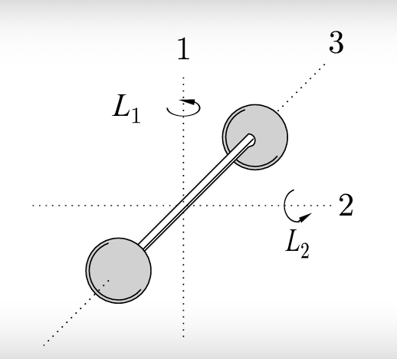
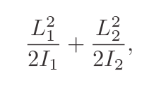
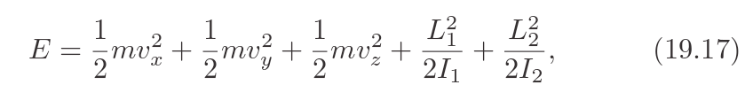
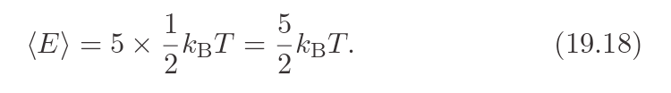
Rotational motion in a diatomic gas
In a diatomic gas, we also need to consider rotational kinetic energy. This adds two terms to the energy:
Where L₁ and L₂ are the angular momenta along the two principal directions and I₁ and I₂ are the corresponding moments of inertia.
The total energy is then:
And all of these degrees of freedom (or modes) are independent of each other, so we can write down the mean energy as:

Slide 29
Problem 4
If we know that for a certain gas 2/5 of the total kinetic energy of the molecules is rotational and 3/5 is due to the motion of their centres of mass,
a. Calculate the average kinetic energy due to the motion of the centre of mass of one of these molecules at 300 K.
b. If the temperature is to be increased by 20 ^{о}C, how much energy must be supplied to a mole of the gas to produce this temperature rise at constant pressure?

