Slide 1
THERMAL PHYSICS:
Temperature and Heat
Prof. Charlene Lobo
Resources:
Halliday, Resnick and Walker, “Fundamentals of Physics – 10th edition” Wiley. This is your assigned text.
Available free at the library.
https://ebookcentral.proquest.com/lib/uts/detail.action?docID=3059079&pq-origsite=primoLinks to an external site.

Slide 2
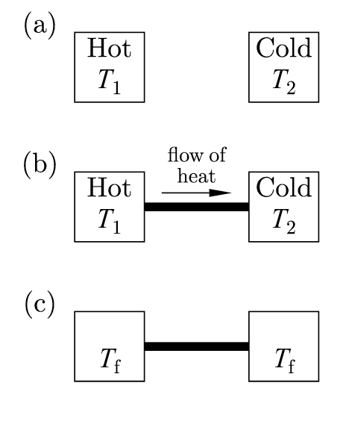
What is temperature?
Temperature is a measure of relative hotness or coldness of an object (a).
(b) Heat is a form of energy. When two objects are placed in contact, heat flows from the higher temperature object (T1) to the lower temperature object (T2). This process is called thermalization.
(c) After a long time, there will be no more heat flow between the two objects. The objects are said to be in thermal equilibrium and have the same temperature T_{f}.
Zero^{th} law of thermodynamics: Two objects, each separately in equilibrium with a third, are in equilibrium with each other.

Slide 3
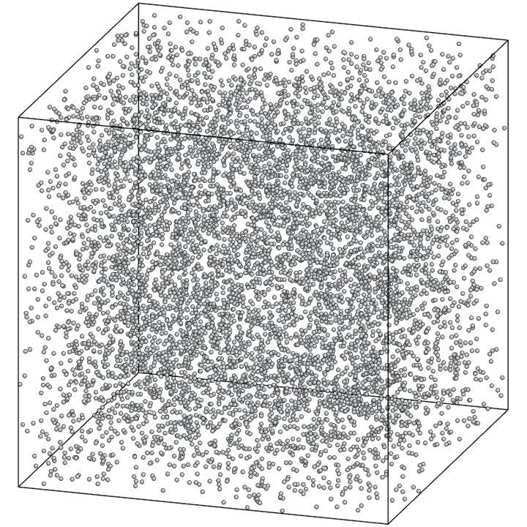
Temperature and Thermal Equilibrium
Many measurable properties of matter depend on temperature:
* length of a metal rod
* steam pressure in a boiler
* ability of a wire to conduct electricity
* colour of a very hot object.
Temperature is related to the kinetic energy of the molecules of a material.
The faster molecules move, the higher the temperature.
Notes:
Run Boltzmann gas simulation in Mathematica

Slide 4
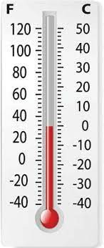
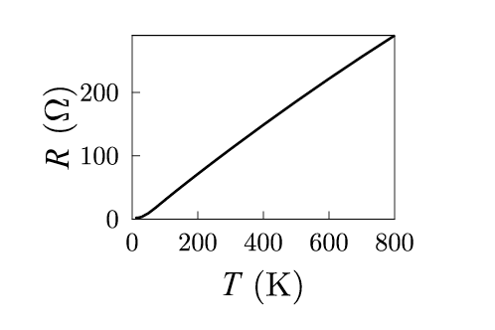
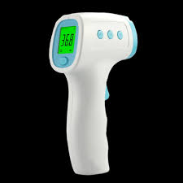
Measurement of Temperature-Thermometers
The Zeroth law justifies how we measure temperature. In this case, the second object is a thermometer: an object with a measureable temperature-dependent physical property.
Examples of commonly used thermometers include:
Liquid thermometers (eg. Alcohol and Mercury), which expand with increasing temperature
Resistance thermometers (eg platinum, carbon), in which the electrical resistance has a well-defined temperature dependence
Cryogenic thermometers, in which vapour pressure depends on temperature (eg. Liquid He).
Infrared thermometers, in which the infrared radiation emitted by an object is measured and converted to a temperature reading.

Slide 5
Liquid Thermometer
How does it work?
Contact between
thermometer and liquid
TRANSFER of heat
- Liquid expands
Liquid stops expanding when no more heat is transferred
– ie. system has reached thermal equilibrium.
http://openclipart.org/detail/48595/rat-in-coffee-by-redccshirt

Slide 6
Gas Thermometers and the Kelvin Scale
The pressure of a gas at constant volume increases with temperature.
By measuring the pressure at two known temperatures e.g. the freezing (0°C) and boiling (100°C) points, a graph of p vs T can be made. Extrapolating to zero pressure gives the hypothetical temperature -273.15 °C.
This is defined as absolute zero on the Kelvin temperature scale (K).

Slide 7
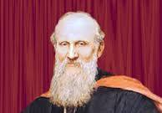
Kelvin Temperature Scale
Named for British physicist William Thomson (Lord Kelvin, 1824 – 1907)
0 K = -273.15 °C
T_{K} = T_{C} + 273.15
Δ K of 1 K is the same size as Δ °C of 1 °C
The Kelvin scale is called an absolute temperature scale and its zero point is called absolute zero.
Absolute zero is the point at which atomic motion is minimized (atoms have their minimum kinetic energy- this is not zero!).

Slide 8
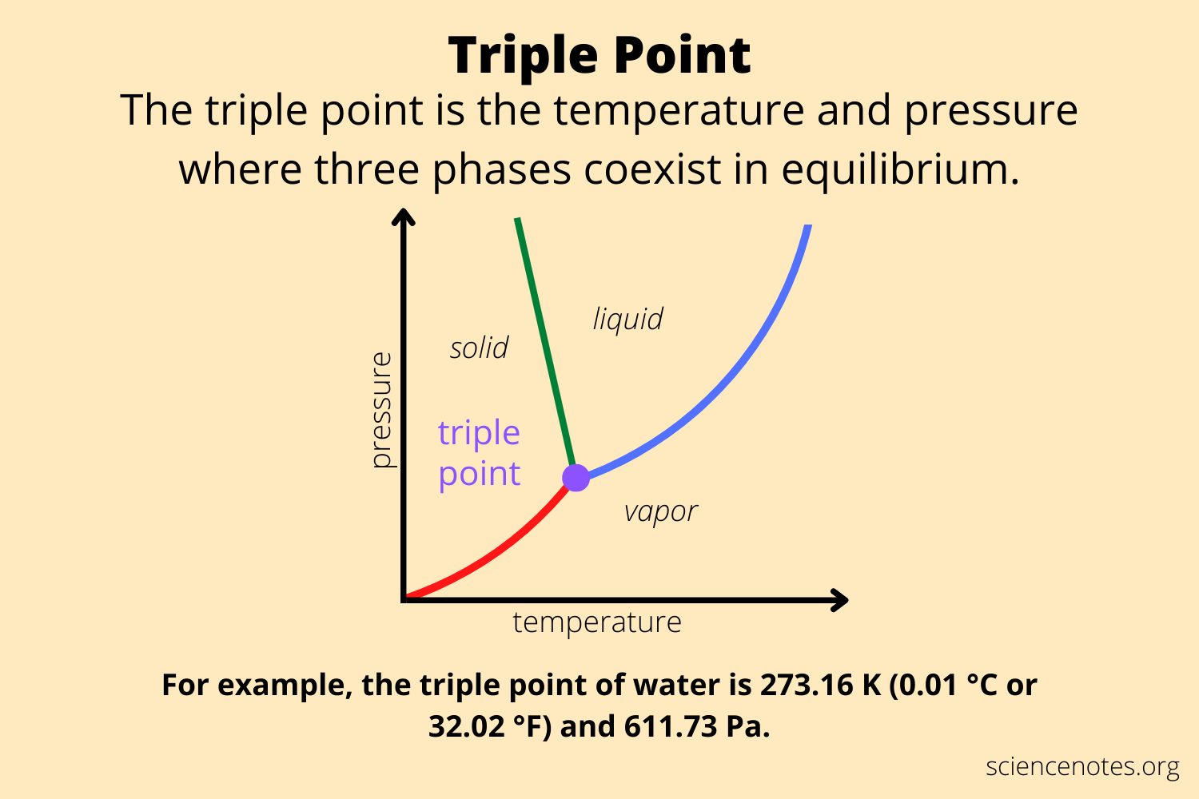
The Kelvin Scale and Absolute Temperature
Taking the ratio of two temperatures (in K) and pressures of a gas thermometer:
so:
At the triple point of water, we only need one point
for both our temperature and pressure reference.
Triple point of water:
P_{triple}=610 Pa and T_{triple}=273.16 K
(ice, liquid, gas in equilibrium).

Slide 9
Thermal Expansion
  Picture the interatomic forces in a solid as springs.
  Each atom vibrates about its equilibrium position.
  An increase in temperature results in an increase in energy and amplitude of vibration.
  The ‘interatomic spring forces’ are not symmetrical about the equilibrium position –they behave as springs
  as vibration amplitude increases the average interatomic distance increases.

Slide 10
Linear Expansion
Imagine a rod of length of L_{o}, at some initial temperature T_{o}. When the temperature changes by ΔT, the length changes by ΔL. ΔL is proportional to ΔT.
ΔL = L_{o} α ΔT
L= L_{o} +ΔL= L_{o} (1+α ΔT)
α is the coefficient of linear expansion (K⁻¹ or (C°)⁻¹)
α Is the coefficient of linear thermal expansion, L is the final length.

Slide 11
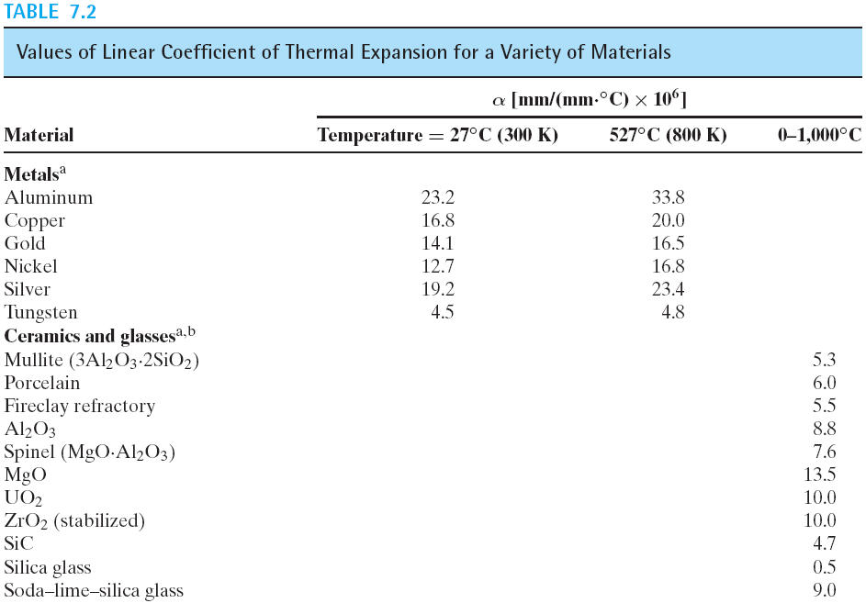
!

Slide 12
Area Expansion
With a temperature change ΔT
ΔA = A_{o} 2α ΔT and A = A_{o} (1 + 2α ΔT)
Volume Expansion
With a temperature change ΔT
  ΔV = V_{o} 3α ΔT and V = V_{o} (1 + 3α ΔT)
Let 3α =β then
ΔV = V_{o} β ΔT and V = V_{o} (1 + β ΔT)
where β is the volume expansion coefficient.

Slide 13
Coefficients of Volume Expansion
Material β (K⁻¹ or (C°)⁻¹)
Aluminum 7.2 × 10⁻⁵
Brass 6.0 × 10⁻⁵
Copper 5.1 × 10⁻⁵
Glass 1.2 – 2.7 × 10⁻⁵
Invar (Ni-Fe alloy) 0.27 × 10⁻⁵
Fused Quartz 0.12 × 10⁻⁵
Steel 3.6 × 10⁻⁵
Liquids
Ethanol 75 × 10⁻⁵
Carbondisulfide 115 × 10⁻⁵
Glycerin 49 × 10⁻⁵
Mercury 18 × 10⁻⁵

Slide 14
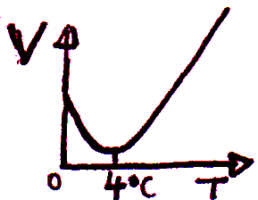
Thermal Expansion of Water
From 0 °C to 4 °C, water decreases in volume with increasing temperature.
Above 4 °C, water expands when heated.
Density of water is thus greatest at 4 °C.
Water expands when it freezes.
Lakes cool from the surface down, at > 4 °C, cooled water flows to the bottom (greatest density).
At < 4 °C, water at the surface is less dense, as it freezes, becomes ice, it floats.
Water at the bottom stays at 4 °C leading to the continuation of plant and animal life.

Slide 15
Problem 1-thermal expansion.
A glass flask of volume 150 cm³ is filled with ethanol (β = 75 × 10⁻⁵ K⁻¹) at 20 °C. How much ethanol overflows when the system temperature is raised to 75 °C?
Notes:
Guide the students through solving this problem (use zoom whiteboard).

Slide 16
Heat
Energy transfer solely because of temperature difference is called heat flow or heat transfer.
Energy transferred like this is called heat.
Symbol for heat is Q and has units Joule (J).
http://openclipart.org/detail/3688/cup-of-coffee-by-tomas_arad
http://openclipart.org/detail/159673/rat�n--mouse-by-maw

Slide 17
Heat Transfer
The same change in temperature of a system may be achieved by:
Doing (mechanical) work on it (b) Direct heating

Slide 18
Specific Heat (little ‘c’)
The quantity of heat, Q, required to raise the temperature of a mass, m, of a particular material from T₁ to T₂ is proportional to ΔT=T₂-T₁.
c is the specific heat of the material being heated. For an infinitesimal temperature change, dT:
c has units J.kg⁻¹.K⁻¹ or J.kg⁻¹.(C°)⁻¹

Slide 19
Problem 2- specific heat and heat transfer.
During a case of the flu, an 80 kg person has a fever of 39.0 °C compared to the normal body temperature of 37.0 °C. Assuming the body is mostly water, how much heat is required to raise the person’s temperature to 39.0 °C?
Note that the specific heat of pure water is ~ 4190 J.kg⁻¹.K⁻¹

Slide 20
Problem 3-specific heat and heat transfer.
An electric element is made of 23 mg of silicon. The element is heated with a power of 7.4 mW. At what rate does the temperature of the silicon increase? (c_{Si} = 705 J.kg⁻¹.K⁻¹)
Notes:
10 min break after this problem.

Slide 21
Molar specific heat (big ‘C’)
The total mass, m, of material is equal to the molar mass (M) multiplied by the number of moles (n):
m = n M
So Q = m c ΔT = n M c ΔT
= n C ΔT
C=M.c is the molar heat capacity or molar specific heat with units J.mol⁻¹.K⁻¹.
Q = n C ΔT

Slide 22
Molar specific heat (big ‘C’)
Substance c(J.kg⁻¹.K⁻¹) C (J.mol⁻¹.K⁻¹)
Aluminum 910 24.6 *
Beryllium 1970 17.7
Copper 390 24.8 *
Ethanol 2428 111.9
Ethylene glycol 2328 148.0
Ice (near 0 °C) 2100 37.8
Iron 470 26.3 *
Lead 130 26.9 *
Marble (CaCO₃) 879 87.9
Mercury 138 27.7 *
Salt (NaCl) 879 51.4
Silver 234 25.3 *
Water (H₂O liquid) 4190 75.4
Solid elements C~25 J.mol⁻¹.K⁻¹
~ same amount of heat to raise by same temperature amount.

Slide 23
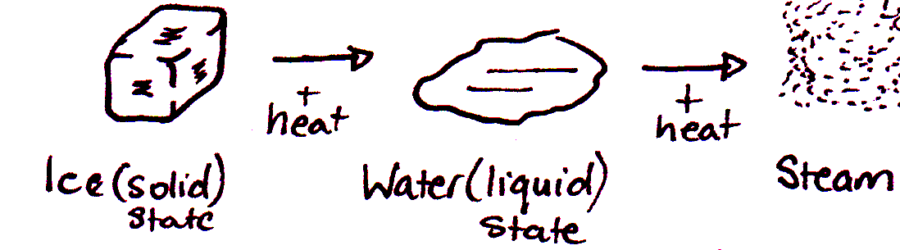
Calorimetry and Phase Changes
Calorimetry: the process of measuring amount of heat released or absorbed during a chemical reaction or phase change
Phase Change/Transition: transition from one phase to another.
For any given pressure, a phase change takes place at a definite temperature with accompanying change in volume and density.

Slide 24
Heat of Fusion (L_{f}, unit J.kg⁻¹)
To melt a mass m with a heat of fusion, L_{f}, at its melting temperature (e.g. 0 °C for ice) requires a quantity of heat, Q, given by:
Q = m L_{f} (heat enters)
The process is reversible, i.e. we can freeze (solidify) a mass m at its melting temperature by removing a quantity of heat, Q, given by:
Q = -m L_{f} (heat exits)
N.B. At the melting temperature the liquid and solid phase can coexist. This is called phase equilibrium.

Slide 25
Heat of Vaporization (L_{V}, unit J.kg⁻¹)
For boiling or evaporation the phase transition is between liquid and gaseous phases. Heat required to change at transition temperature is:
Q =± m L_{V}
+ liquid to gas - gas to liquid
N.B. Heat of vaporization and boiling point are both dependent on pressure.
At lower pressure, boiling temperature is lower and L_{v} is greater.

Slide 26
Changes of state of water
Other materials will follow a similar pattern at a fixed pressure

Slide 27
Changes of state: terminology
Sublimation: when a substance changes directly from solid to gaseous phase. e.g. dry ice (solid CO₂) to CO₂ gas as liquid CO₂ cannot exist at pressures less than 5 × 10⁵ Pa
Heat of Sublimation, L_{s} : heat require to convert a mass, m, of a substance directly to gas.
Heat of Combustion, L_{c} : amount of heat released per mass m of a substance.
Supercooling : cooled below freezing temperature without freezing
Superheated : heated above boiling temperature without boiling.

Slide 28
Problem 4-Calorimetry.
For two bodies isolated from the environment, the amount of heat lost by one body must equal the amount of heat gained by the other.
What is the equilibrium temperature of an aluminium cup (m_{Al} = 0.100 kg, c_{Al} = 910 J kg⁻¹ K⁻¹) initially at 20 °C, to which is added 250 mL of coffee (c_{coffee} = 4190 J kg⁻¹ K⁻¹) at 95 °C?

Slide 29
Mechanisms of Heat Transfer
The three mechanisms of heat transfer are:
Conduction: occurs between two bodies in physical contact
Radiation: heat transfer by electromagnetic radiation e.g. sunshine – needs no matter to be present.
Convection: heat flow driven by temperature differences across a fluid (eg. the atmosphere).
*Convection effects are generally much smaller than radiation and conduction, and it’s much harder to model. Primarily important in atmospheric and climate physics.

Slide 30
Conduction
Heat is transferred from a hot object to a cold object by conduction through the material.
Atoms in hotter regions have more kinetic energy, they jostle their neighbours which jostle theirs etc transferring the energy.
Metals also use free electrons therefore efficient conductors.
Heat current (H) =

Slide 31
Conduction
(units W or J/s)
k is the thermal conductivity of the material
is the temperature difference per unit length called the temperature gradient.
k is dependent on the material and has
units Wm⁻¹K⁻¹
The thermal conductivity of ‘dead’ air (non-moving air) is very small which is why jumpers keep you warm. The fine weave traps air which acts as an insulator.
Notes:
Check sign of equation- should be negative?

Slide 32
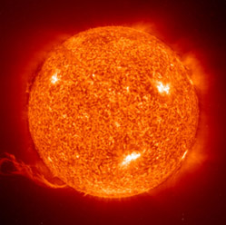
Radiation
Heat is transferred by electromagnetic waves from a radiating object such as the sun.
Occurs even through vacuum.
Every body emits radiation.
At 20 °C, all energy is carried by infrared wavelengths.
At 800 °C, ‘red hot’ self-luminous, still mostly infrared radiation.
At 3000 °C, ‘white hot’, visible light – incandescent bulb.
H α A and H α T⁴ where T is in Kelvin
Depends on nature of surface, a quantity called emissivity, e.

Slide 33
Radiation
A= radiating area in m²
is the Stefan-Boltzmann constant
  σ = 5.670400 × 10⁻⁸ Wm⁻²K⁻⁴
  e is the emissivity, which is unitless.
  e is often larger for dark surfaces:
  e for smooth copper ~ 0.3
  e for dull black surface ~ 1
  e = 1 for a perfect radiator/absorber aka a Black Body

Slide 34
Radiation
Bodies both emit and absorb radiation to and from its surrounds. The net rate of radiation from a body with temperature T with surroundings at Temperature T_{S} is:
A positive H means that the heat is flowing out of the body.

Slide 35
Problem 5-Conduction
Given the diagram, determine T at the junction and H given
k_{Cu} = 385 Wm⁻¹K⁻¹,
k_{steel} = 50.2 Wm⁻¹K⁻¹.

Slide 36
Problem 6- Radiation
What is the net heat transfer of a sphere of tungsten (W) with a radius 2.00 cm, with temperature 1027 °C to the surrounds with temperature 27.0 °C? (e_{W}=0.350)

